Slide 1





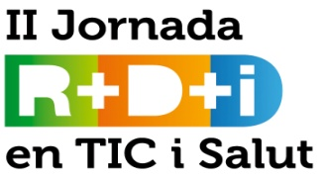
Automatic Techniques for Studying Attention-Deficit/Hyperactivity
Disorder
Laura Igual, Antonio Hernandez, Sergio Escalera,
Miguel Reyes, Josep Moya, Joan Carles Soliva, Jordi Faquet,
Oscar Vilarroya, Petia Radeva

Slide 2
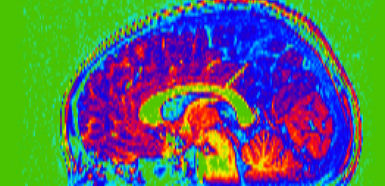
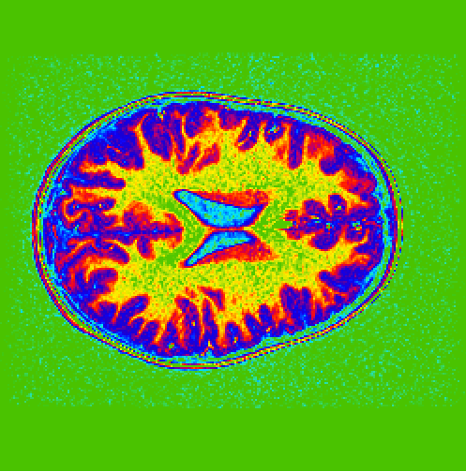
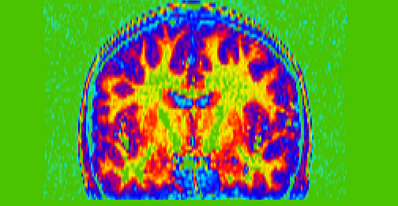
Context
Attention-deficit/hyperactivity disorder (ADHD) is among the most common childhood psychiatric disorders affecting around 8-12% of the worldwide population.
According to standard criteria (DSM-IV-TR and ICD-10 diagnostic criteria) ADHD is a neurodevelopmental disease characterized by:
  Inattention
  Hyperactivity
  Impulsivity
Currently, many research works are devoted to analyze brain alterations related with ADHD.
Structural neuroimaging studies identifies the brain circuits altered in ADHD.

Slide 3
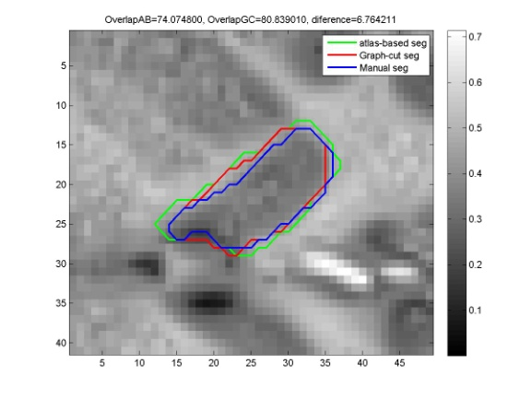
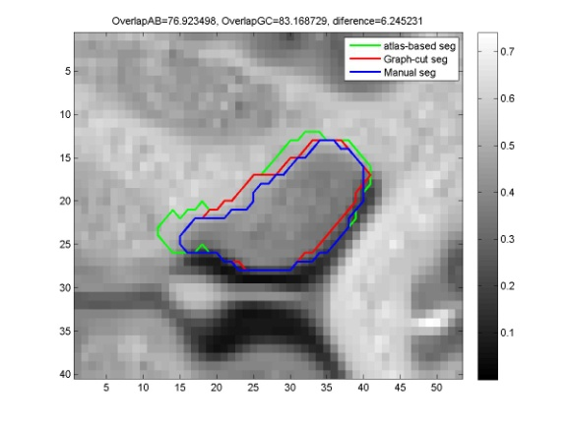
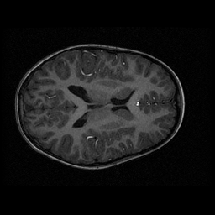
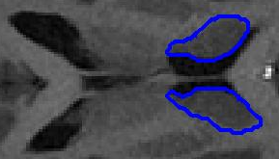
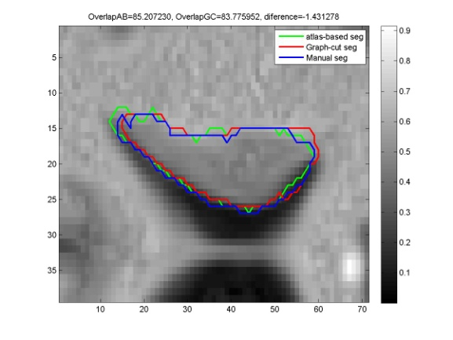
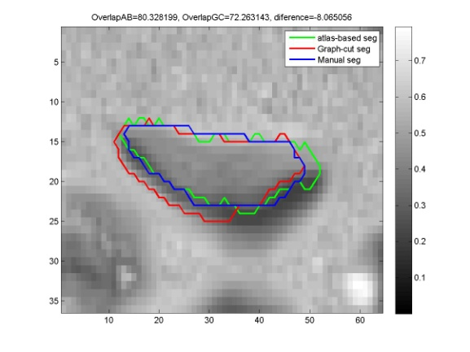
Automatic analysis of brain anatomical differences in ADHD children
The ADHD children presented significant volumetric differences in certain structure as the caudate nucleus.
Manual labeling of MRI slices are used, but reproducibility and feasibility of these studies can be questioned.
Aim: automatic techniques to accelerate and make the procedure clinically feasible.
Materials:
40 children/adolescents with ADHD (ages 6–18),
40 healthy control subjects matched on age, gender, and handedness.
Automatic segmentation of Caudate.
Automatic extraction of shape descriptors.
Several techniques comparison
Partners: Cognitive Neuroscience Group. Responsible: Oscar Vilarroya, director de la Unidad de Investigación en Neurociencia Cognitiva y director de la Cátedra “El cerebro social”.

Slide 4
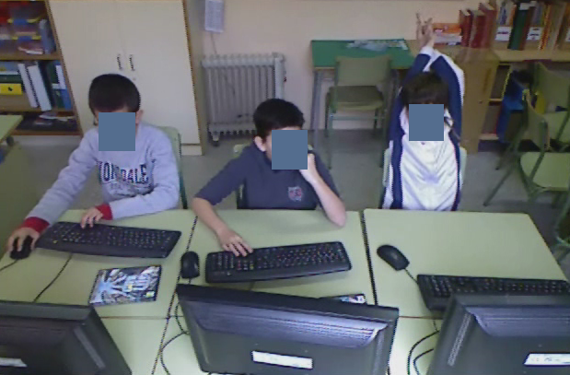
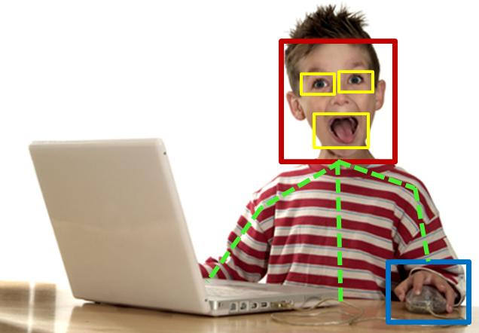
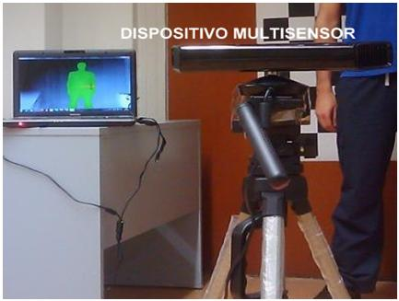
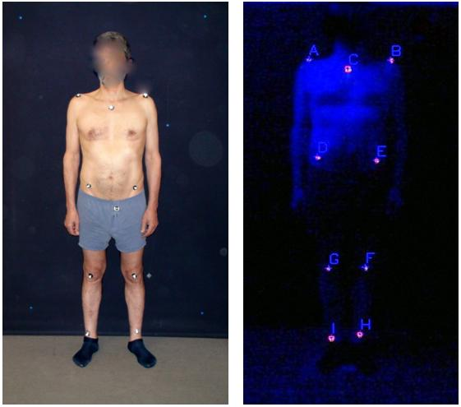
Automatic analysis of
behavior in ADHD children
Aim: Search for behavioral patterns related to ADHD
Automatically extract behavioral information using Computer Vision and Machine Learning techniques.
Materials: (5 hours recorded)
5 children/adolescents with ADHD
5 healthy control subjects
Automatic detection, tracking and analysis of landmarks
Cheap hardware → general corporal analysis
Partners: Parc Taulí, Centre de Salut Mental Infantil i Juvenil de Martorell. Responsible: Josep Moya, jefe del Observatori de salut mental de Catalunya.

Slide 5
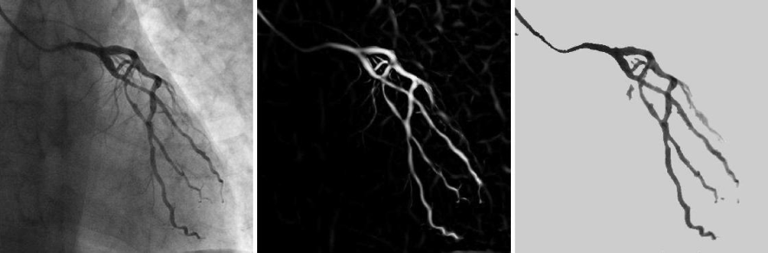
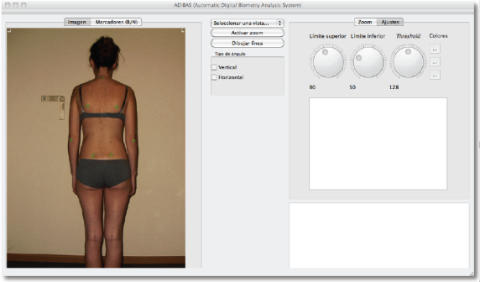
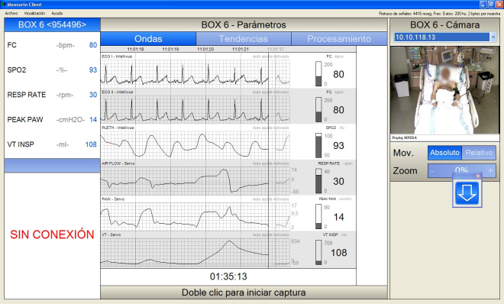
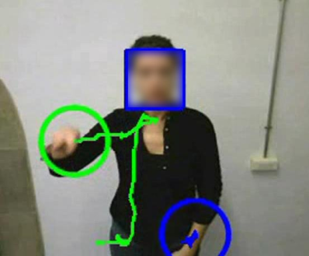



Future lines
Multi-modal analysis combining:
  Automatic anatomical analysis of MRI structures in combination with behavioral information
Generalization of the Segmentation and Behavioral analysis techniques for different health care applications:
Automatic angiography segmentation
Psysiotherapy, rehabilitation, and sports
Impatient monitoring
Sign language recognition

Slide 6
THANK YOU
ligual@cvc.uab.es

