Slide 1
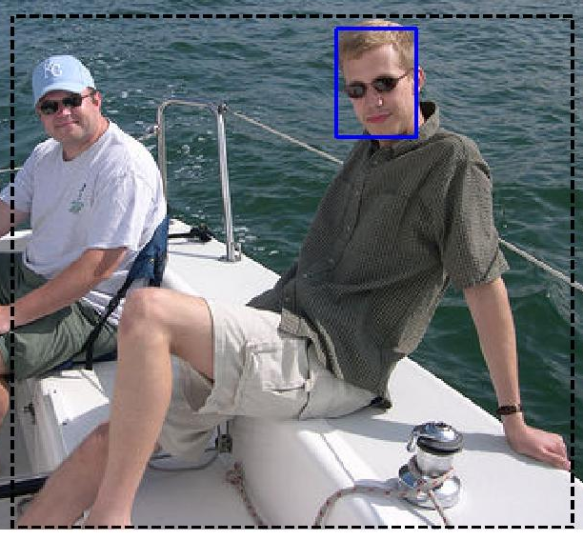
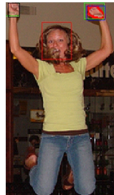
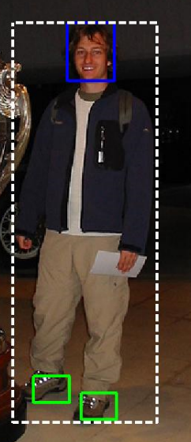
Combining detectors for human layout analysis.
M. Drozdzal, A. Hernández, S. Seguí, X. Baró, S. Escalera, A. Lapedriza, D. Masip, P. Radeva, J. Vitrià
Barcelona Perceptual Computing Lab
Universitat de Barcelona, Computer Vision Center, Universitat Oberta de Catalunya
Assumption: The head is visible and is the most reliable human part to detect. Head position is used as an anchor point for detecting other parts.
      HEAD Average Precision %: 74.4
      The head is detected by integrating evidences from several state-of-the-art part detectors: frontal and profile faces (OpenCV), person parts (Felzenszwalb et al), informative poselets (selected from the full set of Bourdev at al), and pictorial models (Ramanan et al.)
      Integration is based on weighted hierarchical clustering of head windows hypothesis.
      HANDS Average Precision %: 3.3
      A specific skin model is extracted from the detected face. This model is used to segment the image using Mean Shift. Resulting blobs are filtered using geometric constraints.
      FEET Average Precision %: 1.2
      We use a person detection system proposed by Felzenszwalb et al. We have selected two 2 full body models which include feet in their components. For each model we choose the component related to the leg position. Inside the leg box the foot box position is learned by cross-validation.

