Slide 1











Slide 2
INDEX
THE PROBLEM & THE IMPACT TO SOCIETY
THE NEED AND SOLUTION
THE COMPETITORS AND THE CARE RESPITE ADDED VALUE
THE CUSTOMERS & THE USERS
MARKET SEGMENTATION
BUSINESS MODEL
KEY FINANCIAL INDICATORS
FINANCIAL NEEDS
CARE RESPITE: THE WHOLE PICTURE

Slide 3
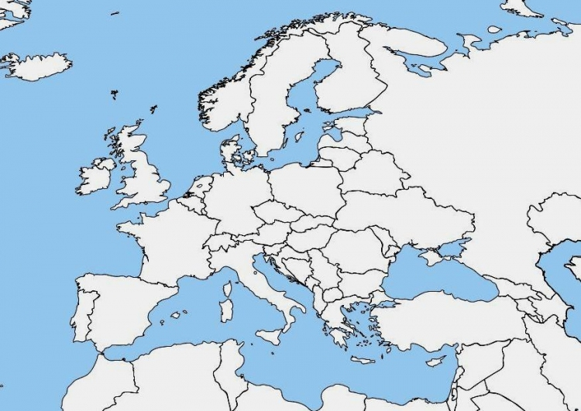
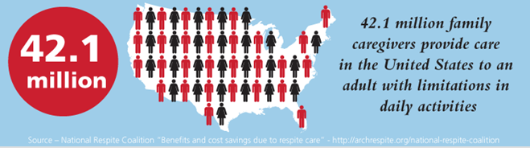
THE PROBLEM & IMPACT TO SOCIETY
The increasing need of long term care due to the growth of the oldest people
6,3% by 2025 and 11,4% by 2025
EUROPE
USA
Persons in need of care
31 M (2005) → 36,7 M (2050)
Consequence
A gap between demand and supply
(each dependent person needs 1,25 carers, IMSERSO 2010)
Reduce the career activities that provides less value for the dependent people
More careers subjected to :
STRESS, ANXIETY, ANGUISH, DEPRESSIONS
Provide solutions to reduce burn out that causes to be a career

Slide 4



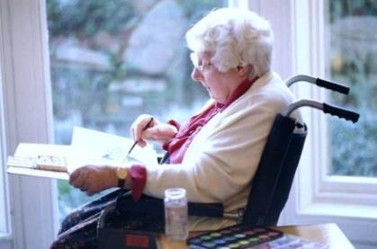


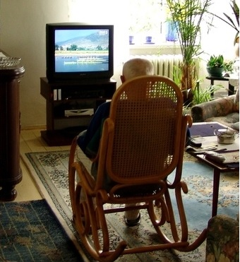
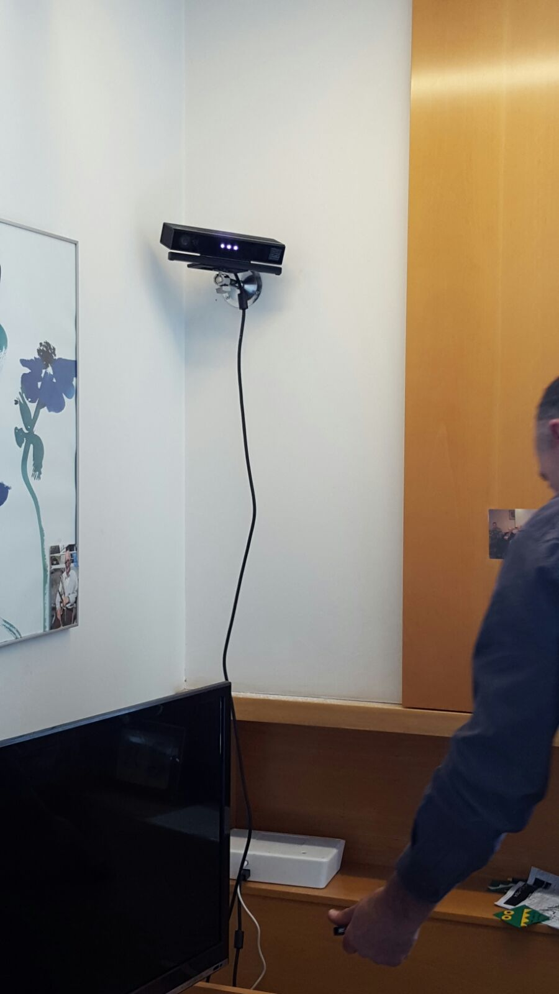

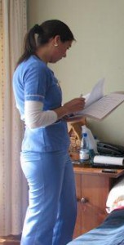




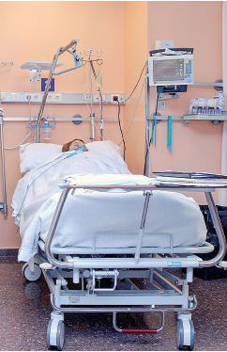
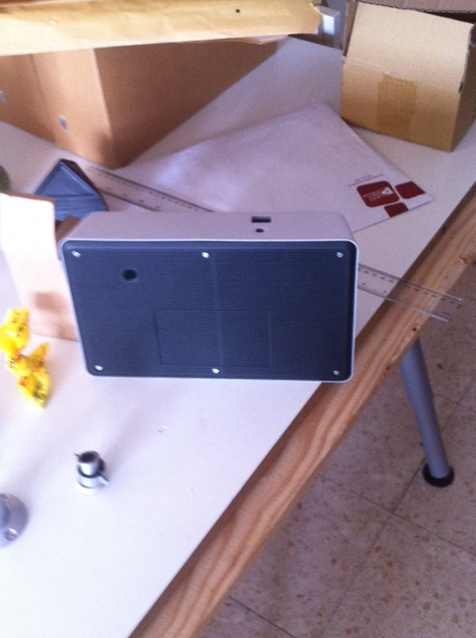
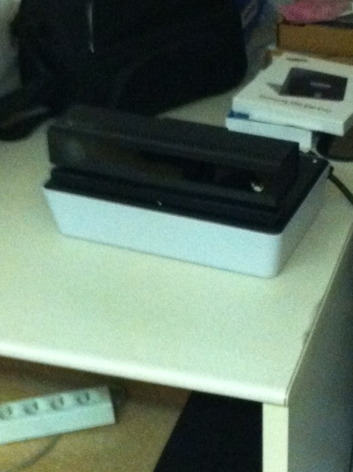
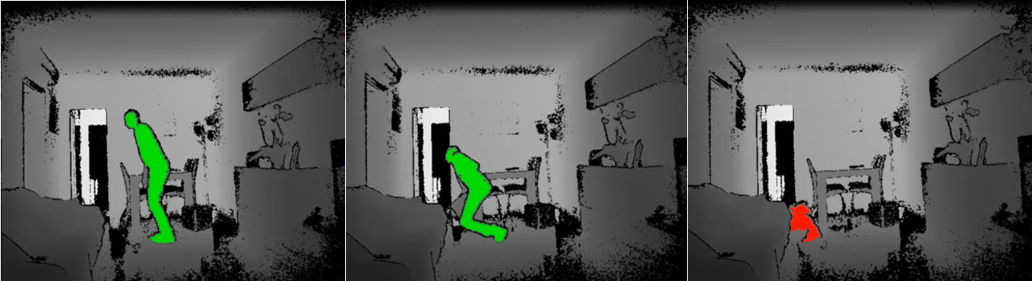
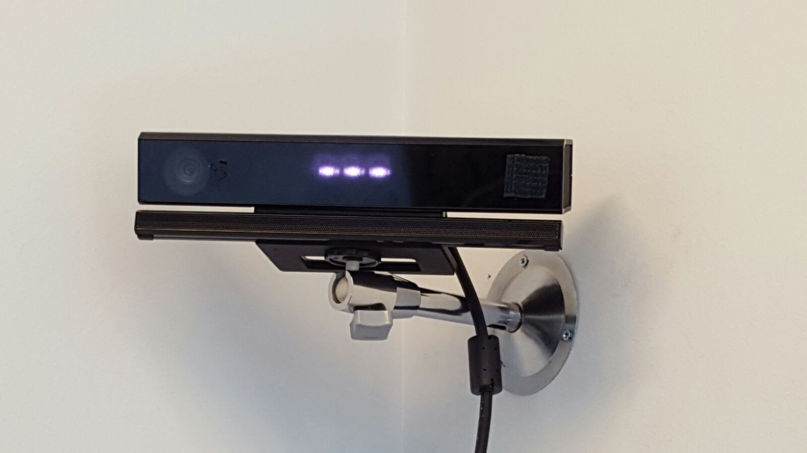
NEED & SOLUTION
Taking Time Off
GROWING DEMAND OF CARE
Increased pressure on carers
CARERS RESPITE
Adequate relief
Ambient monitoring and intelligent visual warning
Worldwide Innovate system: Groundbreaking computer vision and artificial intelligence advances
PRODUCT
VIDEO
Notes:
Why care respite? The aim is to give or facilitate respite to carers, reduce burnout. We all one day become a caregiver and we will all need to be cared for one day. There are today more than 20 M informal/fily caregivers in EU and more than 45 M caregovrrs in USA. This amount will increase at the same poportion life expectancy increases and due to ageing demographics . By challange in which technology will play sn important role..... blabla
DEMAND OF CARE: the overall increase in life expectancy and demographic ageing is generating a growing incidence of age-related diseases and demand for care.
PROBLEM TO BE SOLVED:
Carers should have the opportunity of taking time off. Therefore, adequate relief i.e. respite care arrangements, acceptable both to the carer and the cared for person, must be readily available and tailored to carers' needs.
Better quality of life of the CAREGIVERS ….Improve carers conditions, avoiding carers burnout and social isolation
HOW: Taking CARE and giving support to CARERS to perform a better supervision reducing their stress, and improving the autonomy and wellness of both dependent person and its caregiver. BY BEEING CAREGIVERS NOT AS STRESSED WHILE LOOKING AFTER THE PERSON WITH NEED OF CARE
CARE RESPITE will give support to CARERS by enabling free periods of time off to do other activities while continue keeping an eye on to the person they are looking after.
This increase in demand for long-term care by older people is a challenge for the Member States. On the one hand, the formal care system will not have enough economic and human resources to deal with this increase. We know that public expenditure on long-term care in the EU27 could almost double over the period 2010–60: +1.7 percentage point of GDP increase (ECFIN, 2012).
On the other hand, informal care will be also a limited resource for care in the future. Current demographic change projects a decrease in the availability of informal carers and a gap between demand and supply in informal care (Robine et al., 2007; Karlsson et al., 2004; Pickard, 2008; Pickard et al., 2009).

Slide 5
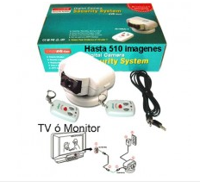
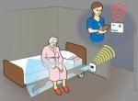
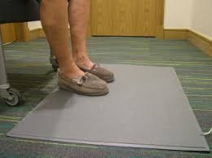
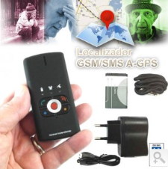
THE COMPETITORS & THE ADDED VALUE
Camera
Fix sensors
Mobile sensors
CARE RESPITE TECHNOLOGICAL SYSTEM
C
FS
MS
CR
Intelligence
Privacy & Intimacy
Scalability
CR
MS
CR
CR
Stress
Anxiety
Burn out
FS
MS
FS
C
C
MS
C
FS
Visual
Verification
Visual
Verification
Non
invasive
ATOMISED & HETEROGENOUS MARKET
Small companies: Sensovida, Domo– Alert, Tecmova, Healthsense, Mylively, Keepclosecontact, etc.
Big companies: Telefonica Healthcare, GE Healthcare, Philips

Slide 6
THE CUSTOMERS & THE USERS
2016: SMART CARE PRO TO RETIRMENT HOMES
2017: SMART CARE HOME TO NON PROFESSIONAL CARERS

Slide 7
MARKET SEGMENTATION
SMART CARE PRO – RETIRMENT HOMES – PROFESIONAL CARERS
SMART CARE HOME – HOME – NON PROFESSIONAL CARERS
Region | RETIRMENT HOMES (centers) | NUMBER OF USERS | ESTIMATED % OF POTENTIAL USERS | POTENTIAL MARKET (number of devices sold)
Catalonia | 1.017 | 58.919 | 6 % | 3.535
Spain | 5.390 | 351.548 | 6 % | 21.093
Europe | ND | 2.900.000 | 6 % | 174.000
TOTAL |  |  |  | 198.628
Region | DEPENDENT PEOPLE AGED > 65 | RECEIVING INFORMAL CARE OR ANY CARE
Spain | 2.375.000 | 70 % | 1.662.500
Europe | 20.700.000 | 60% | 12.420.000
TOTAL |  |  | 14.082.500

Slide 8
BUSINESS MODEL
SMART CARE PRO – RETIREMENT HOMES – PRFESSIONAL CARER
Fix payment per Device Price: 3.200 € / Average Price: 3.000 €
Gross Margin: ~ 1.200 € / unit
Other potential incomes / revenues
  (€/month): x app downloaded licenses
  (€/month): x number of mobiles / users connected to each device; and or (SIII)
  (€/h): software update (87 e / year) to each device
  (€/h): technical adjustments (consultancy)
Retirement homes market: sales expected, market share, and revenues
  Catalonia: 3.535 units / Spain: 21.093 units / Europe: 174.000 units
 | 2016 |  | 2017 |  | 2018 |  | 2019 |  | 2020
Sales | 20 | - % | 200 | 1% | 900 | 4% | 2.400 | 11% | 5.000 | 24%
Revenues | 60.000€ |  | 0,6 M€ |  | 2,7 M€ |  | 7,2 M€ |  | 15 M€

Slide 9
KEY FINANCIAL INDICATORS
Notes:
Describe the asset, its origin, level of development, protection of the asset...
CARE RESPITE is an ambient intelligent device and a remote receiver that captures audio, RGB, and depth maps (thanks to infrared structured light technology).
The CARE RESPITE sensor is able to capture the information to be processed by a new generation of Computer Vision and Machine Learning software, able to recognize the events present in the environment.
Its main CHARACTERISTICS are: Ambient intelligent device, VISUAL checking in real time, Day and Night events recognition (RGB + Depth, data protection), NON invasive, SCALABLE, NON invasive, Two-way voice communication, Plug & play, Not require fixed installation
ORIGIN: joining technology developers with socials scientists and end users through metadesign sessions organized by the UAB Parc de Reçerca in 2013 under the topic of “the ageing population”.
LEVEL OF DEVELOPMENT: Ending product development to start validation tests.
PROTECTION OF THE ASSET:
European patent. Applied (EP14382294.8). Patent Assignee: Universitat de Barcelona, Fundació Universitat Oberta de Catalunya, Acceplan Accesibilidad S.L. & Universitat Autònoma de Barcelona.
PCT. Pending. July 2015 and “Care Respite” brand internationally registered

Slide 10
FINANCIAL NEEDS
2016
2017
Revenues
60.000 €
(20 units sold)
MAIN
GOALS
Revenues
600.000 €
(200 units sold)
150.000 €
FINANCIAL NEEDS
420.000 €
50.000 € – 100.000 €
Private investment expected
200.000 € – 350.000 €
Expenses | 2016 |  | 2017
Technologies developments | 34.000 € | 23% | 85.000 € | 20%
Manufacturing & Engineering | 72.000 € | 48% | 63.000 € | 15%
MKT | 10.000 € | 4% | 30.000 € | 7%
Admin – Fin - Legal | 15.000 € | 10% | 32.000 € | 8%
Employees | 22.500 € | 15% | 210.000 € | 50%
TOTAL | 150.000 € | 100% | 420.000 € | 100%
Notes:
Describe the asset, its origin, level of development, protection of the asset...
CARE RESPITE is an ambient intelligent device and a remote receiver that captures audio, RGB, and depth maps (thanks to infrared structured light technology).
The CARE RESPITE sensor is able to capture the information to be processed by a new generation of Computer Vision and Machine Learning software, able to recognize the events present in the environment.
Its main CHARACTERISTICS are: Ambient intelligent device, VISUAL checking in real time, Day and Night events recognition (RGB + Depth, data protection), NON invasive, SCALABLE, NON invasive, Two-way voice communication, Plug & play, Not require fixed installation
ORIGIN: joining technology developers with socials scientists and end users through metadesign sessions organized by the UAB Parc de Reçerca in 2013 under the topic of “the ageing population”.
LEVEL OF DEVELOPMENT: Ending product development to start validation tests.
PROTECTION OF THE ASSET:
European patent. Applied (EP14382294.8). Patent Assignee: Universitat de Barcelona, Fundació Universitat Oberta de Catalunya, Acceplan Accesibilidad S.L. & Universitat Autònoma de Barcelona.
PCT. Pending. July 2015 and “Care Respite” brand internationally registered

Slide 11
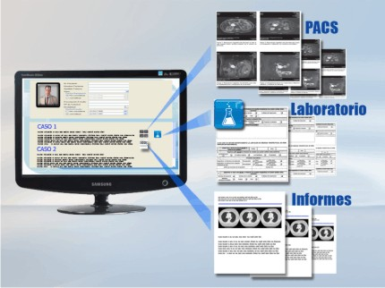



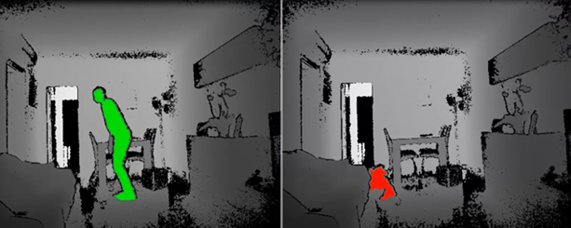
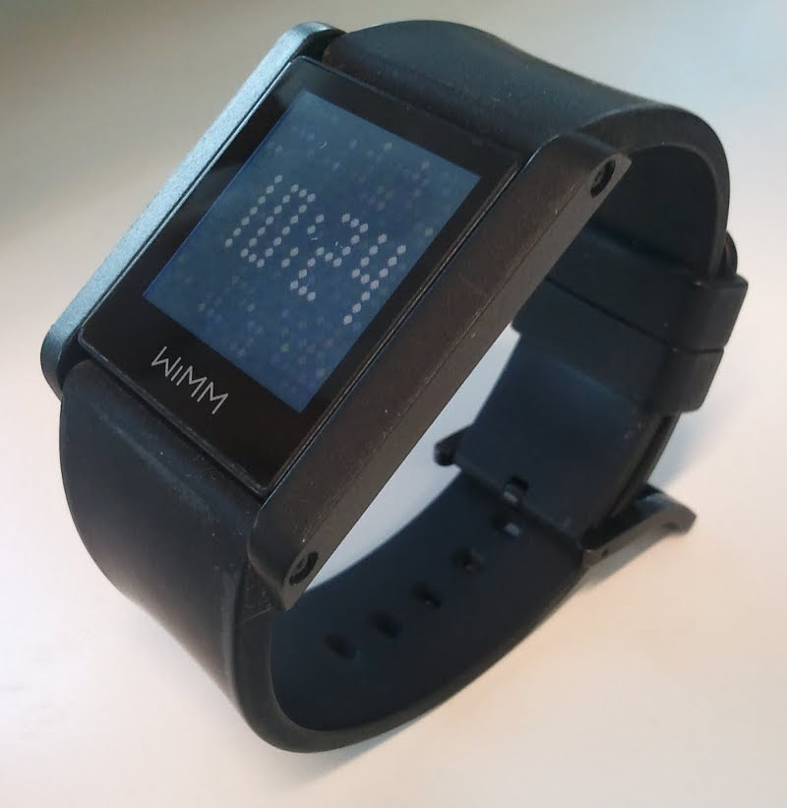
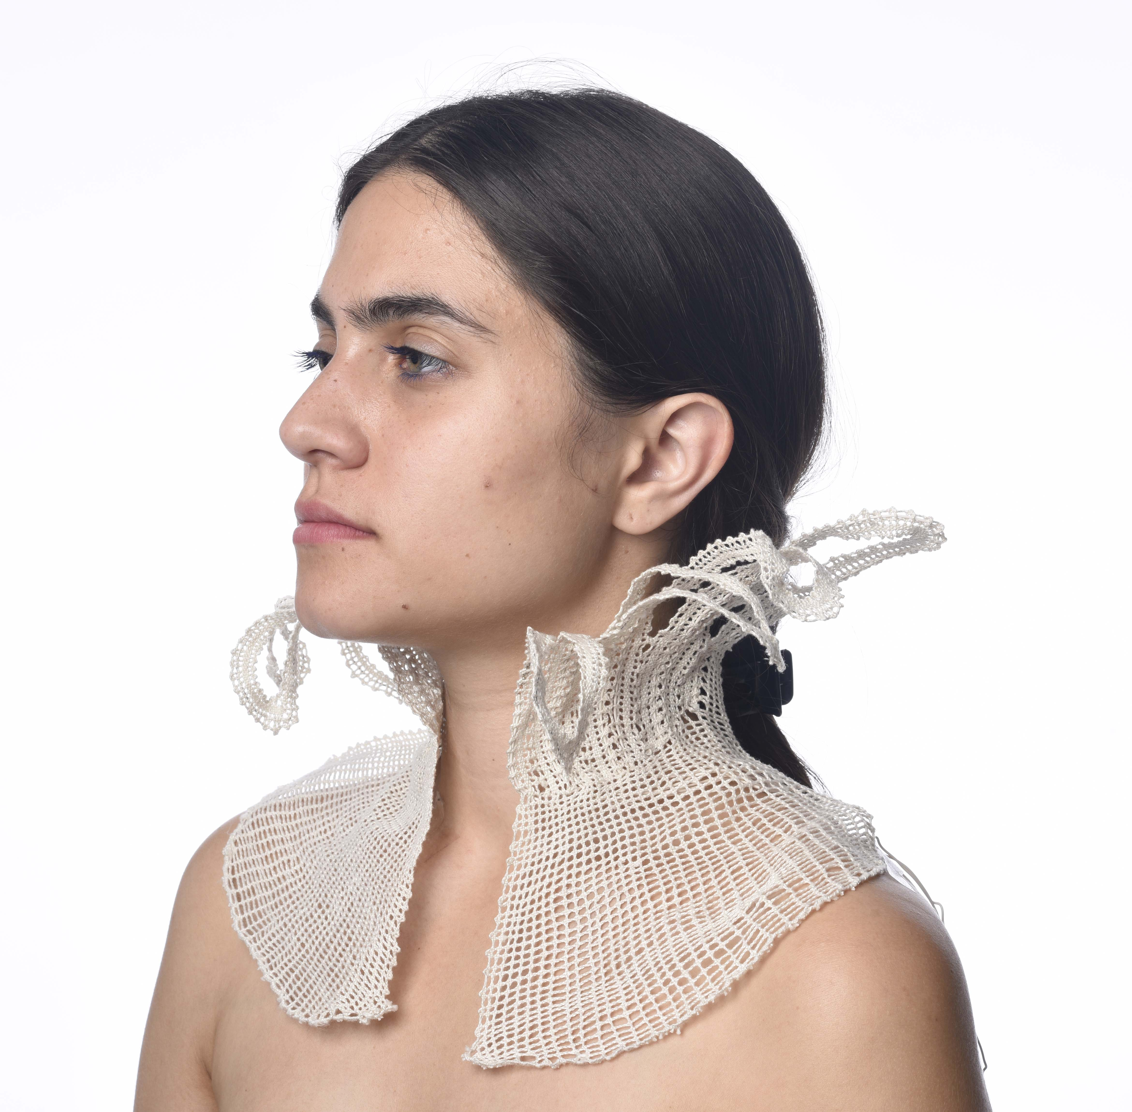
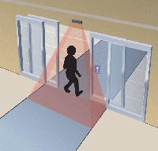
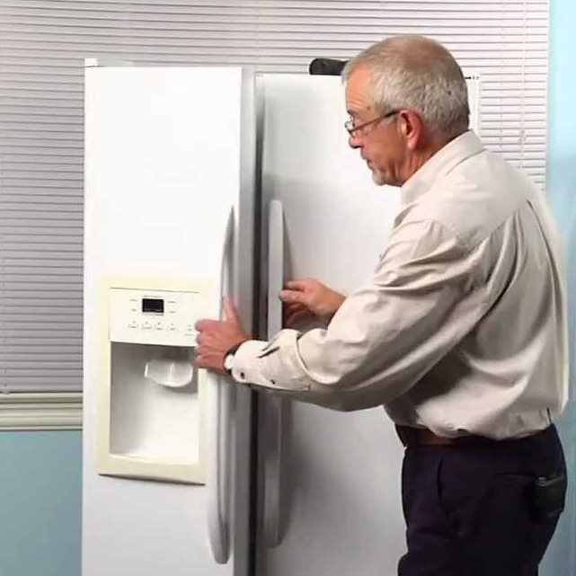
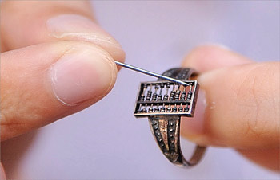
CARE RESPITE: THE WHOLE PICTURE
Distributed intelligence
Event detection/prediction
Recommendation module
Social networks
Electronic clinical history
Georeference
Computer Vision and Ambient intelligence
... …
Wearable and egocentric computing
Intelligent objects and sensors

Slide 12
THANK YOU
info@care-respite.com

