Slide 1



Human Behavior Analysis from Depth Maps
Dr. Sergio Escalera
Head of the Human Pose Recovery and Behavior Analysis Group (HuPBA) at the University of Barcelona
http://www.maia.ub.es/~sergio/

Slide 2

Outline
Human behavior analysis understanding
Understanding Human Pose Recovery (HPR): a taxonomy and state-of-the-art
HPR from depth maps: overview of state-of-the-art approaches
HuPBA methods and applications for HPR and HBA using depth maps
Conslusion

Slide 3
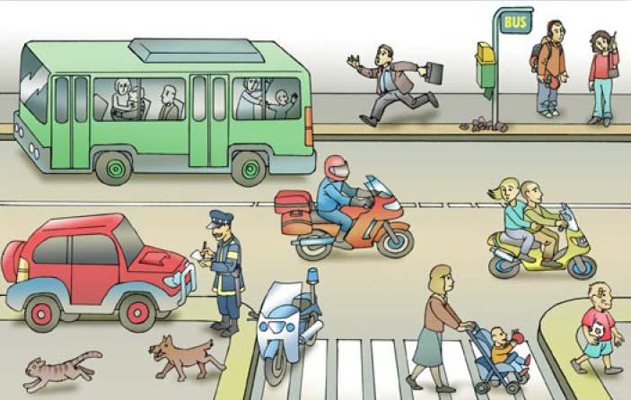
Human behavior analysis understanding

Slide 4
Human behavior analysis understanding
Gesture/Activity recognition
Human Pose Recovery
Image features
Human Behavior Analysis
Semantic information about human actions
“observable activity in a human or animal. “
Particular movements for a particular period of time with a particular goal
“Gesture: a movement or position of the hand, arm, body, head, or face that is expressive of an idea, opinion, emotion, etc.”
“Activity: a specific deed, action, function, or sphere of action.”
Description of human body configurations, usually defined as a configuration of human limbs in a particular instant of time (still images)
Description of human body configurations, usually defined as a configuration of human limbs in a particular instant of time (still images)
Image evidences

Slide 5
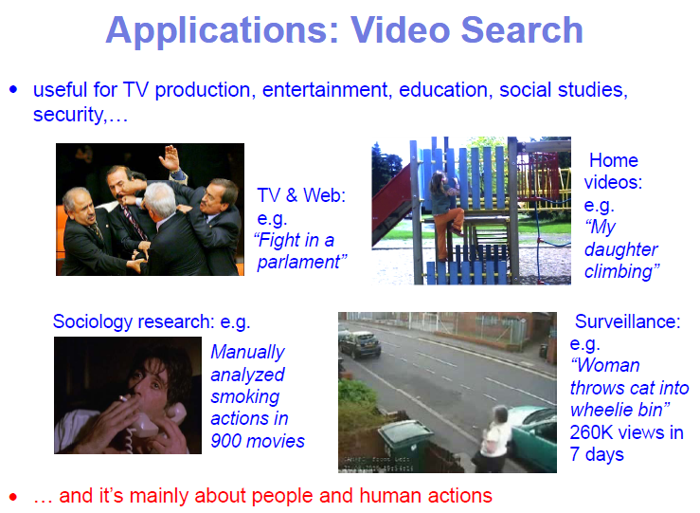
Human behavior analysis understanding

Slide 6
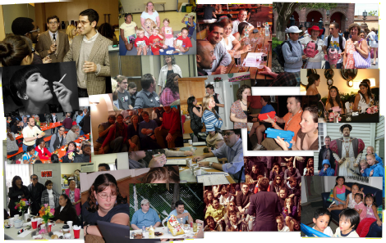
Human Pose Recovery: a taxonomy
X. Zhu, D. Ramanan. Face Detection, Pose Estimation, and Landmark Localization in the Wild, in: CVPR, 2012.

Slide 7
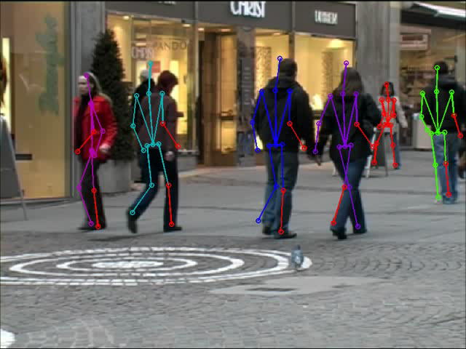
Human Pose Recovery: a taxonomy
M. Andriluka, S. Roth, B. Schiele, Monocular 3d pose estimation and tracking by detection, in: CVPR, 2010.

Slide 8
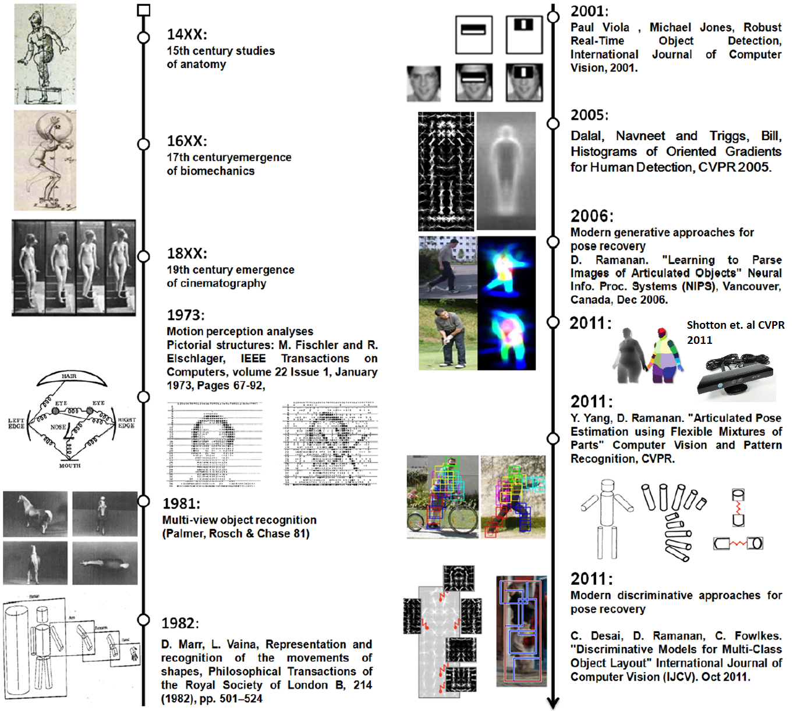
Human Pose Recovery: a taxonomy

Slide 9
Human Pose Recovery: a taxonomy
Appearance
Viewpoint
Spatial models
Temporal models
Behavior
Xavier Pérez-Sala, Sergio Escalera, and Cecilio Angulo, Survey on Spatio-Temporal View
Invariant Human Pose Recovery, CCIA 2012.

Slide 10


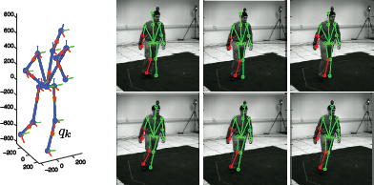
Human Pose Recovery: a taxonomy
Monocular 3d pose estimation and tracking by detection (Andriluka et al. 2010):
Appearance
Viewpoint
Spatial models
Temporal models
Behavior
“WALKING”

Slide 11
Human Pose Recovery: a taxonomy
Appearance
Viewpoint
Spatial models
Temporal models
Behavior
Global
Local
Pixel-based
Logical

Slide 12


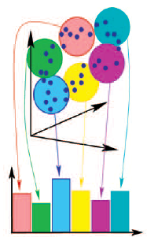
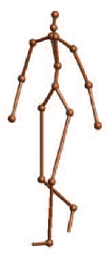
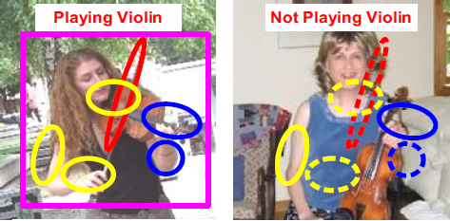
Human Pose Recovery: a taxonomy
Global appearance
Silhouettes and contours
Global discriminative classifiers
Global generative classifiers
Local appearance
Edges, color and texture
Motion
Depth
Templates
Pixel based
Logical
A. Agarwal, B. Triggs, Recovering 3d human pose from monocular images, PAMI, 2006.
Pirsiavash, D. Ramanan, Steerable part models, in: CVPR, 2012.
B. Yao, L. Fei-fei, L.: Grouplet: A structured image representation for recognizing human and object interactions, 2010.

Slide 13
Human Pose Recovery: a taxonomy
Appearance
Viewpoint
Spatial models
Temporal models
Behavior
Discrete
Continuous

Slide 14
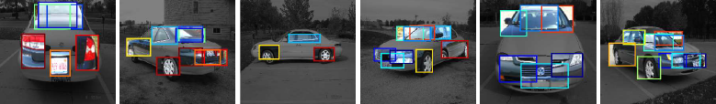
Human Pose Recovery: a taxonomy
Discrete
M. Sun, H. Su, S. Savarese, L. Fei-Fei, A multi-view probabilistic model for 3d object classes, in: CVPR, 2009.
M. Andriluka, S. Roth, B. Schiele, Monocular 3d pose estimation and tracking by detection, in: CVPR, 2010.

Slide 15
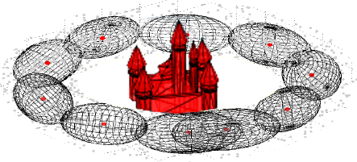
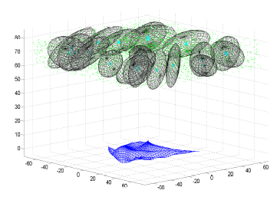
Human Pose Recovery: a taxonomy
Continuous
M. Andriluka, S. Roth, B. Schiele, Monocular 3d pose estimation and tracking by detection, in: CVPR, 2010.
F. Moreno-Noguer, V. Lepetit, P. Fua, Pose priors for simultaneously solving alignment and correspondence, in: ECCV, 2008.
J. Sanchez-Riera, J. Ostlund, P. Fua, F. Moreno-Noguer, Simultaneous pose, correspondence and non-rigid shape, in: CVPR, 2010,

Slide 16
Human Pose Recovery: a taxonomy
Appearance
Viewpoint
Spatial models
Temporal models
Behavior
Probabilistic assemblies
of parts
Kinematic models

Slide 17
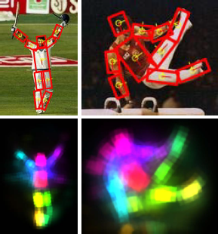
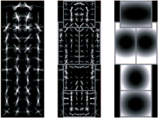
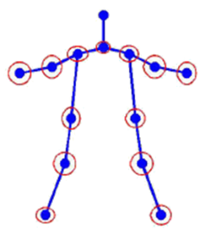
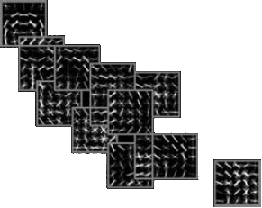
Human Pose Recovery: a taxonomy
Probabilistic assemblies of parts
Pictorial structures Grammars Graphs / Trees
M. Andriluka, S. Roth, B. Schiele, Pictorial structures revisited: People detection and articulated pose estimation, in: CVPR, 2009.
P. Felzenszwalb, R. Girshick, D. McAllester, D. Ramanan, Object detection with discriminatively trained part-based models, PAMI, 2010.
Y. Yang, D. Ramanan, Articulated pose estimation with exible mixtures-of-parts, in: CVPR, 2011.

Slide 18
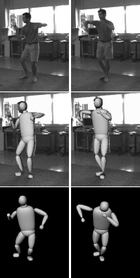
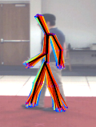
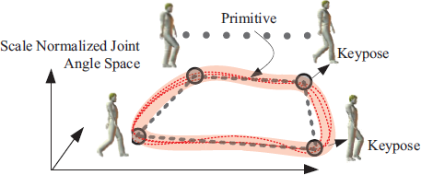
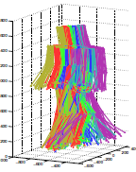
Human Pose Recovery: a taxonomy
Kinematic models
C. Sminchisescu, B. Triggs, Kinematic jump processes for monocular 3d human tracking, in: CVPR, 2003.
E. Simo-Serra, A. Ramisa, G. Alenyà, C. Torras, F. Moreno-Noguer, Single Image 3D Human Pose Estimation from Noisy Observations, in: CVPR: 2012.
V. Singh, R. Nevatia, Action recognition in cluttered dynamic scenes using pose-specic part models, in: ICCV, IEEE, 2011.

Slide 19
Human Pose Recovery: a taxonomy
Appearance
Viewpoint
Spatial models
Temporal models
Behavior
Tracking
Motion models

Slide 20
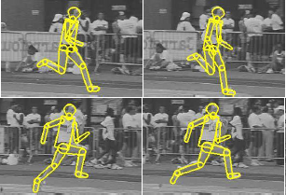
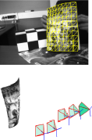
Human Pose Recovery: a taxonomy
Tracking
Single, 2D, whole body Multiple, 3D, whole body Multiple, 3D,
“body” parts
A. Agarwal, B. Triggs, Tracking articulated motion with piecewise learned dynamical models, in: ECCV, 2004.
M. Andriluka, S. Roth, B. Schiele, Monocular 3d pose estimation and tracking by detection, in: CVPR, 2010.
F. Moreno-Noguer, J. Porta, Probabilistic simultaneous pose and non-rigid shape recovery, in: CVPR, 2011.

Slide 21
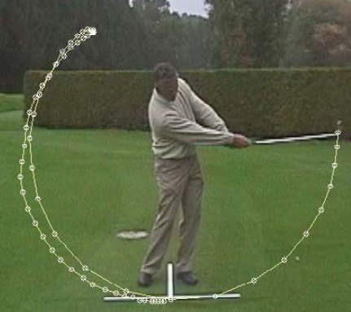
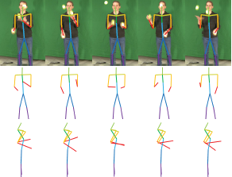
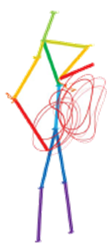




Human Pose Recovery: a taxonomy
Motion models
Task-specific models General Models
R. Urtasun, D. Fleet, P. Fua, Monocular 3d tracking of the golf swing, in: CVPR, 2005.
H. Park, Y. Sheikh, 3d reconstruction of a smooth articulated trajectory from a monocular image sequence, in: ICCV, 2011.

Slide 22
Human Pose Recovery: a taxonomy
Appearance
Viewpoint
Spatial models
Temporal models
Behavior
Activity
Context

Slide 23
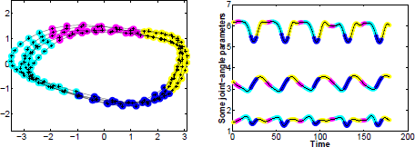
Human Pose Recovery: a taxonomy
Activity
V. Singh, R. Nevatia, Action recognition in cluttered dynamic scenes using pose-specic part models, in: ICCV, 2011.
A. Agarwal, B. Triggs, Tracking articulated motion with piecewise learned dynamical models, in: ECCV, 2004.

Slide 24
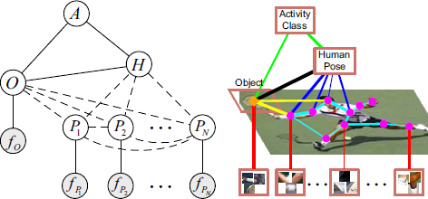
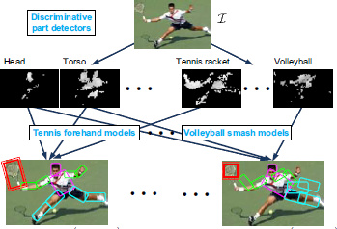
Human Pose Recovery: a taxonomy
Context
B. Yao, L. Fei-Fei, Modeling mutual context of object and human pose in human-object interaction activities, in: CVPR, IEEE, 2010.

Slide 25

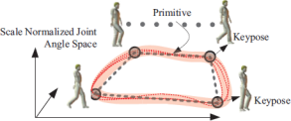
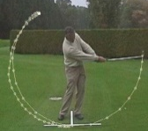

Human Pose Recovery: a taxonomy
Appearance
Viewpoint
Spatial models
Temporal models
Behavior
Local
Continuous
Probabilistic assemblies
of parts
Tracking
Activity
(Andriluka et al., 2010)
Local
Continuous
Kinematic models
-
Activity
(Simo-Serra et al., 2012)
Local
Discrete
Kinematic models
Tracking
Activity
(Singh & Nevatia, 2011)
Local
Discrete
Kinematic models
Motion models
Activity
(Urtasun et al., 2005)
Local
Discrete
Probabilistic assemblies
of parts
-
Context
(Yao & Fei-Fei, 2010)

Slide 26
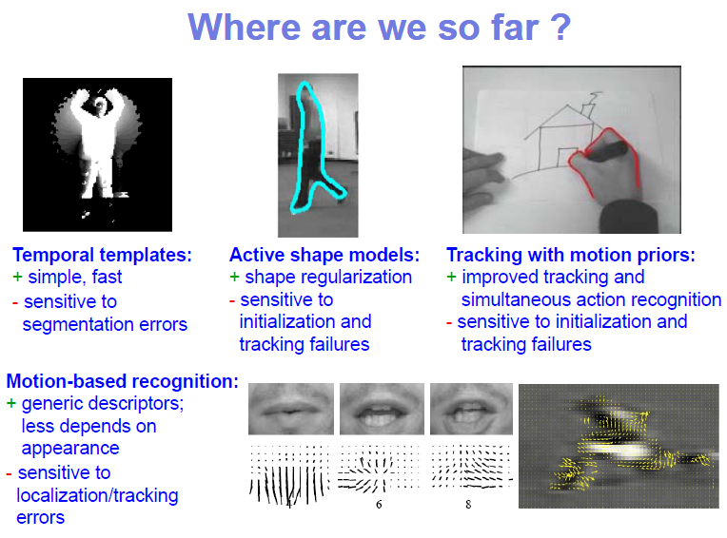
Human Pose Recovery: a taxonomy

Slide 27
HPR from depth maps

Slide 28
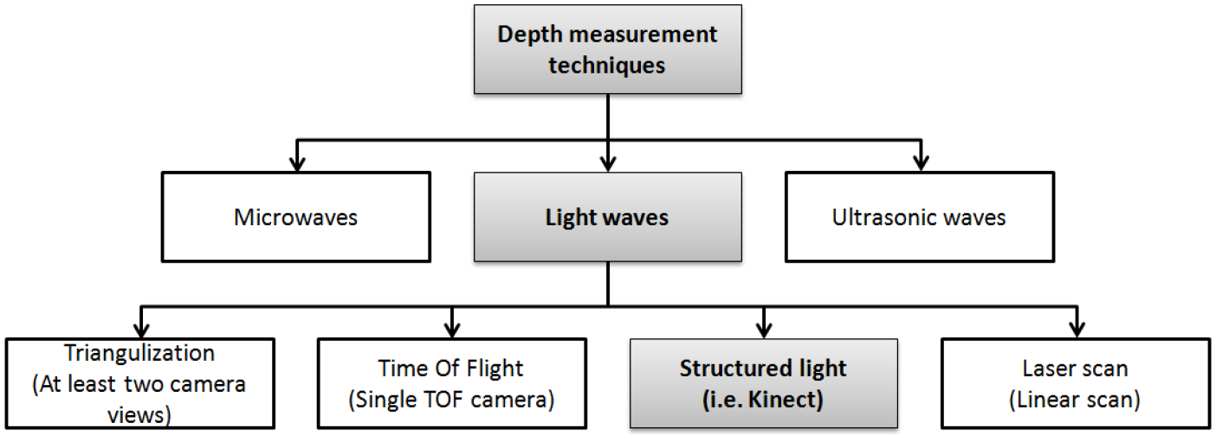
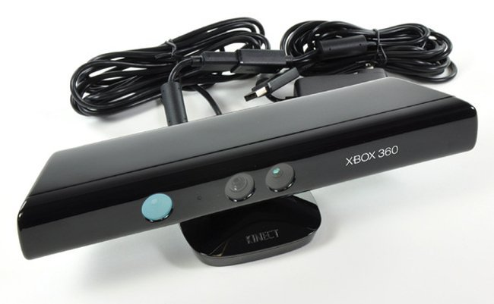
HPR from depth maps

Slide 29
HPR from depth maps
Appearance
Viewpoint
Spatial models
Temporal models
Behavior

Slide 30
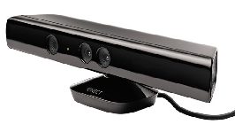

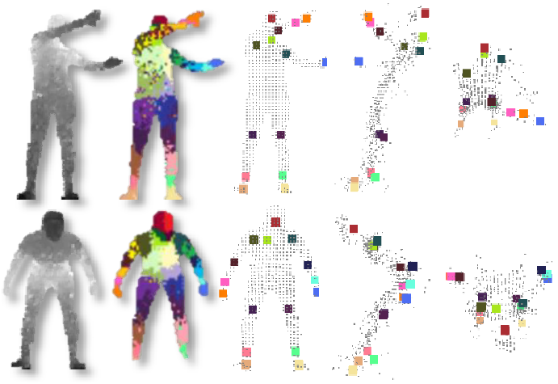
HPR from depth maps
KINECT – RBGD representation

Slide 31


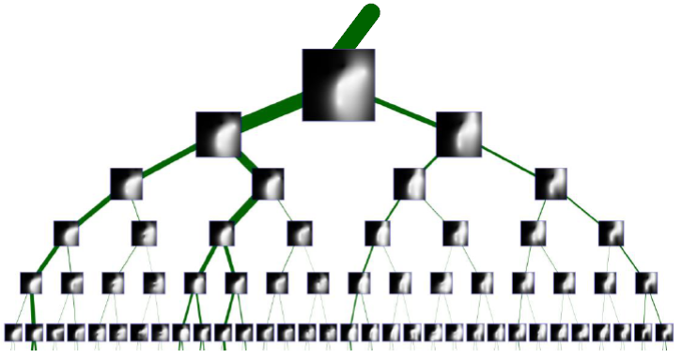
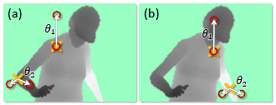
HPR from depth maps
KINECT – RBGD representation

Slide 32
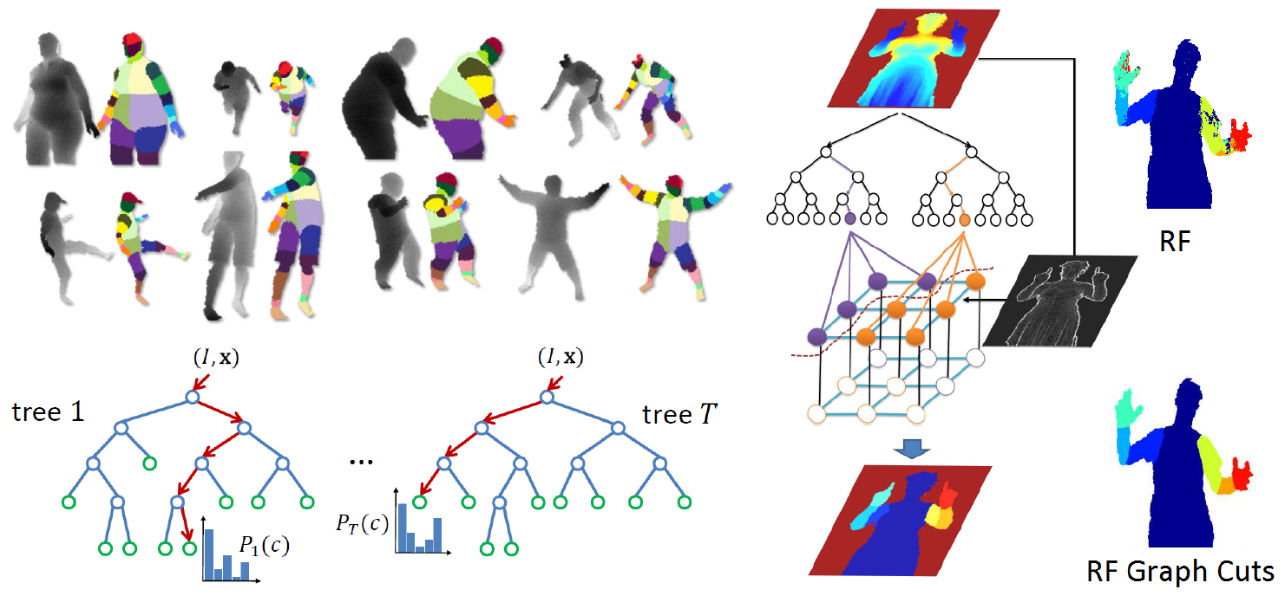
HPR from depth maps
J. Shotton, A. Fitzgibbon, M. Cook, T. Sharp, M. Finocchio, Real-time human
pose recognition in parts from single depth images, 2011.
A. Hernandez-Vela, N. Zlateva, A. Marinov, M. Reyes, P. Radeva, D. Dimov, S. Escalera, Graph cuts optimization for multi-limb human segmentation in depth maps, in: CVPR, 2012.

Slide 33
HPR from depth maps
Graph Cuts (Energy minimization)
S
S
1. Energy function
Unary potential
3. Min-cut algorithm
Pair-wise potential
T
T
2. Graph representation
Yuri Y. Boykov and Marie-Pierre Jolly, “Interactive Graph Cuts for Optimal Boundary & Region Segmentation of Objects in N-D Images”, International Conference on Computer Vision, 2001

Slide 34
HPR from depth maps
Graph Cuts (Energy minimization)
s
s
s
2
0
3
2
0
3
2
0
1
2
1
2
1
2
1
2
1
1
1
1
1
1
3
1
1
2
1
1
2
1
3
4
3
4
3
4
1
2
3
2
3
5
5
2
5
2
t
t
t
Cmin = 2
Cmin = 1
Cmin = 1

Slide 35
HPR from depth maps
Maximum flow
Graph Cuts (Energy minimization)
S
s
2
0
2
1
1
2
1
1
Mincut
Flow direction
2
1
1
3
4
2
2
5
1
Maxflow 2+2=4
t
T
1
2

Slide 36

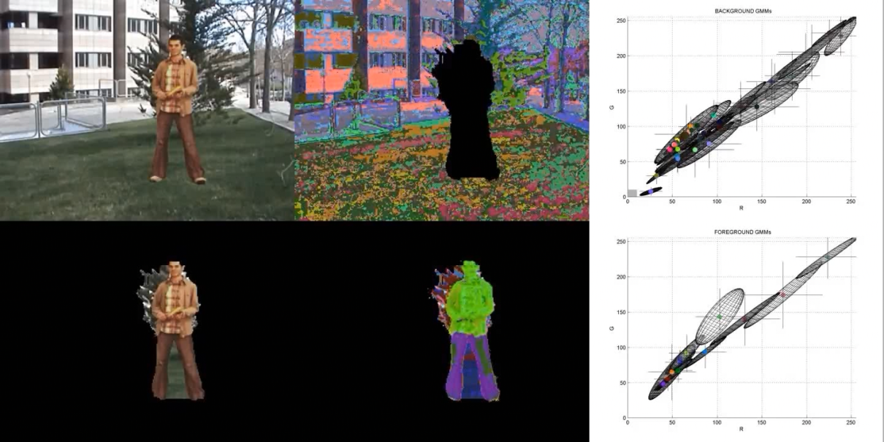
HPR from depth maps
GrabCut
V=N
Gaussian Mixture Model for pixel label probability estimation

Slide 37
HPR from depth maps
Extensible to N-D!
Example: Video (3D)
Frame t
Frame t-1

Slide 38
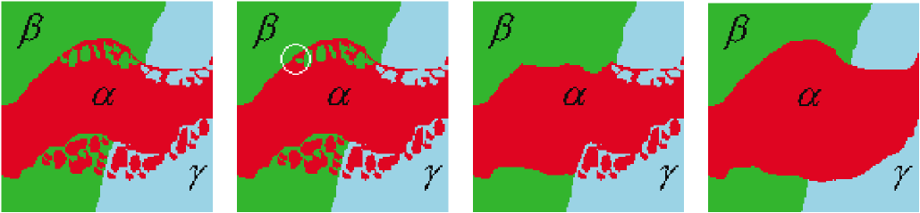
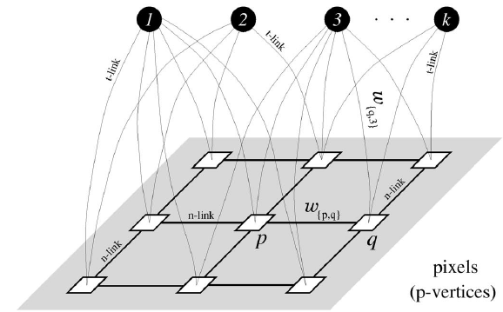
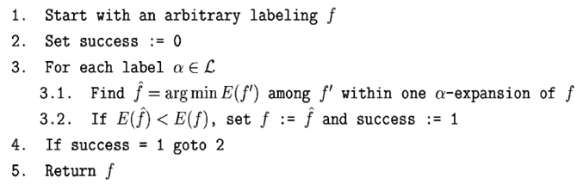
HPR from depth maps
Multilabel problem → Set of binary problems
Yuri Boykov, Olga Veksler, Ramin Zabih, “Fast approximate energy minimization via graph cuts”, IEEE Transactions on Pattern Analysis and Machine Intelligence, Vol. 23 (2001)

Slide 39
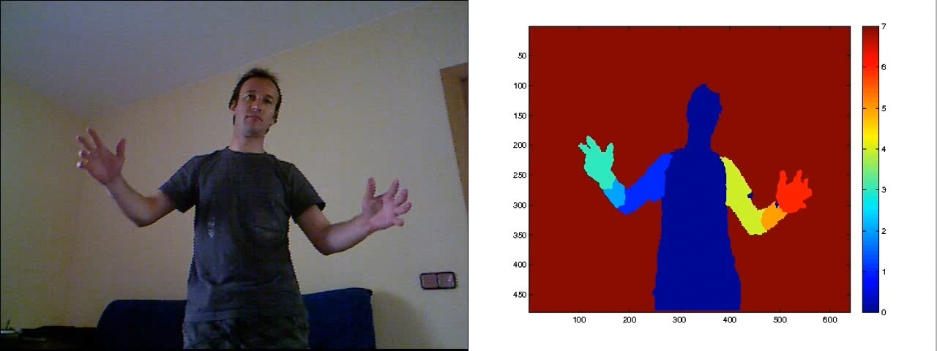
HPR from depth maps
A. Hernandez-Vela, N. Zlateva, A. Marinov, M. Reyes, P. Radeva, D. Dimov, S. Escalera, Graph cuts optimization for multi-limb human segmentation in depth maps, in: CVPR, 2012.

Slide 40
HPR from depth maps
Appearance
Viewpoint
Spatial models
Temporal models
Behavior
Global
Local
Pixel-based
Logical

Slide 41
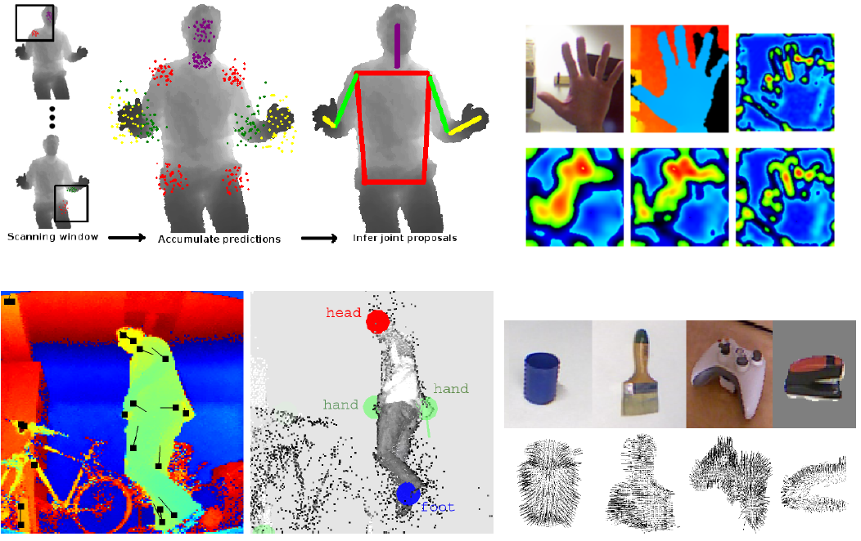
HPR from depth maps
B. Holt, E.-J. Ong, H. Cooper, R. Bowden, Putting the pieces together: Connected poselets for human pose estimation, in: ICCV, 2011.
N. Pugeault, R. Bowden, Spelling it out: Real-time asl ngerspelling recognition, in: ICCV, 2011.
C. Plagemann, V. Ganapathi, D. Koller, S. Thrun, Real-time identication and localization of body parts from depth images, in: ICCV, 2011, pp. 3108{3113.
A. Clapes, M. Reyes, S. Escalera, User identication and object recognition in clutter scenes based on rgb-depth analysis, in: Articulated Motion of Deformable Objects, 2012.

Slide 42
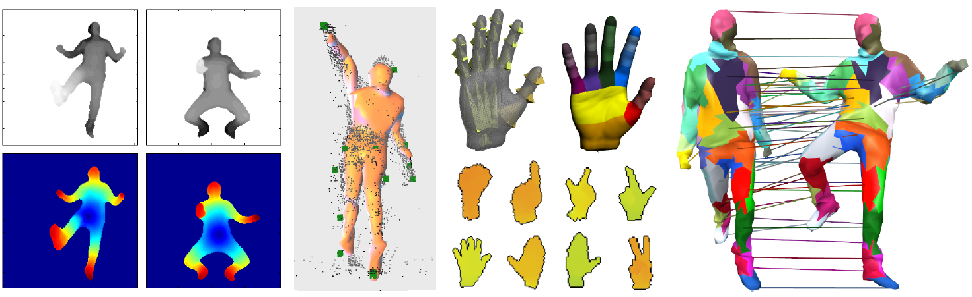
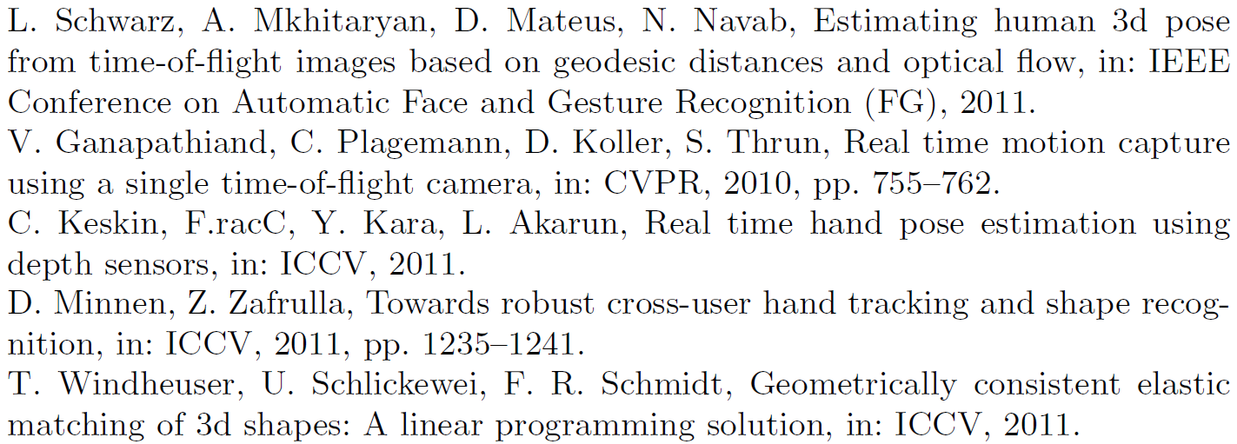
HPR from depth maps
[1] [2] [3,4] [5]
[1]
[2]
[3]
[4]
[5]
Several hybrid discriminative generative methods for HPR taking benefit from multi-modal RGBDT representation

Slide 43









HuPBA group: methods and applications
Human Pose Recovery and Behavior Analysis Group (HuPBA) at the University of Barcelona http://www.maia.ub.es/~sergio/
Dr. Sergio Escalera
Oscar Amorós
Albert Clapés
Xavier Pérez-Sala
Miguel A. Bautista
A. Hernández-Vela
Víctor Ponce
Miguel Reyes
Mario Gorga

Slide 44

HuPBA group: methods and applications

Slide 45
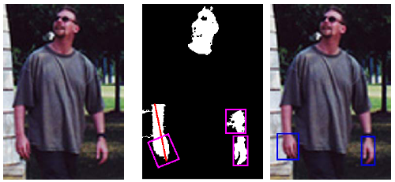
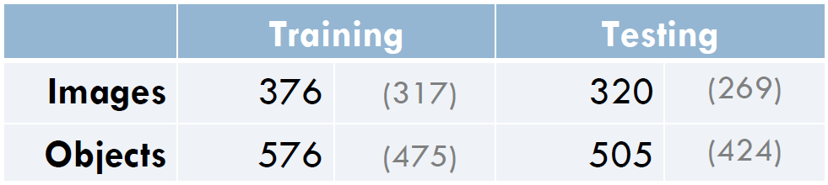
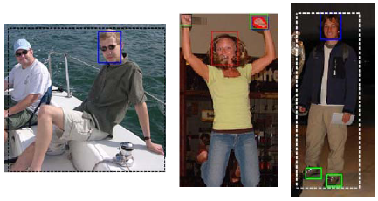
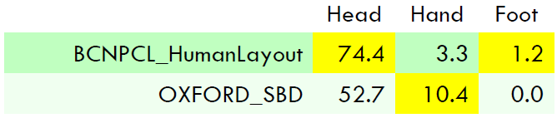
HuPBA group: methods and applications
Color segmentation and spatial coherence
A challenging problem
Detectors and color segmentation

Slide 46





HuPBA group: methods and applications

Slide 47






HuPBA group: methods and applications

Slide 48

HuPBA group: methods and applications

Slide 49

HuPBA group: methods and applications

Slide 50



HuPBA group: methods and applications
-Multiple view reconstruction and analysis
-Automatic physical evolution analyses of treatments
A. Hernández, M. Bautista, X. Pérez, V. Ponce, O. Pujol, X. Baró, S. Escalera, BoVDW: Bag-of-Visual-and-Depth-Words for Gesture Recognition, ICPR 2012

Slide 51



HuPBA group: methods and applications

Slide 52

HuPBA group: methods and applications

Slide 53

HuPBA group: methods and applications
Real-time automatic volume analysis
http://code.google.com/p/simple-opencl/

Slide 54


HuPBA group: methods and applications
Analysis of the communication process in
criminal mediation situations
Provide expert’s feedback from the situations for detecting why and when people opinions begin to match.

Slide 55



HuPBA group: methods and applications
Assisted Living: old people with dementia

Slide 56
Conclusion
Automatic Human Behavior Analysis is a hot topic for both Artificial Intelligence Research and to deal with Real Applications.
Depth maps have become a useful tool for improved description of human poses.
Real applications become feasible.
Still a lot of work to do: high efficiency is required in real applications: large scale (multi-modal data, viewpoint, changes in appearance), occlusions, illumination changes (reflectance problem in case of different surface materials in case of infrared sensors), etc.

Slide 57
Thank you!

