Slide 1


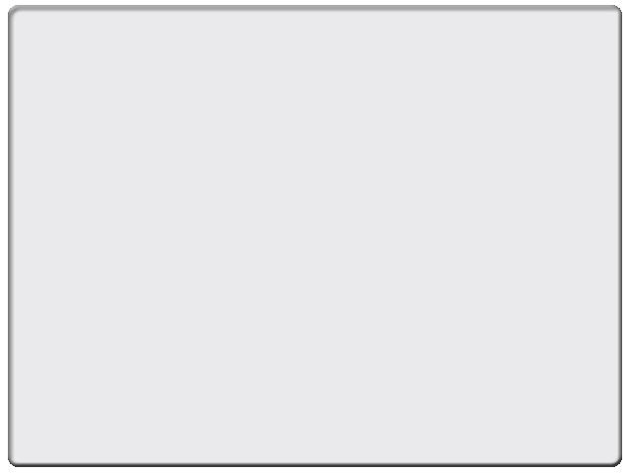
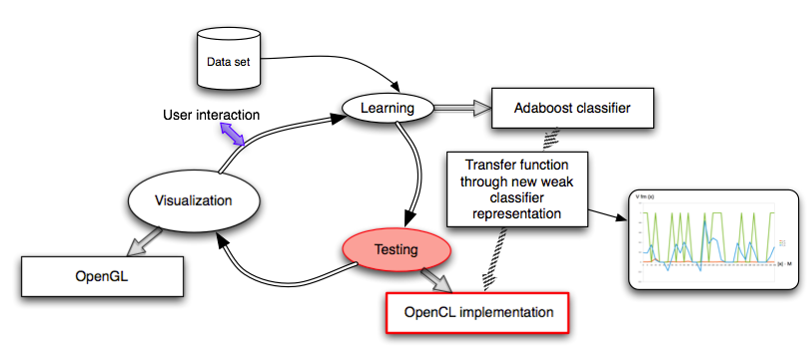
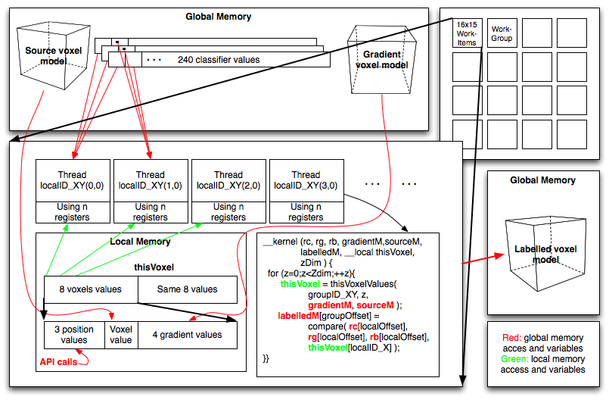
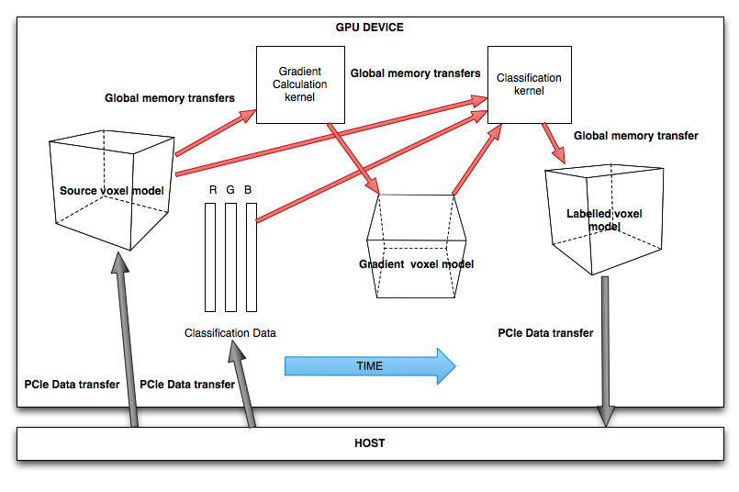

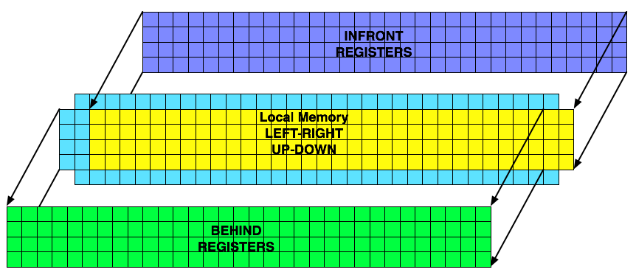
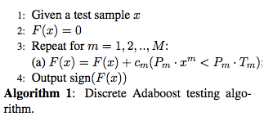
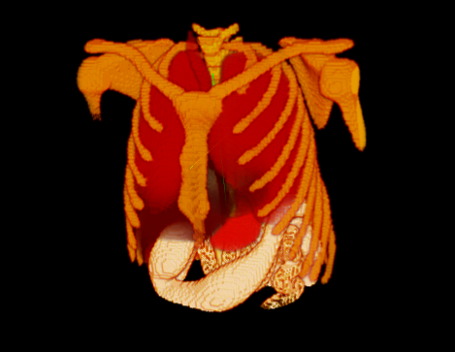
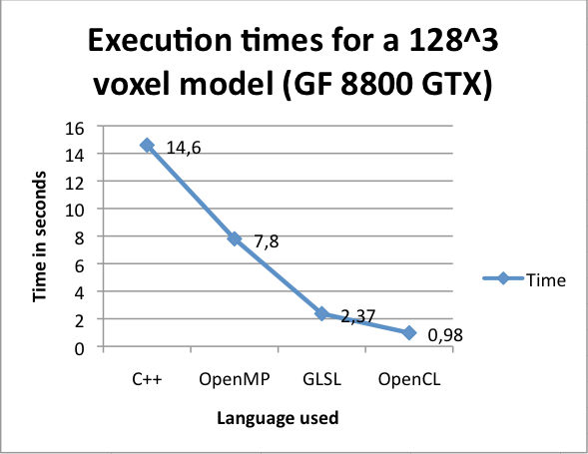
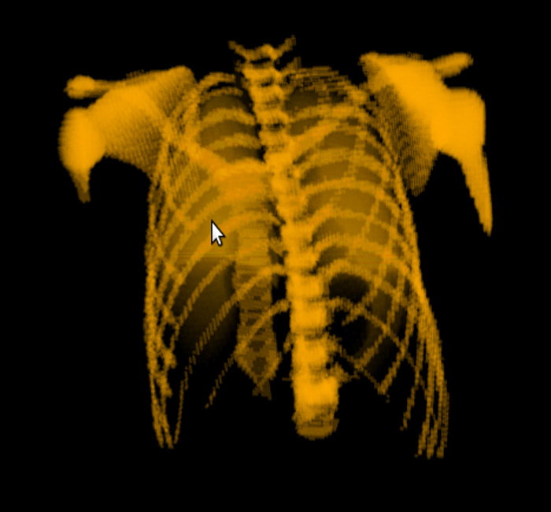
OpenCL based machine learning labeling
of biomedical datasets
Oscar Amoros, Sergio Escalera and Anna Puig
Computer Vision Center, Universitat Autònoma de Barcelona, 08193 Cerdanyola, Spain
Dept. Matemàtica Aplicada i Anàlisi, UB, Gran Via 585,
08007, Barcelona, Spain
oamorohu7@alumnes.ub.edu, sescalera@cvc.uab.es, anna@maia.ub.es
Sub-title
Abstract
In medical imaging it becomes imperative to provide an automatic and interactive method to label or to tag different structures contained into input data. We propose a two-stage labeling method of large biomedical datasets through a parallel approach in a single GPU. We define an alternative representation of the Adaboost binary classifier, allowing an interactive learning step. We use this proposed representation to define a new GPU-based parallelized Adaboost testing stage using OpenCL for GPU’s, in order to make this functionality usable in terms of speed.
1. Overview
2. OpenCL implementation
We focused on exploiting parallelism and reduce PCIe transfers by using uchar values and calculating gradients also in GPU, to accelerate their calculation and avoid transferring them through PCIe.
The algorithm shown uses a work group to classify one voxel. By classifying 64 voxel with a work group we can exploit the GPU memory bandwidht.
We accelerated the thesting step by creating a new weak classifier representation that can be more easilly paralelizable and implementing it on GPU’s using OpenCL.
The Adaboost [1] procedure trains the classifiers f_{m}(x) on weighed versions of the training sample, giving higher weights to cases that are currently misclassified. For each f_{m}(x) we just need to compute a threshold value and a polarity to make a binary decision, selecting that one that minimizes the error based on the assigned weights.
This sim- ple combination of classifiers has demonstrated to reduce the variance error term of the final classifier F (x).
In Algorithm 1, we show the testing of the final decision function h using the Discrete Adaboost algorithm with Decision Stump ”weak classifier”.
The Gradient classification kernel (below) is based on Micikevicius [2] stencil algorithm to reduce global memory transfers. It uses uchar. By using uchar4 we can exploit maximum memory bandwidth.
3. RESULTS
Torax without classification
Classified torax for bone visualization
4. Conclusions and future work
[1] Yoav Freund, Robert E. Schapire. ”A Decision-Theoretic Generalization of on-Line Learning and an Application to Boosting”, 1995.
This weak classifier representation is perfect for embarrassingly parallel architectures. We are able to generate tens of billion (thousand million) threads for 512^3 voxel models.
Even with the minimum global memory use, we achieve a good improvement in performance, so we expect real time testing when integrating it with OpenGL visualization, and implementing the global memory optimizations.
OpenCL has a good performance on GPU’s but is still unstable for ATI cards. Also, a lot of coding is needed for the Host code part.
Future work includes optimizations, Multiclass testing, GPU learning stage, interactive inteface and testing more maintainable and portable language StarSs [3].
[2] Paulius Micikevicius, 3D Finite Difference Computation on GPUs using CUDA, NVIDIA
[3] http://www.prace-project.eu/documents/08_starss_jl.pdf

