Slide 1


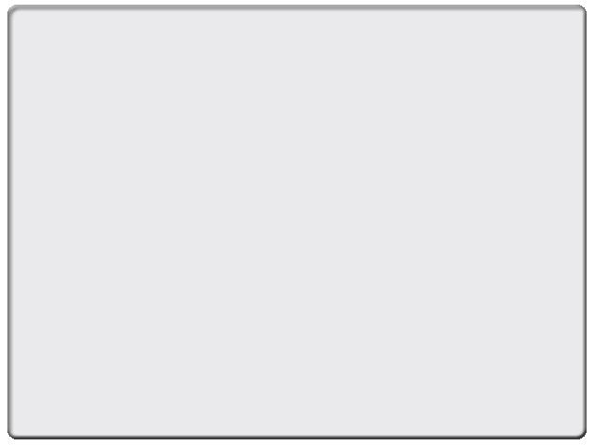
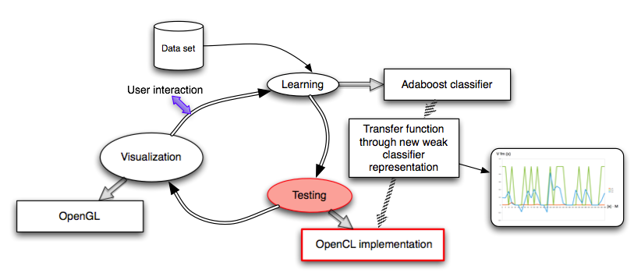

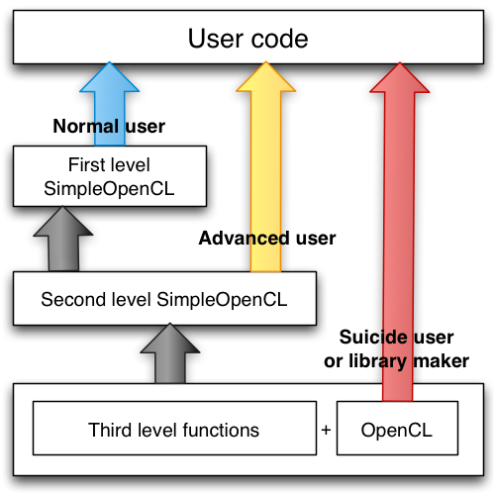
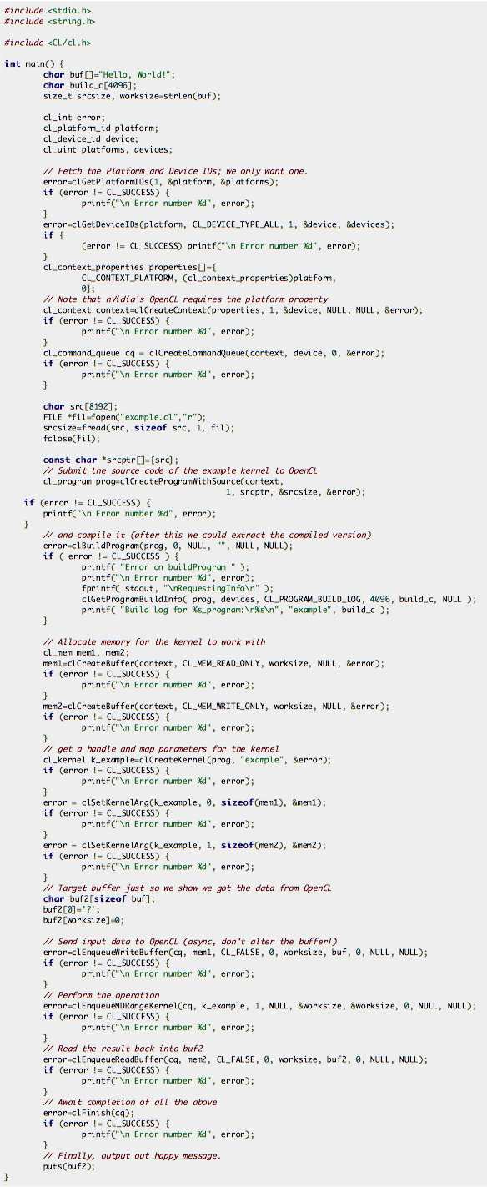
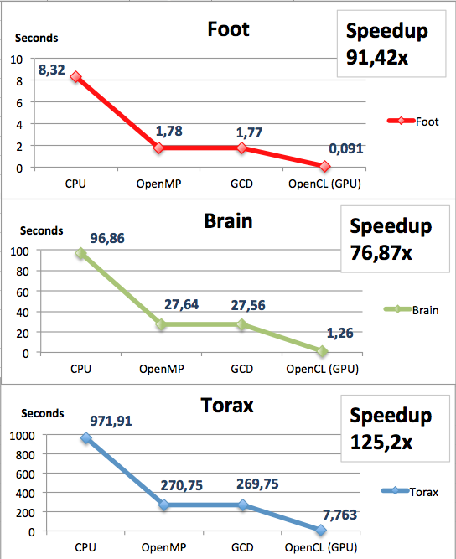
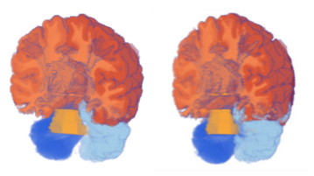
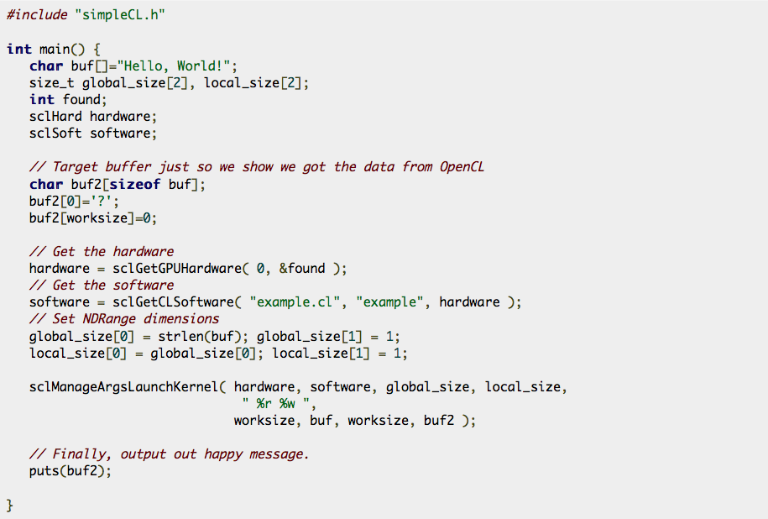
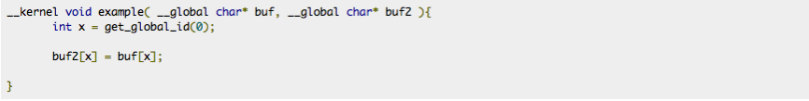
GPGPU Volume Classification using SimpleOpenCL
Oscar Amoros, Sergio Escalera, Anna Puig and Maria Salamó
Computer Vision Center, Universitat Autònoma de Barcelona, 08193 Cerdanyola, Spain
Dept. Matemàtica Aplicada i Anàlisi, UB, Gran Via 585,
08007, Barcelona, Spain
oamorohu7@alumnes.ub.edu, sescalera@cvc.uab.es, anna@maia.ub.es, maria@maia.ub.es
Sub-title
Abstract
In volume visualization, the definition of the regions of interest is inherently an iterative trial-and-error process finding out the best parameters to classify and render the final image. In this work, we present a general framework for training multi-class classifiers using Error-Correcting Out- put Codes. Moreover, we propose a GPGPU paral·lelization system using SimpleOpenCL, an OpenSource library we created to make it easier to use OpenCL. Results show accurate classification results as well as good speed ups.
1. Classification framework overview
2. SimpleOpenCL overview
SimpleOpenCL is an OpenSource library and Google Code project that we created. It is written in ANSI C to be used by C and C++ programs. The main goal of SimpleOpenCL has been reducing the code needed to run the experiments on the GPU with OpenCL, but also supports managing CPU devices.
OpenCL provides so much control over the system that it requires a lot of code. So with SimpleOpenCL we are providing two levels of programming. The first level provides the simplest way to do an OpenCL program.
We also provide a second level, where the programmer has more control, but also has to write more code, although less than with plain OpenCL.
We propose a general framework of supervised statistical classification methods to label on-demand multiple regions of interest.
The learning step gets a subset of preclassified samples to train a set of
Adaboost classifiers[1] , which are codified as TFs, and combined in an ECOC design [2].
The testing stage multi-classifies and labels a subset of volume classes based on user interaction.
We accelerated the thesting step by creating a new weak classifier representation that can be more easilly paralelizable.
We implemented it on CPU’s and GPU’s using OpenMP, GCD and OpenCL.
For the OpenCL version we have developed a new library called SimpleOpenCL available at Google code. This library allowed us to code faster, debug faster with much less complexity on the Host code side, and without performance penalizations on the Device code side.
SimpleOpenCL (SCL) also offers a way to manage Devices that makes it easier to initialize them, identify them, and select them by performance or Device type criteria. Instead of having a lot of different OpenCL objects related to the hardware spread across your Host code, you only need to use the sclHard data type that SCL provides. You can use it with SCL functions, or access its components to use them with native OpenCL functions. The same is true for .cl source files and kernel objects. You just need the sclSoft data type.
3. SCL Example
4. Performance results
The same “Hello world” program with or without SimpleOpenCL
Host code without SimpleOpenCL
Host code with SimpleOpenCL
Device code for both cases
4. Conclusions and future work
[1] J. Friedman, T. Hastie, R. Tibshirani, Additive logistic regres- sion: a statistical view of boosting, Annals of Statistics 28.
[2] S. Escalera, D. Tax, O. Pujol, P. Radeva, R. Duin, Subclass problem-dependent design of error-correcting output codes, in: IEEE Transactions in Pattern Analysis and Machine Intelligence, Vol. 30, 2008, pp. 1–14.
Semi automatic classification is a promising technology for reducin classification costs not only on medical imaging but also other fields that need volumetric dataset classification.
SimpleOpenCL is a promising tool that will be extended adding more advanced first and second level functions.

