Slide 1
Efficient complementary viewpoint selection in volume rendering
S. Grau, A. Puig, S. Escalera, M. Salamó and O. Amorós

Slide 2
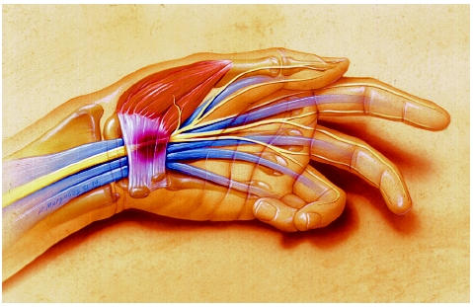

Slide 4
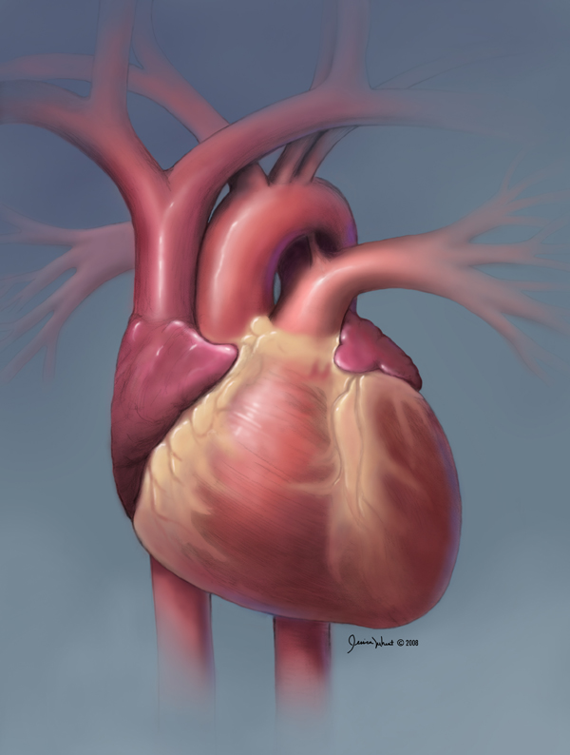

Slide 5
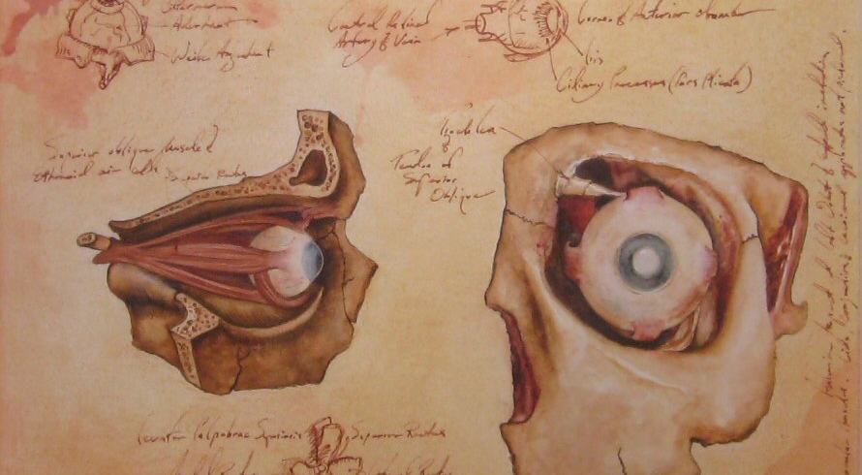

Slide 6
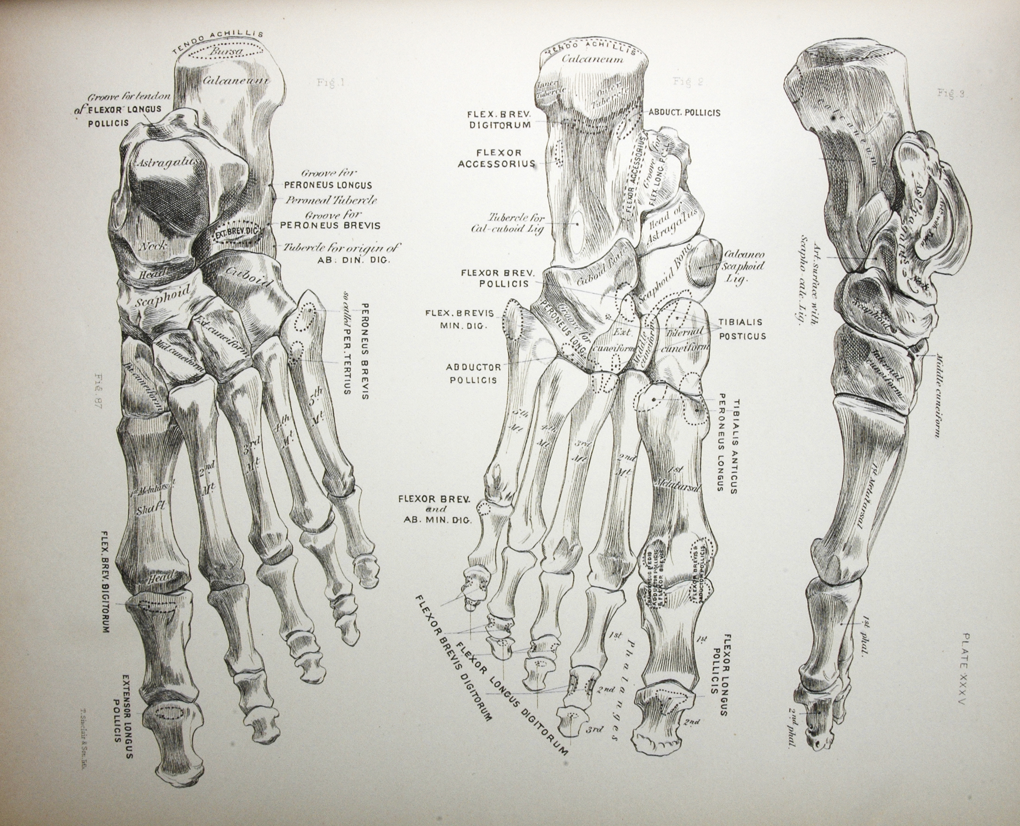

Slide 7
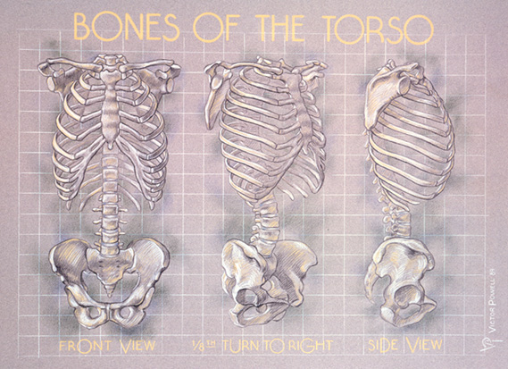

Slide 8
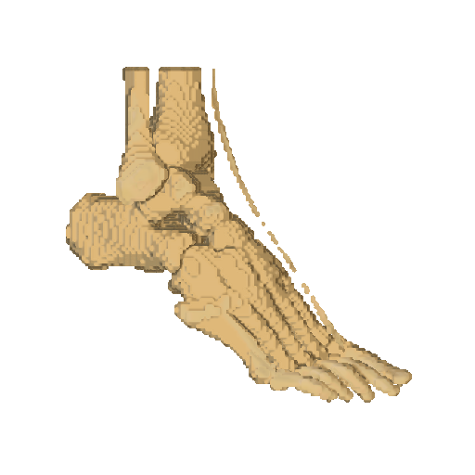

Slide 10
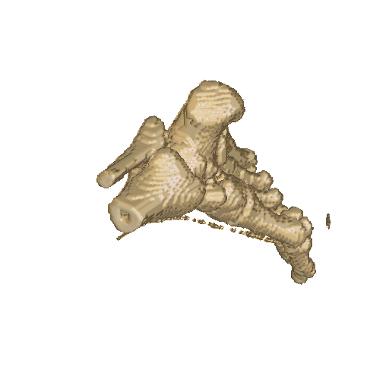
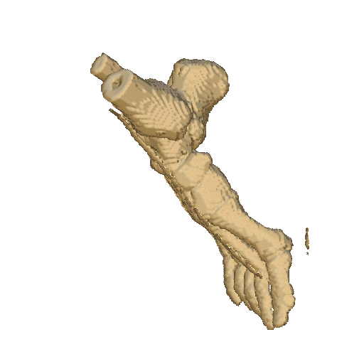
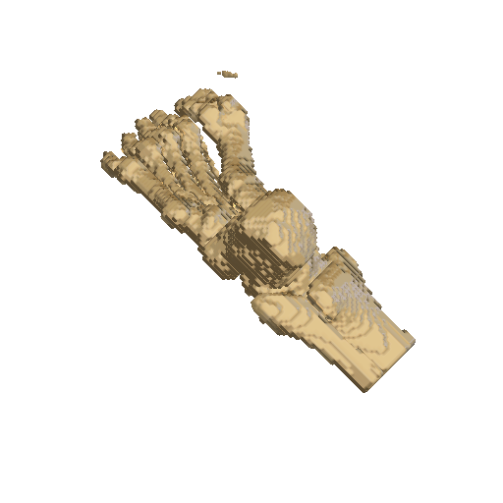
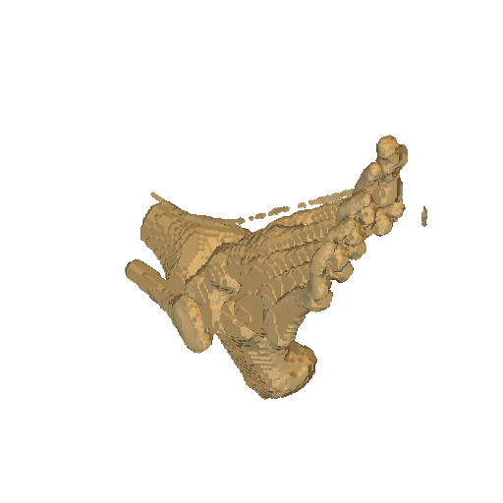

Slide 11
Scoring - Descriptors
Environment-dependent
Object-dependent
Viewpoint-dependent

Slide 12
Scoring - Descriptors
Environment-dependent
Object-dependent
Viewpoint-dependent
Projected area
Number of visible objects
Occlusion between objects
Object self-occlusions
Luminance

Slide 13
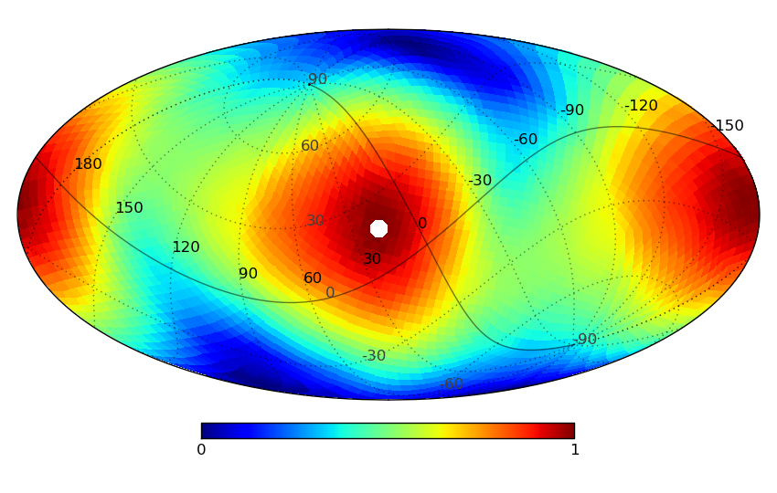
Scoring

Slide 14
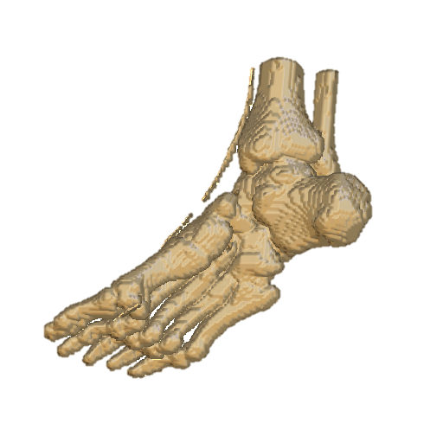
Scoring

Slide 15
Optimal complementary camera
?

Slide 16
Optimal complementary camera

Slide 17
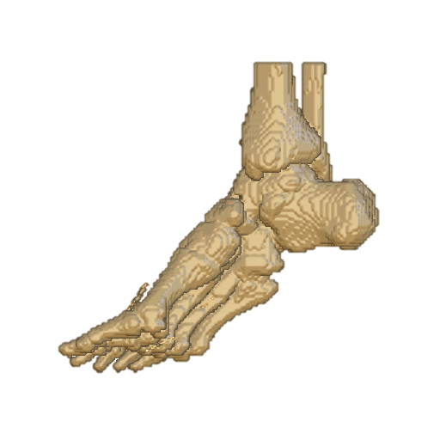
Optimal complementary camera

Slide 18


Similarity
VS
Number of objects?
Projected area per object?
Projected shape?
Notes:
#labels?
Area projected per label? (normalitzat, correlació)
Shape projected?

Slide 19

Similarity
VS
Number of objects?
Projected area per object?
Projected shape?
Notes:
#labels?
Area projected per label? (normalitzat, correlació)
Shape projected?

Slide 20
Similarity
VS
Number of objects?
Projected area per object?
Projected shape?
Notes:
#labels?
Area projected per label? (normalitzat, correlació)
Shape projected?

Slide 21
Similarity
VS
Number of objects?
Projected area per object?
Projected shape?
Notes:
#labels?
Area projected per label? (normalitzat, correlació)
Shape projected?

Slide 22


Shape Similarity
Notes:
#labels?
Area projected per label? (normalitzat, correlació)
Shape projected?

Slide 23
Shape Similarity

Slide 24
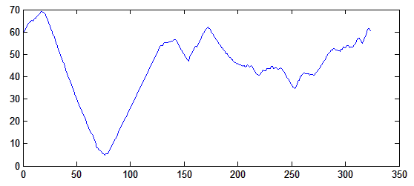
Shape Similarity

Slide 25
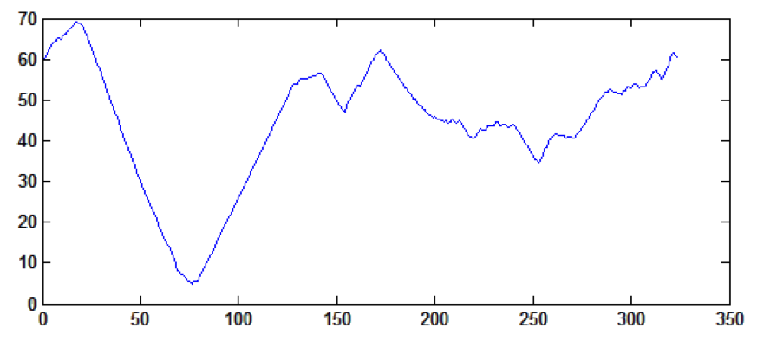
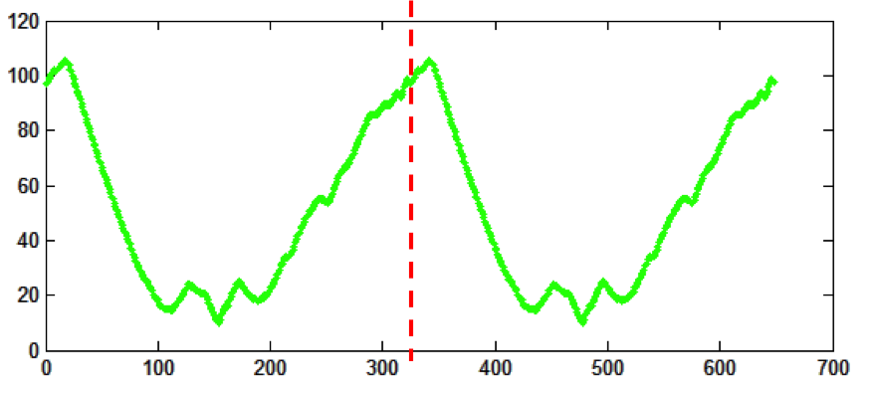
Shape Similarity
VS
Notes:
#labels?
Area projected per label? (normalitzat, correlació)
Shape projected?

Slide 26
Shape Similarity
VS
2x
Notes:
#labels?
Area projected per label? (normalitzat, correlació)
Shape projected?

Slide 27
Shape Similarity
Dynamic Time Warping
Notes:
#labels?
Area projected per label? (normalitzat, correlació)
Shape projected?

Slide 28
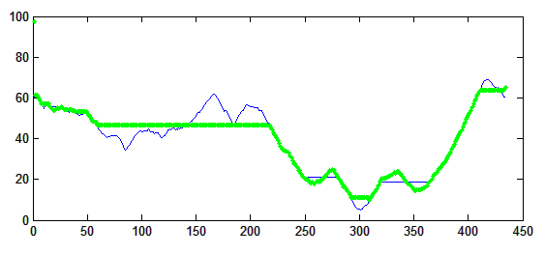
Shape Similarity
Dynamic Time Warping
Notes:
#labels?
Area projected per label? (normalitzat, correlació)
Shape projected?

Slide 29
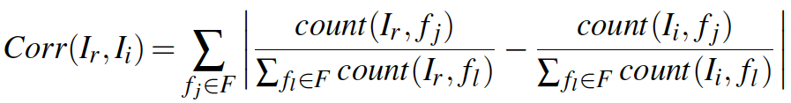
Similarity
Notes:
#labels?
Area projected per label? (normalitzat, correlació)
Shape projected?

Slide 30
Optimal complementary camera

Slide 31
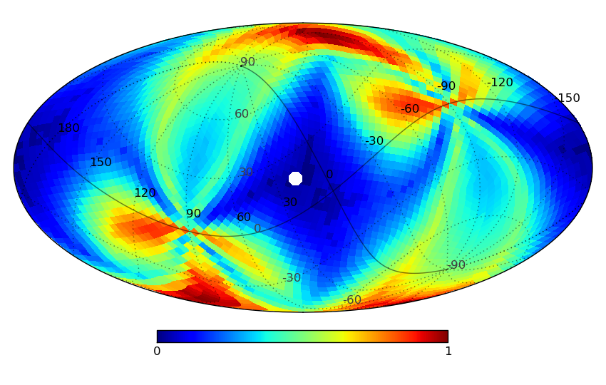
Optimal complementary camera

Slide 32
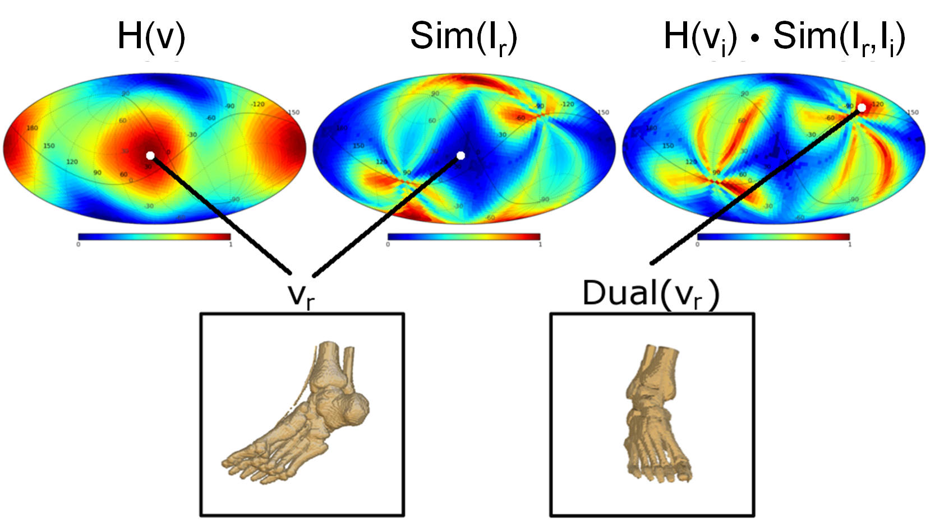
Optimal complementary camera

Slide 33
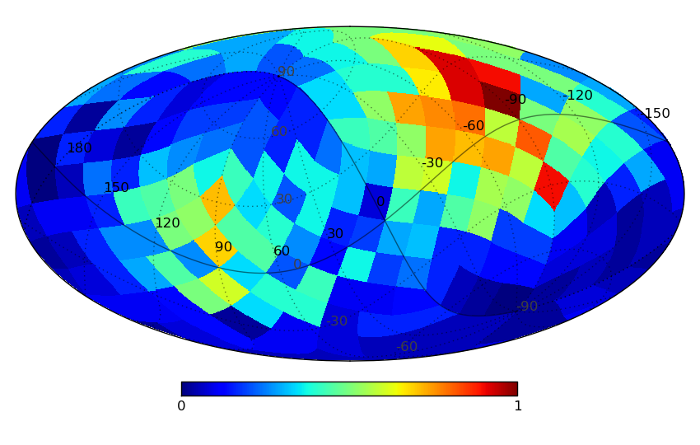
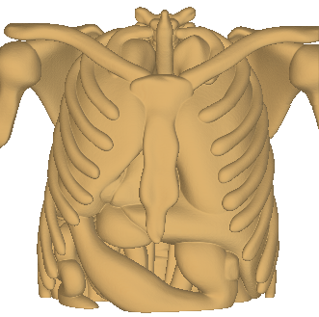
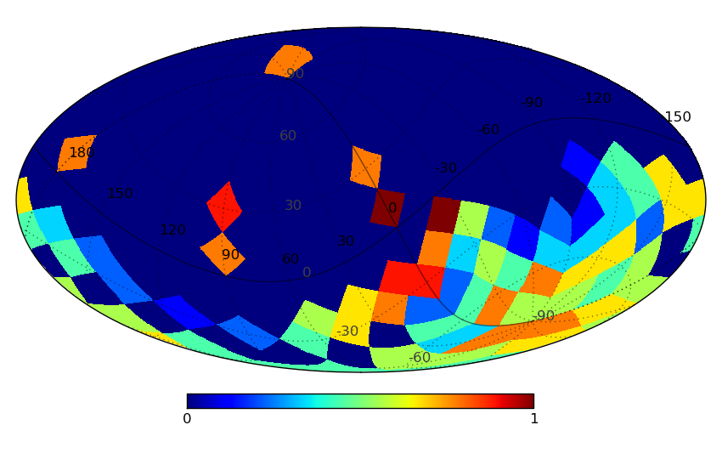
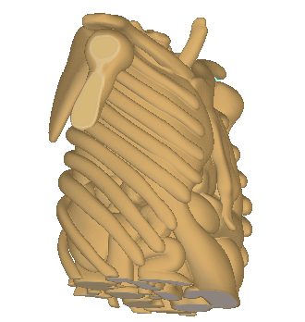
Simulations
Live-User Evaluation

Slide 34
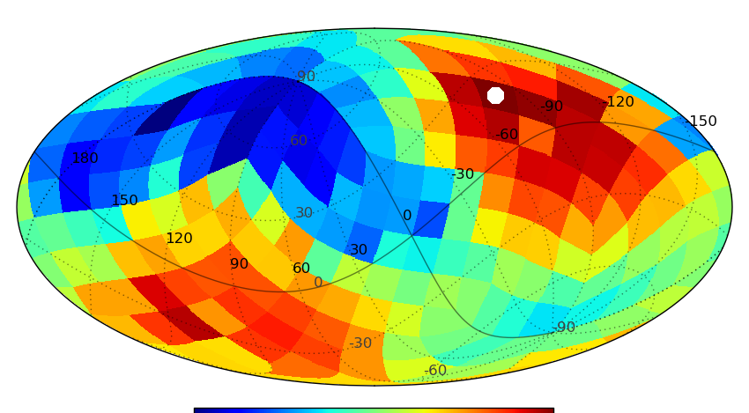
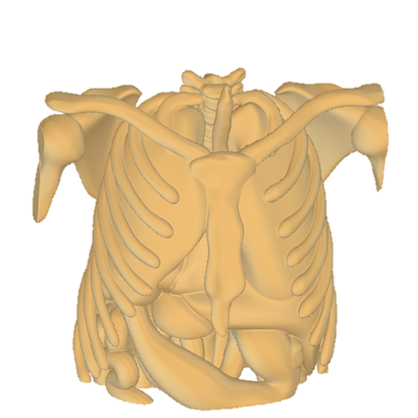
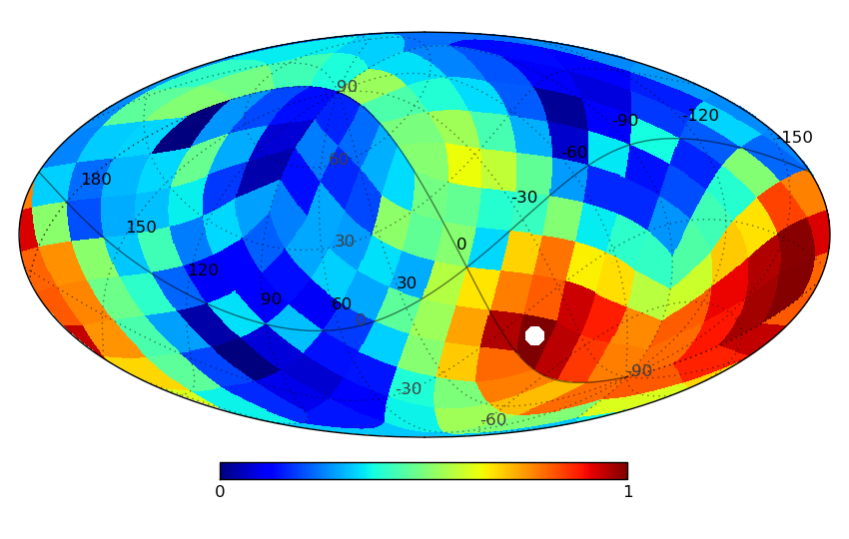
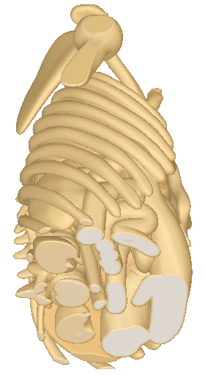
Simulations
Live-User Evaluation
System setup

Slide 35
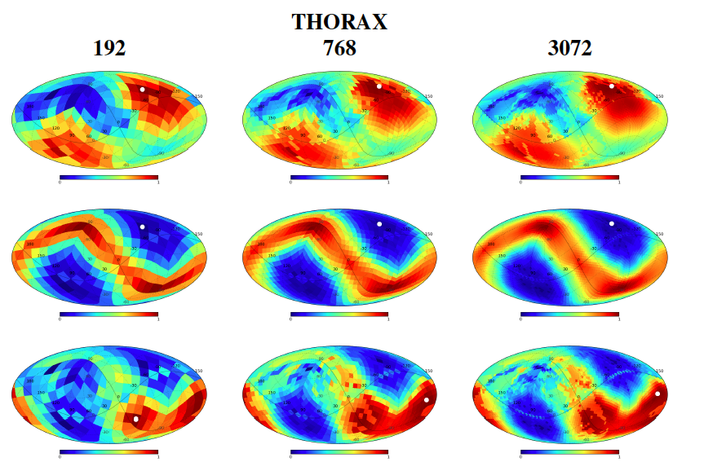
Simulations

Slide 36
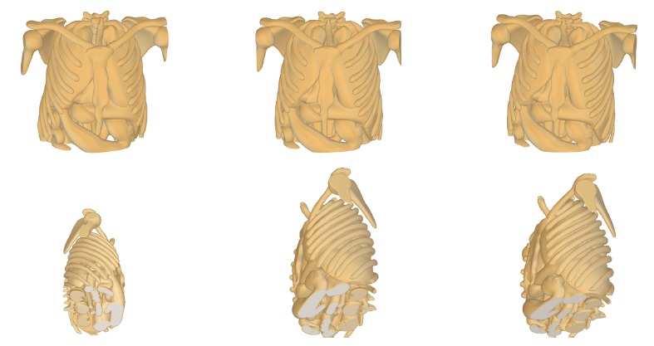
Simulations

Slide 37
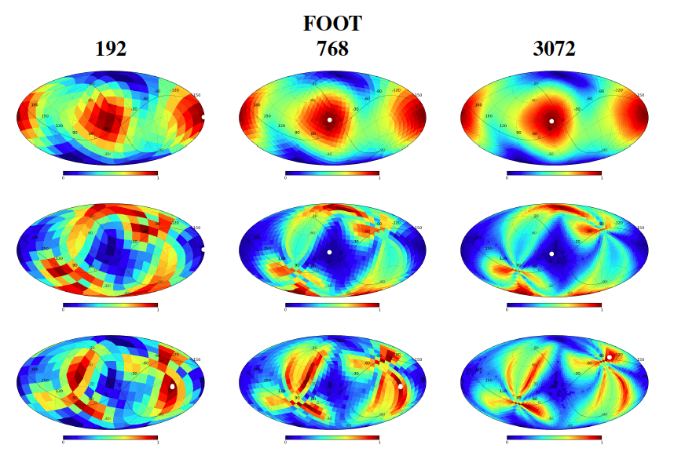
Simulations

Slide 38
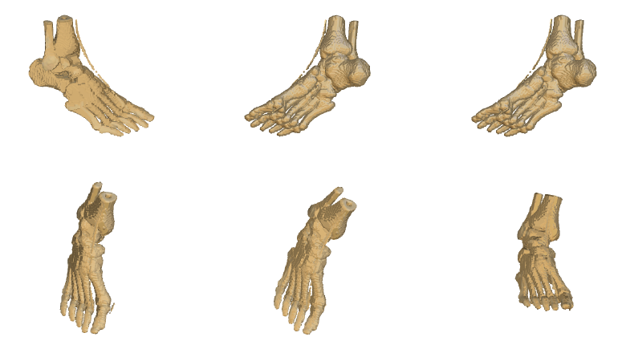
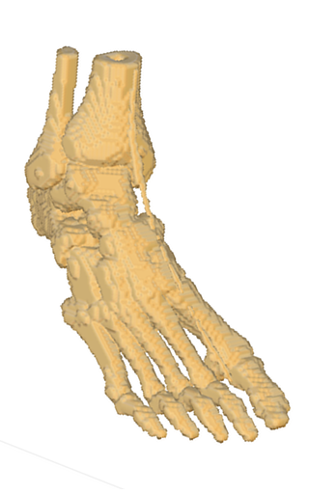
Simulations

Slide 39
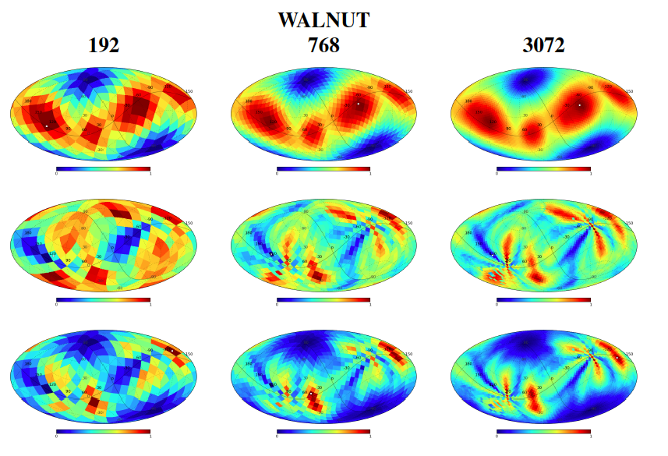
Simulations

Slide 40
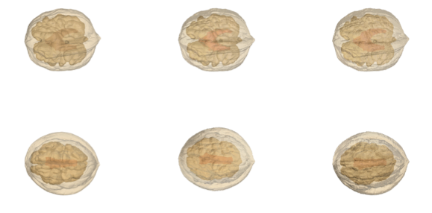
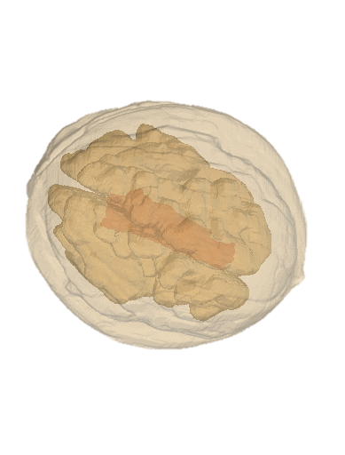
Simulations

Slide 41
Conclusions

Slide 42
Efficient complementary viewpoint selection in volume rendering
S. Grau, A. Puig, S. Escalera, M. Salamó and O. Amorós

Slide 43
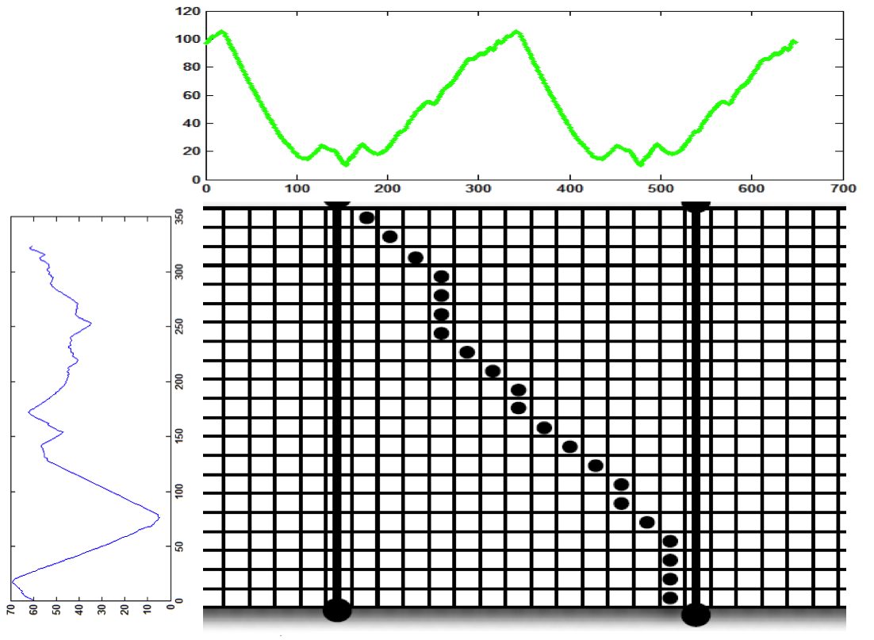
Dynamic Time Warping
Notes:
#labels?
Area projected per label? (normalitzat, correlació)
Shape projected?

