Slide 1




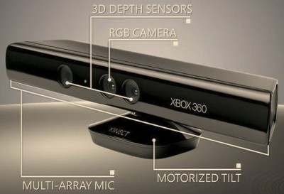
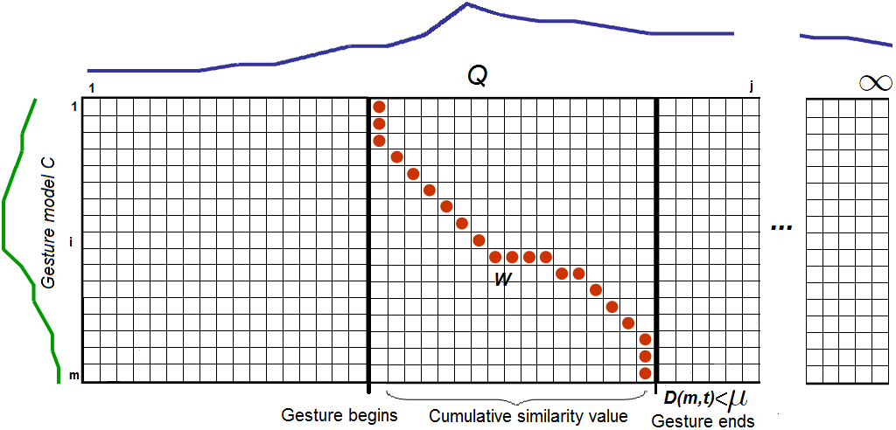
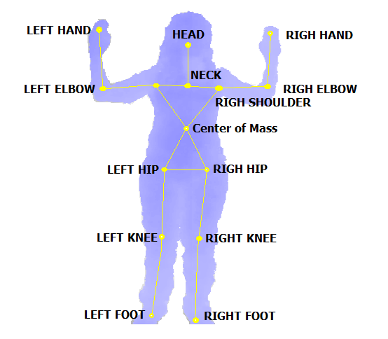
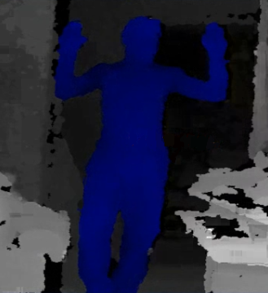
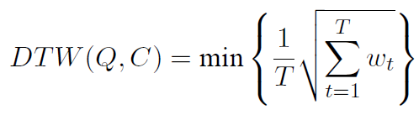

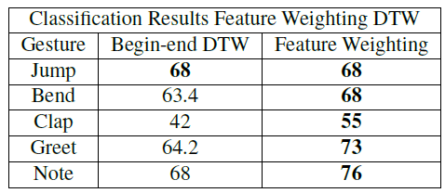
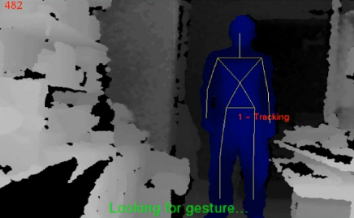
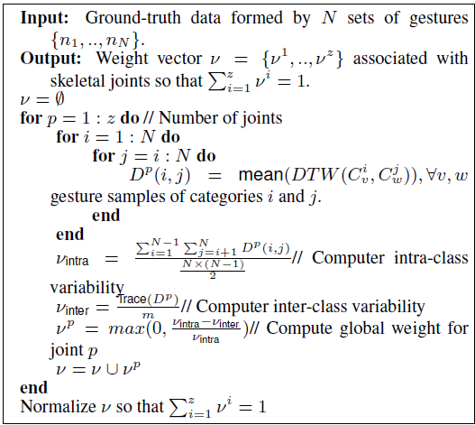
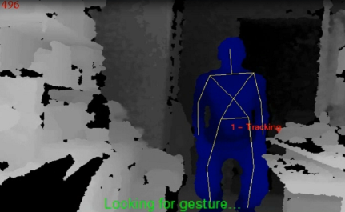
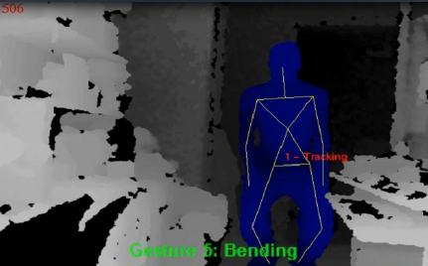
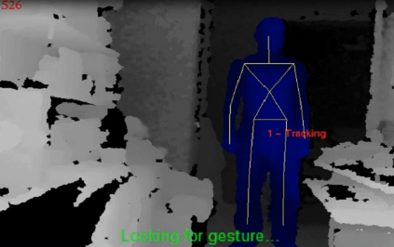
Miguel Reyes^{1,2}, Gabriel Dominguez², Sergio Escalera^{1,2}
Computer Vision Center (CVC)¹, University of Barcelona (UB)²
mreyes@cvc.uab.cat, gabry.dominguez@gmail.com, sergio@maia.ub.es
Feature Weighting in Dynamic Time Warping for Gesture Recognition in Depth Data
ABSTRACT
We present a gesture recognition approach for depth video data based on a novel Feature Weighting approach within the Dynamic Time Warping framework. Depth features from human joints are compared through video sequences using Dynamic Time Warping, and weights are assigned to features based on inter-intra class gesture variability. Feature Weighting in Dynamic Time Warping is then applied for recognizing begin-end of gestures in data sequences. The obtained results recognizing several gestures in depth data show high performance compared with classical Dynamic Time Warping approach.
1. Data acquisition + Feature extraction
2. Gesture detection
Body
Skeleton
(set of
Joints)
Dynamic Time Warping
Dynamic Time Warping
DTW matches temporal distortions between two models: the input sequence (blue), and a previously recorded gesture model (green), by minimizing the warping cost:
If this warping cost, is lower than a certain threshold, a gesture will be detected.
Gesture training database
Threshold computing
In order to compute the thresholds for each gesture model, similarity measures are computed between different gestures and samples, in a leave-one-out fashion. Furthermore, the most informative sample of each gesture would be selected as the one for the DTW computation.
G1
G1₁
G1₂
G2
G2₁
…
…
G1₃
G2₂
…
G2₃
Gn₃
Gn
Gn₂
Gn₁
Depth Map
Feature
vector
4. Feature Weighting in DTW
4. Results
Novel Approach
Is intuitive that not all skeletal elements of the model participate equally for discriminating the performed gesture. our proposal is based on associating a discriminatory weight to each joint of the skeletal model depending on its participation in a particular gesture. In order to automatically compute this weight per each joint, we propose an inter-intra gesture similarity algorithm.
Classification Performance
We designed a new data set of gestures using the Kinect device consisting of ﬁve different categories: jumping, bendding, clapping, greeting, and noting with the hand. The data set contains the high variability from uncontrolled environments.
The results show the final performance per gesture over the whole data set using both classification strategies. Feature Weight-
ing improves the accuracy of standard DTW.
The evaluation of the method has been performed on a novel depth data set of gestures, automatically detecting begin-end of gesture and obtaining performance improvements compared to classical DTW algorithm.
Automatic indicator recognition example
References
[1] J. Rodgers, D. Anguelov, P. Hoi-Cheung, and K. D. Object pose detection in range scan data. CVPR, pages 2445–2452, 2006.
[2] B. Sabata, F. Arman, and J. Aggarwal. Segmentation of 3d range images using pyramidal data structures,. CVGIP: Image Understanding, 57(3):373–387, 1993.
[3] J. Shotton, A. Fitzgibbon, M. Cook, T. Sharp, M. Finocchio, R. Moore, A. Kipman, and A. Blake. Real-time human pose recognition in parts from single depth images. CVPR, 2011.
[4] C. Sminchisescu, A. Kanaujia, and D. Metaxas. Conditional models for contextual human motion recognition. CVIU, 104(2-3):210–220, 2006.
[5] V. V. Ganapathi, C. Plagemann, D. Koller, and S. Thrun. Real time motion capture using a single time-of-ﬂight camera. CVPR, pages 755–762, 2010.
[6] F. Zhou, F. De la Torre, and J. K. Hodgins. Aligned cluster analysis for temporal segmentation of human motion. In IEEE Conference on Automatic Face and Gestures Recognition (FG), September 2008.

