Slide 1

Spatio-Temporal View Invariant Human Pose Recovery in Cluttered Scenes
THESIS pROPOSAL
Xavier Pérez Sala
Advisor
Cecilio Angulo Bahon
Co-Advisor
Sergio Escalera Guerrero
July 5th, 2012

Slide 2
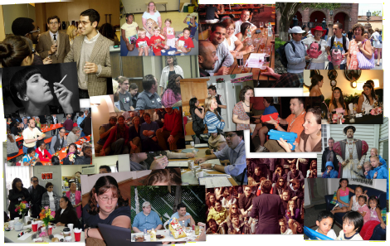
Motivation
[1] X. Zhu, D. Ramanan. Face Detection, Pose Estimation, and Landmark Localization in the Wild, in: CVPR, 2012.

Slide 3
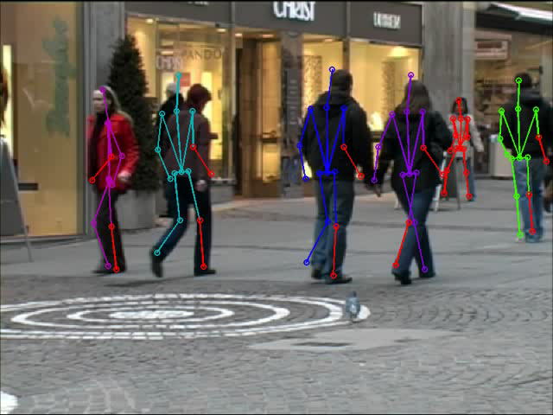
Motivation
[2] M. Andriluka, S. Roth, B. Schiele, Monocular 3d pose estimation and tracking by detection, in: CVPR, 2010.
Notes:
State of the Art of multi-people body pose estimation in cluttered scenes

Slide 4
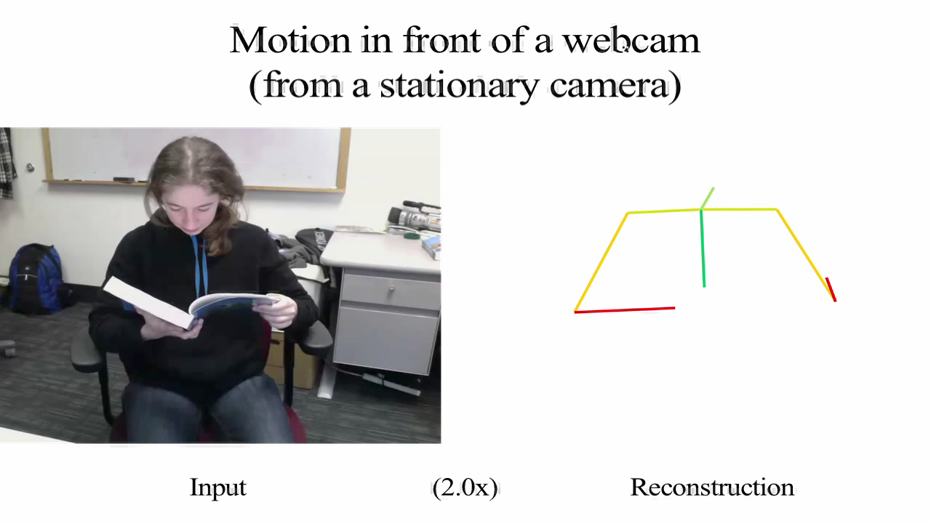
Motivation
[3] H. Park, Y. Sheikh, 3d reconstruction of a smooth articulated trajectory from a monocular image sequence, in: ICCV, 2011.

Slide 5
Outline
Taxonomy
State of the Art
Discussion
Goals
Project overview
Expected contributions
Working plan
State of research
Summary
5

Slide 6
Taxonomy
Appearance
Viewpoint
Spatial models
Temporal models
Behavior
Notes:
These sections are always observed in human pose estimation. Sometimes they are tacked into account explicitly and sometimes implicitly, for example choosing a certain BBDD or restricting the experiments to some points of view.

Slide 7


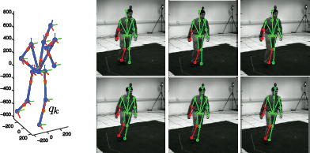
Taxonomy
Monocular 3d pose estimation and tracking by detection (Andriluka et al. 2010):
Appearance
Viewpoint
Spatial models
Temporal models
Behavior
“WALKING”

Slide 8
State of the Art
Appearance
Viewpoint
Spatial models
Temporal models
Behavior
Global
Local
Pixel-based
Logical

Slide 9


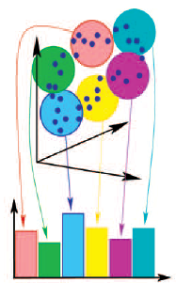
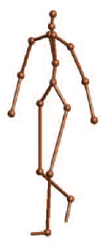
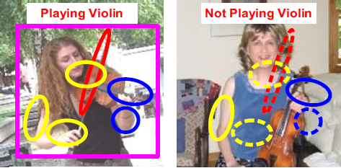
State of the Art
Global appearance
  Silhouettes and contours
  Global discriminative classifiers
  Global generative classifiers
Local appearance
  Edges, color and texture
  Motion
  Depth
  Templates
Pixel based
Logical
[4] H. Pirsiavash, D. Ramanan, Steerable part models, in: CVPR, 2012.
[5] A. Agarwal, B. Triggs, Recovering 3d human pose from monocular images, PAMI, 2006.
[6] B. Yao, L. Fei-fei, L.: Grouplet: A structured image representation for recognizing human and object interactions, 2010.
Notes:
Useful for initialization

Slide 10
State of the Art
Appearance
Viewpoint
Spatial models
Temporal models
Behavior
Discrete
Continuous

Slide 11
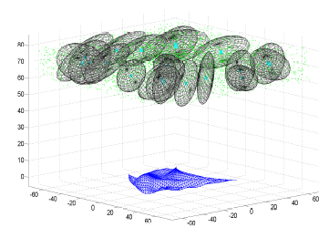
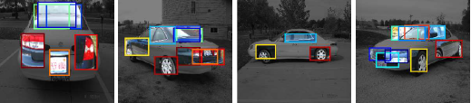
State of the Art
Discrete
Continuous
[7] M. Sun, H. Su, S. Savarese, L. Fei-Fei, A multi-view probabilistic model for 3d object classes, in: CVPR, 2009.
[2] M. Andriluka, S. Roth, B. Schiele, Monocular 3d pose estimation and tracking by detection, in: CVPR, 2010.
[8] J. Sanchez-Riera, J. Ostlund, P. Fua, F. Moreno-Noguer, Simultaneous pose, correspondence and non-rigid shape, in: CVPR, 2010.
Notes:
With the same spirit of…

Slide 12
State of the Art
Appearance
Viewpoint
Spatial models
Temporal models
Behavior
Probabilistic assemblies
of parts
Kinematic models

Slide 13
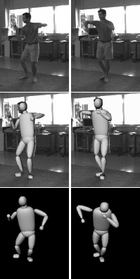
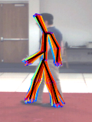
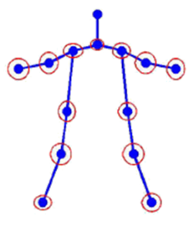
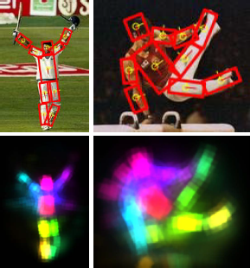
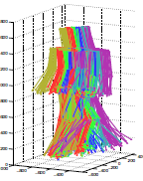
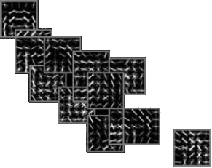
State of the Art
Probabilistic assemblies of parts
Kinematic models
[9] M. Andriluka, S. Roth, B. Schiele, Pictorial structures revisited: People detection and articulated pose estimation, in: CVPR, 2009.
[10] Y. Yang, D. Ramanan, Articulated pose estimation with exible mixtures-of-parts, in: CVPR, 2011.
[11] C. Sminchisescu, B. Triggs, Kinematic jump processes for monocular 3d human tracking, in: CVPR, 2003.
[12] E. Simo A. Ramisa, G. Alenyà, C. Torras, F. Moreno-Noguer, Single Image 3D Human Pose Estimation from Noisy Observations, CVPR,2012.
Notes:
3D recovery of human pose from monocular images is the most challenging situation
in human pose estimation due to projection ambiguities. Since information is lost during
the projection from real world to the image plane, several 3D poses match with 2D image
evidences [77]. Kinematic constraints on pose and movement are typically employed
to solve the inherent ambiguity in monocular human pose reconstruction. Therefore,
different works have focused on reconstruct the 3D pose given the 2D joint projections
from inverse kinematic, as well as the subsequent tracking.
Moreno-Noguer
The recovered number of Degrees of Freedom (DOF) varies greatly among dierent
works, from 10 DOF for upper body pose estimation, to full-body with more than 50
DOF. The number of possible poses is very high, even for a model with few DOF and
a discrete parameter space. Hence, kinematic constraints such as joint angle limits are
typically applied over kinematic models. Other solutions rely on reducing the dimensionality
by choosing characteristic poses [6] or using unsupervised techniques as Principal
Component Analysis (PCA). A set of distinctive pose priors is manually chosen in [6],
or learned from Motion Capture (MoCap) 3D data if available. For each dierent action
in database, keyposes are selected which result in discontinuities in pose energy. Then,
3D pose can be estimated by projecting pose priors onto the image evidence.

Slide 14
State of the Art
Appearance
Viewpoint
Spatial models
Temporal models
Behavior
Tracking
Motion models

Slide 15
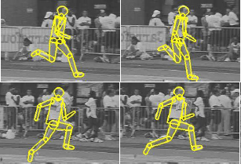
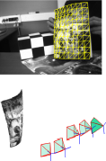
State of the Art
Tracking
Single, 2D, whole body Multiple, 3D, whole body Multiple, 3D,
“body” parts
[13] A. Agarwal, B. Triggs, Tracking articulated motion with piecewise learned dynamical models, in: ECCV, 2004.
[2] M. Andriluka, S. Roth, B. Schiele, Monocular 3d pose estimation and tracking by detection, in: CVPR, 2010.
[14] F. Moreno-Noguer, J. Porta, Probabilistic simultaneous pose and non-rigid shape recovery, in: CVPR, 2011.
Notes:
???
3D tracking with multiple hypothesis is considered in [11].
First, the whole body is tracked in 2D, then 3D poses at each frame are estimated
and propagated along all the sequence, nally the results are rened with a Bayesian
framework, achieving consistent tracking and 3D pose estimation for all frames. Note
that joint 3D pose and tracking allow an implicit tracking of the body parts.
In the topic
of shape recovery, a probabilistic formulation is presented in [56] which simultaneously
solves the camera pose and the non-rigid shape of a mesh (i.e. body pose in this topic)
in batch. Possible positions of landmarks (i.e. body parts/joints) and their covariances
are propagated

Slide 16
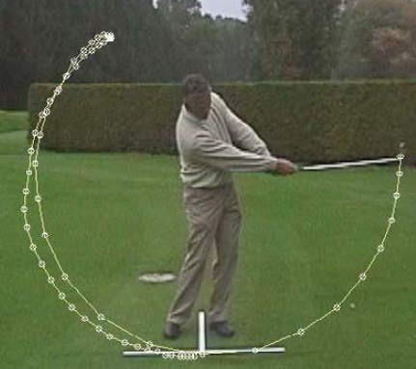
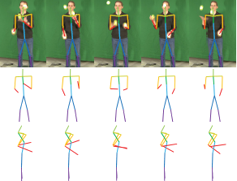
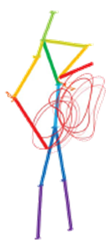




State of the Art
Motion models
Task-specific models General Models
[15] R. Urtasun, D. Fleet, P. Fua, Monocular 3d tracking of the golf swing, in: CVPR, 2005.
[3] H. Park, Y. Sheikh, 3d reconstruction of a smooth articulated trajectory from a monocular image sequence, in: ICCV, 2011.
Notes:
The human body can perform a huge diversity of movements, however specic actions
could be dened by smaller sets of movements (e.g. in cyclic actions as walking). In
this way, a set of motion priors can describe the whole body movements when a single
action is performed, though hard restrictions on the possible motions recovered are as
well established. A potential issue of motion priors is that the variety of movements that
can be described highly depends on the amount and diversity of the training data.
Statistical motion models are widely applied for human tracking and 3D pose estimation,
usually learned from Motion Capture (MoCap) using multi camera systems. Since
human body motions tend to be highly non-linear, common methods cluster the state
space and specically reduce the dimensionality in each region, where clusters are usually
directly related to activities being performed in the database. Dierent approaches
dier on the state representation and clustering methods, as well as in procedures for
dimensionality reduction.
Consecutive 3D positions of each body joint are clustered in [81], clusters being
described with their principal eigenvectors using Singular Value Decomposition (SVD).
Here, the reduction of dimensionality of human gestures helps to estimate the 3D pose
at each frame. In [76], the state space represented by joint angles is also clustered, PCA
is applied over each cluster to reduce the dimensionality and a Gaussian auto regressive
process is applied in order to deal with non-linearities of the human body performing
dierent actions. However, the number of possible movements in the video sequence is a
critical parameter, since a same action seen from dierent viewpoints can be interpreted
as dierent movements. In [85], motion models are learned from MoCap sequences of
walking and running. A reduction of dimensionality is performed by applying PCA over
sequences of joint angles from dierent examples. This work is extended in [86] for
modeling golf swings from monocular images. Scaled Gaussian Process Latent Variable
Models (SGPLVM) can also represent more dierent human motions [87] such as walking
and golf-swings together from monocular image sequences.
A clear weakness of using priors is overtting on the training data because they
can only generalize over a small set of specic movements. In [88], a general trajectory
based on the Discrete Cosine Transform (CDT) is introduced to reconstruct dierent
movements from, for example, faces and toys. In this case, trajectory model is combined
with spatial models of the tracked objects. Applications of such motion models related
to human pose can be found in [89], where it is achieved a 3D reconstruction of moving
points tracked from humans and scenes; as well in [90], where articulated trajectories
are reconstructed for upper body models.

Slide 17
State of the Art
Appearance
Viewpoint
Spatial models
Temporal models
Behavior
Activity
Context
Notes:
BBDD: indirect election of behavior

Slide 18
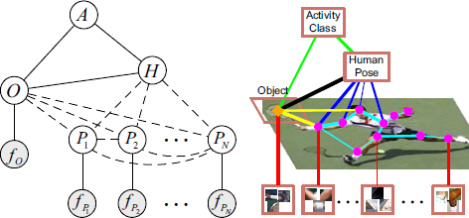
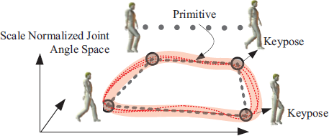
State of the Art
Activity
Context
[16] V. Singh, R. Nevatia, Action recognition in cluttered dynamic scenes using pose-specic part models, in: ICCV, IEEE, 2011.
[17] B. Yao, L. Fei-Fei, Modeling mutual context of object and human pose in human-object interaction activities, in: CVPR, IEEE, 2010.

Slide 19

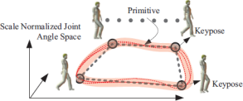
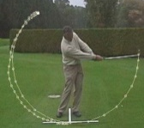

State of the Art (Examples)
Appearance
Viewpoint
Spatial models
Temporal models
Behavior
Local
Continuous
Probabilistic assemblies
of parts
Tracking
Activity
(Andriluka et al., 2010)
Local
Continuous
Kinematic models
-
Activity
(Simo-Serra et al., 2012)
Local
Discrete
Kinematic models
Tracking
Activity
(Singh & Nevatia, 2011)
Local
Discrete
Kinematic models
Motion models
Activity
(Urtasun et al., 2005)
Local
Discrete
Probabilistic assemblies
of parts
-
Context
(Yao & Fei-Fei, 2010)

Slide 20
State of the Art (Discussion)
Drawbacks | Hypotheses
Inaccurate 2D detectors | Spatial and temporal models should deal with such uncertainty
Drawbacks | Hypotheses
Inaccurate 2D detectors | Spatial and temporal models should deal with such uncertainty
3D pose priors are not often used in body pose estimation | Priors on 3D kinematic skeletons should decrease non-linearities of human body
Drawbacks | Hypotheses
Inaccurate 2D detectors | Spatial and temporal models should deal with such uncertainty
3D pose priors are not often used in body pose estimation | Priors on 3D kinematic skeletons should decrease non-linearities of human body
Non-linearities due to camera projection | Joint 3D body pose and camera viewpoint should decrease the non-linearities of body pose and camera projection
Drawbacks | Hypotheses
Inaccurate 2D detectors | Spatial and temporal models should deal with such uncertainty
3D pose priors are not often used in body pose estimation | Priors on 3D kinematic skeletons should decrease non-linearities of human body
Non-linearities due to camera projection | Joint 3D body pose and camera viewpoint should decrease the non-linearities of body pose and camera projection
3D pose priors are not often combined with motion models | Combined spatio-temporal priors should restrict the search space
Drawbacks | Hypotheses
Inaccurate 2D detectors | Spatial and temporal models should deal with such uncertainty
3D pose priors are not often used in body pose estimation | Priors on 3D kinematic skeletons should decrease non-linearities of human body
Non-linearities due to camera projection | Joint 3D body pose and camera viewpoint should decrease the non-linearities of body pose and camera projection
3D pose priors are not often combined with motion models | Combined spatio-temporal priors should restrict the search space
Both motion and spatial models are supposed to be independent | Jointly learned spatio-temporal models should improve the estimation efficiency
Drawbacks | Hypotheses
Inaccurate 2D detectors | Spatial and temporal models should deal with such uncertainty
3D pose priors are not often used in body pose estimation | Priors on 3D kinematic skeletons should decrease non-linearities of human body
Non-linearities due to camera projection | Joint 3D body pose and camera viewpoint should decrease the non-linearities of body pose and camera projection
3D pose priors are not often combined with motion models | Combined spatio-temporal priors should restrict the search space
Both motion and spatial models are supposed to be independent | Jointly learned spatio-temporal models should improve the estimation efficiency
Motion and spatial priors introduce hard restrictions on possible movements | Task-specific models should relax such constraints while maintaining efficiency
Drawbacks | Hypotheses
Inaccurate 2D detectors | Spatial and temporal models should deal with such uncertainty
3D pose priors are not often used in body pose estimation | Priors on 3D kinematic skeletons should decrease non-linearities of human body
Non-linearities due to camera projection | Joint 3D body pose and camera viewpoint should decrease the non-linearities of body pose and camera projection
3D pose priors are not often combined with motion models | Combined spatio-temporal priors should restrict the search space
Both motion and spatial models are supposed to be independent | Jointly learned spatio-temporal models should improve the estimation efficiency
Motion and spatial priors introduce hard restrictions on possible movements | Task-specific models should relax such constraints while maintaining efficiency
Lack of joint estimation of behavior and human pose | Different models should have a direct relation with the performed behavior
Notes:
Inaccurate state-of-the-art 2D detectors yield either estimations or partly miss some of the body parts. →
Spatial and temporal models should deal with such uncertainty
- Unlike motion priors, pose priors are not often used in body pose estimation →
Pose priors on 3D kinematic skeletons should decrease non-linearities of human body, usually magnified by non-linearities due to camera projection, improving flexibility and performance of kinematic models.
- non-linearities due to camera projection →
joint 3D body pose and camera viewpoint should decrease the non-linearities of body pose and camera projection, achieving more accurate results at the expense of increasing the computational time
- 3D pose priors are not often combined with motion models →
Combined spatio-temporal models should provide a robust framework to estimate 3D body pose from monocular image sequences in a small number of
frames.
- Both motion models and spatial models are attempts to explain spatio-temporal deformations in different dimensions. Nevertheless, they are supposed to be independent and both learnings are performed separately. Therefore, important information for human motion only noticed in a joint domain could be ignored because of a poor relevance in temporal or in spatial domains separately. In addition, independent learning and application of both models leads to a bottleneck of computational time and memory storage. →
jointly learned spatio-temporal models should decrease the stored data and the estimation time, while providing similar or even better results.
- Motion and spatial priors reduce the search space, in spite of limiting the human poses and movements which can be detected by the system →
Choosing the specific model, depending on the pose or motion that is being performed, should relax the hard prior constraints while maintaining the reduced search space in multi-activity databases.
- →
model should have a direct relation with the activity or behavior that is being detected: jointly estimate behavior and human pose

Slide 21
Goals
Research and design public databases
Research on state-of-the-art body part descriptors
3D task-specific pose priors
Joint body pose and viewpoint estimation
General vs. action specific motion models
Joint learning of motion priors and body pose priors
Joint estimation of behavior and human pose

Slide 22
Overview
Behavior
Appearance
Temporal models
Appearance
Viewpoint
Spatial models
Temporal models
Behavior
Spatial models
Viewpoint

Slide 23
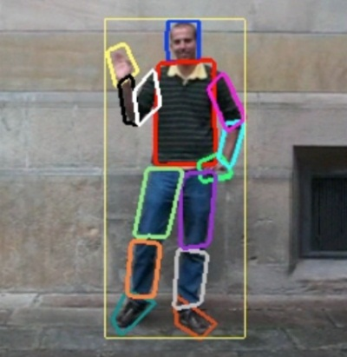








Overview
Behavior
Body part detectors
Motion priors
Image sequence
3D human motion
$$t_{n}$$
$$t_{1}$$
$$t_{2}$$
Camera pose space
Camera pose (viewpoint)
3D human pose
Pose priors
23

Slide 24
Expected Contributions
3D human pose recovery from 2D part detectors, making temporal and spatial computations in 3D
Joint estimate of the body pose and the camera viewpoint from monocular image sequences
Search space reduction by the combination of both motion and body priors
Joint estimation of behavior and human pose

Slide 25
Working Plan
State of the Art
BBDD & Part detectors
3D body pose from 2D image evidences
3D body tracking
3D body pose and viewpoint estimation
Feedback from activity
App. in real scenarios
Compilation of results
25

Slide 26
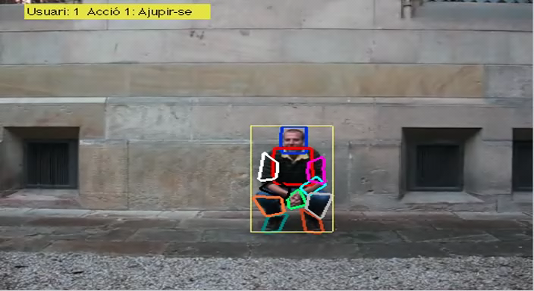
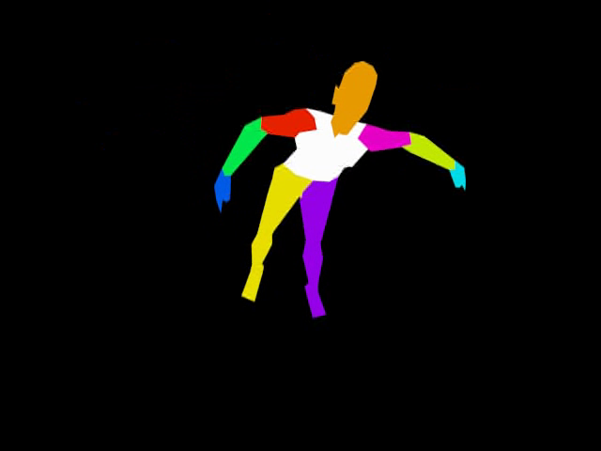
State of Research
Databases:
  Manually labeled body parts in video sequences
  3D human poses compilation
26

Slide 27
State of Research
Published papers:
  X. Perez-Sala, C. Angulo, S. Escalera, Biologically inspired path execution using surf flow in robot navigation, in: ACI, Springer, 2011.
  X. Perez-Sala, C. Angulo Bahón, S. Escalera, Biologically inspired turn control for autonomous mobile robots, in: CCIA, IOS Press, 2011.
  O. Franco Genís, X. Perez-Sala, C. Angulo Bahón, Identificación y seguimiento de personas usando kinect por parte de un robot seguidor, in: JARCA, Universidad de Sevilla, 2011.
  X. Perez-Sala, L. Igual, S. Escalera, C. Angulo, Uniform Sampling of Rotations for Discrete and Continuous Learning of 2D Shape Models, IGI Global, Spain, 2012.
  X. Perez-Sala, S. Escalera, C. Angulo, Survey on spatio-temporal view invariant human pose recovery, in: CCIA, 2012.
  A. Hernandez-Vela, M. Bautista, X. Perez-Sala, V. Ponce, X. Baró, O. Pujol, C. Angulo, S. Escalera, Bovdw: Bag-of-visual-and-depth-words for gesture recognition, in: ICPR, 2012.
27
Notes:
1. Biologically inspired path execution using SURF flow in robot navigation [29]: In the field of social robotics, has been completed research on detectors and descriptors based on RGB cues, as well as using motion.
2. Biologically Inspired Turn Control for Autonomous Mobile Robots [30]: Complementing the previous work [29], egomotion is studied in this paper in order to compute motion information from monocular image sequences.
3. Identificación y seguimiento de personas usando kinect por parte de un robot seguidor [34]: Tracking of people by applying color histograms was proposed in this work to follow people with a social robot.
4. Uniform Sampling of Rotations for Discrete and Continuous Learning of 2D Shape Models [55]: Diferent approaches to uniform samplings of rotations are reviewed in this book chapter with the final goal of building statistical models.
5. BoVDW: Bag-of-Visual-and-Depth-Words for Gesture Recognition [38]: A framework is proposed to classify human gestures from RGB features, as well as using motion combined with depth information.

Slide 28
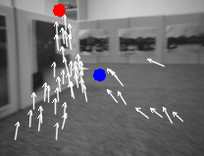
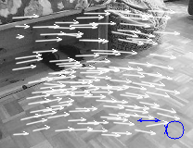
State of Research
From edges & motion features to control the robot movement
28

Slide 29
State of Research
Published papers:
  X. Perez-Sala, C. Angulo, S. Escalera, Biologically inspired path execution using surf flow in robot navigation, in: ACI, Springer, 2011.
  X. Perez-Sala, C. Angulo Bahón, S. Escalera, Biologically inspired turn control for autonomous mobile robots, in: CCIA, IOS Press, 2011.
  O. Franco Genís, X. Perez-Sala, C. Angulo Bahón, Identificación y seguimiento de personas usando kinect por parte de un robot seguidor, in: JARCA, Universidad de Sevilla, 2011.
  X. Perez-Sala, L. Igual, S. Escalera, C. Angulo, Uniform Sampling of Rotations for Discrete and Continuous Learning of 2D Shape Models, IGI Global, Spain, 2012.
  X. Perez-Sala, S. Escalera, C. Angulo, Survey on spatio-temporal view invariant human pose recovery, in: CCIA, 2012.
  A. Hernandez-Vela, M. Bautista, X. Perez-Sala, V. Ponce, X. Baró, O. Pujol, C. Angulo, S. Escalera, Bovdw: Bag-of-visual-and-depth-words for gesture recognition, in: ICPR, 2012.
29
Notes:
1. Biologically inspired path execution using SURF flow in robot navigation [29]: In the field of social robotics, has been completed research on detectors and descriptors based on RGB cues, as well as using motion.
2. Biologically Inspired Turn Control for Autonomous Mobile Robots [30]: Complementing the previous work [29], egomotion is studied in this paper in order to compute motion information from monocular image sequences.
3. Identificación y seguimiento de personas usando kinect por parte de un robot seguidor [34]: Tracking of people by applying color histograms was proposed in this work to follow people with a social robot.
4. Uniform Sampling of Rotations for Discrete and Continuous Learning of 2D Shape Models [55]: Diferent approaches to uniform samplings of rotations are reviewed in this book chapter with the final goal of building statistical models.
5. BoVDW: Bag-of-Visual-and-Depth-Words for Gesture Recognition [38]: A framework is proposed to classify human gestures from RGB features, as well as using motion combined with depth information.

Slide 30
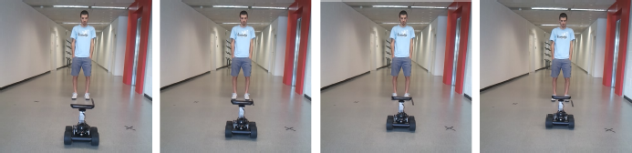
State of Research
From people tracking by depth & color to robot movement
30

Slide 31
State of Research
Published papers:
  X. Perez-Sala, C. Angulo, S. Escalera, Biologically inspired path execution using surf flow in robot navigation, in: ACI, Springer, 2011.
  X. Perez-Sala, C. Angulo Bahón, S. Escalera, Biologically inspired turn control for autonomous mobile robots, in: CCIA, IOS Press, 2011.
  O. Franco Genís, X. Perez-Sala, C. Angulo Bahón, Identificación y seguimiento de personas usando kinect por parte de un robot seguidor, in: JARCA, Universidad de Sevilla, 2011.
  X. Perez-Sala, L. Igual, S. Escalera, C. Angulo, Uniform Sampling of Rotations for Discrete and Continuous Learning of 2D Shape Models, IGI Global, Spain, 2012.
  X. Perez-Sala, S. Escalera, C. Angulo, Survey on spatio-temporal view invariant human pose recovery, in: CCIA, 2012.
  A. Hernandez-Vela, M. Bautista, X. Perez-Sala, V. Ponce, X. Baró, O. Pujol, C. Angulo, S. Escalera, Bovdw: Bag-of-visual-and-depth-words for gesture recognition, in: ICPR, 2012.
31
Notes:
1. Biologically inspired path execution using SURF flow in robot navigation [29]: In the field of social robotics, has been completed research on detectors and descriptors based on RGB cues, as well as using motion.
2. Biologically Inspired Turn Control for Autonomous Mobile Robots [30]: Complementing the previous work [29], egomotion is studied in this paper in order to compute motion information from monocular image sequences.
3. Identificación y seguimiento de personas usando kinect por parte de un robot seguidor [34]: Tracking of people by applying color histograms was proposed in this work to follow people with a social robot.
4. Uniform Sampling of Rotations for Discrete and Continuous Learning of 2D Shape Models [55]: Diferent approaches to uniform samplings of rotations are reviewed in this book chapter with the final goal of building statistical models.
5. BoVDW: Bag-of-Visual-and-Depth-Words for Gesture Recognition [38]: A framework is proposed to classify human gestures from RGB features, as well as using motion combined with depth information.

Slide 32
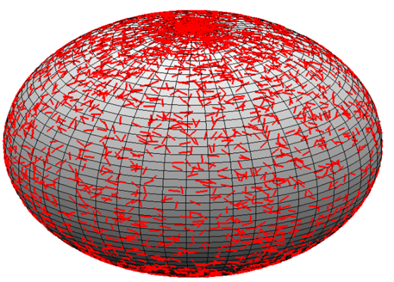
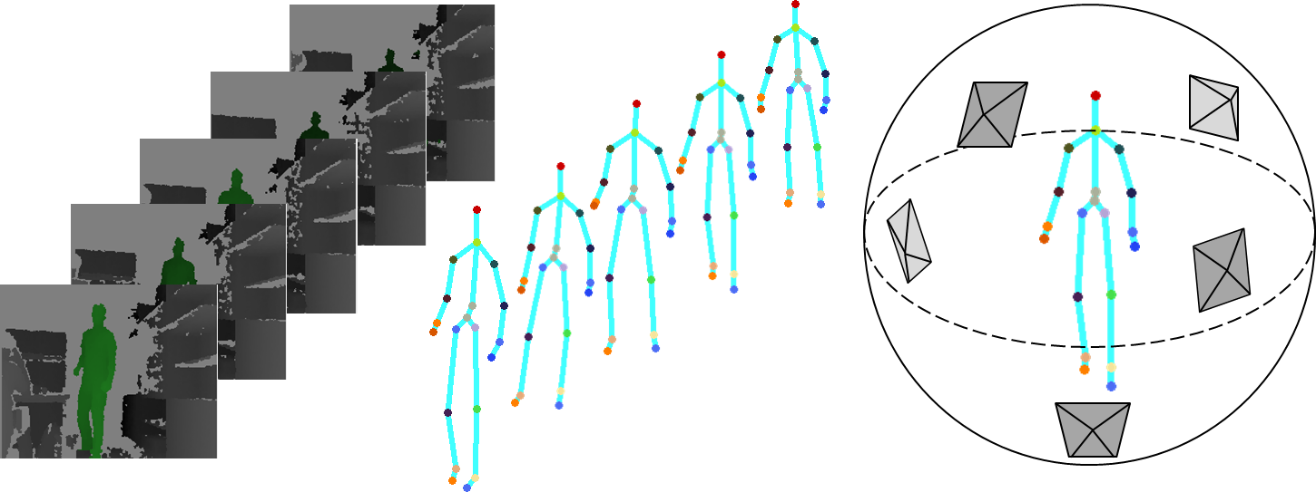
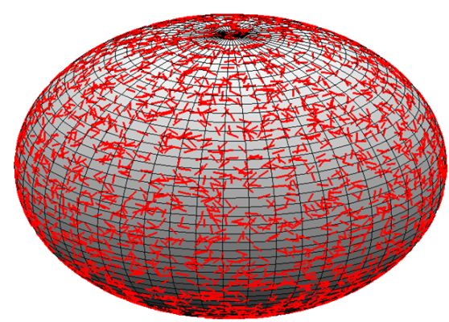
State of Research
Uniform sampling strategies to create models from 3D objects
32

Slide 33
State of Research
Published papers:
  X. Perez-Sala, C. Angulo, S. Escalera, Biologically inspired path execution using surf flow in robot navigation, in: ACI, Springer, 2011.
  X. Perez-Sala, C. Angulo Bahón, S. Escalera, Biologically inspired turn control for autonomous mobile robots, in: CCIA, IOS Press, 2011.
  O. Franco Genís, X. Perez-Sala, C. Angulo Bahón, Identificación y seguimiento de personas usando kinect por parte de un robot seguidor, in: JARCA, Universidad de Sevilla, 2011.
  X. Perez-Sala, L. Igual, S. Escalera, C. Angulo, Uniform Sampling of Rotations for Discrete and Continuous Learning of 2D Shape Models, IGI Global, Spain, 2012.
  X. Perez-Sala, S. Escalera, C. Angulo, Survey on spatio-temporal view invariant human pose recovery, in: CCIA, 2012.
  A. Hernandez-Vela, M. Bautista, X. Perez-Sala, V. Ponce, X. Baró, O. Pujol, C. Angulo, S. Escalera, Bovdw: Bag-of-visual-and-depth-words for gesture recognition, in: ICPR, 2012.
33
Notes:
1. Biologically inspired path execution using SURF flow in robot navigation [29]: In the field of social robotics, has been completed research on detectors and descriptors based on RGB cues, as well as using motion.
2. Biologically Inspired Turn Control for Autonomous Mobile Robots [30]: Complementing the previous work [29], egomotion is studied in this paper in order to compute motion information from monocular image sequences.
3. Identificación y seguimiento de personas usando kinect por parte de un robot seguidor [34]: Tracking of people by applying color histograms was proposed in this work to follow people with a social robot.
4. Uniform Sampling of Rotations for Discrete and Continuous Learning of 2D Shape Models [55]: Diferent approaches to uniform samplings of rotations are reviewed in this book chapter with the final goal of building statistical models.
5. BoVDW: Bag-of-Visual-and-Depth-Words for Gesture Recognition [38]: A framework is proposed to classify human gestures from RGB features, as well as using motion combined with depth information.

Slide 34
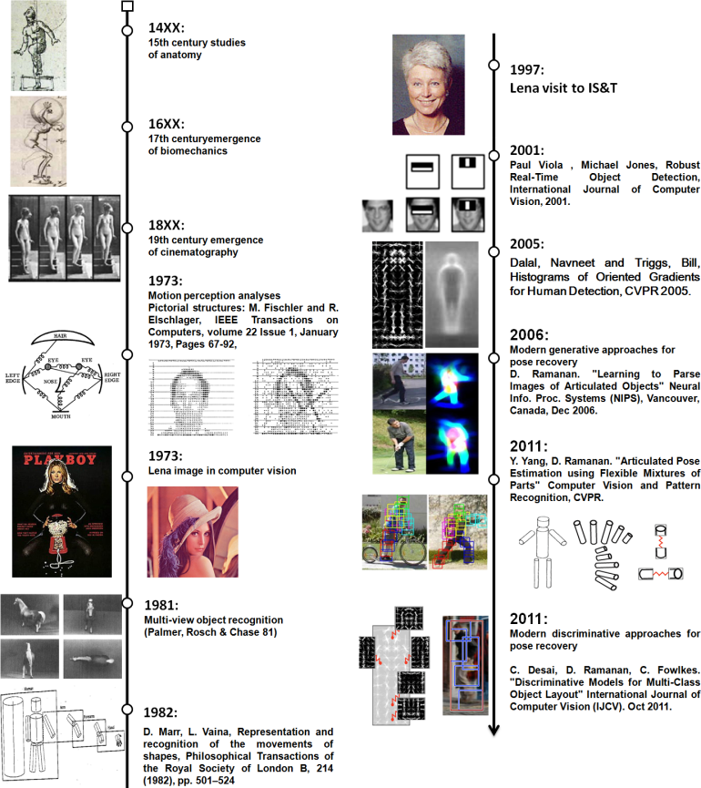
State of Research
Appearance
Viewpoint
Spatial models
Temporal models
Behavior
Survey of human pose estimation, proposing a new taxonomy
34

Slide 35
State of Research
Published papers:
  X. Perez-Sala, C. Angulo, S. Escalera, Biologically inspired path execution using surf flow in robot navigation, in: ACI, Springer, 2011.
  X. Perez-Sala, C. Angulo Bahón, S. Escalera, Biologically inspired turn control for autonomous mobile robots, in: CCIA, IOS Press, 2011.
  O. Franco Genís, X. Perez-Sala, C. Angulo Bahón, Identificación y seguimiento de personas usando kinect por parte de un robot seguidor, in: JARCA, Universidad de Sevilla, 2011.
  X. Perez-Sala, L. Igual, S. Escalera, C. Angulo, Uniform Sampling of Rotations for Discrete and Continuous Learning of 2D Shape Models, IGI Global, Spain, 2012.
  X. Perez-Sala, S. Escalera, C. Angulo, Survey on spatio-temporal view invariant human pose recovery, in: CCIA, 2012.
  A. Hernandez-Vela, M. Bautista, X. Perez-Sala, V. Ponce, X. Baró, O. Pujol, C. Angulo, S. Escalera, Bovdw: Bag-of-visual-and-depth-words for gesture recognition, in: ICPR, 2012.
35
Notes:
1. Biologically inspired path execution using SURF flow in robot navigation [29]: In the field of social robotics, has been completed research on detectors and descriptors based on RGB cues, as well as using motion.
2. Biologically Inspired Turn Control for Autonomous Mobile Robots [30]: Complementing the previous work [29], egomotion is studied in this paper in order to compute motion information from monocular image sequences.
3. Identificación y seguimiento de personas usando kinect por parte de un robot seguidor [34]: Tracking of people by applying color histograms was proposed in this work to follow people with a social robot.
4. Uniform Sampling of Rotations for Discrete and Continuous Learning of 2D Shape Models [55]: Diferent approaches to uniform samplings of rotations are reviewed in this book chapter with the final goal of building statistical models.
5. BoVDW: Bag-of-Visual-and-Depth-Words for Gesture Recognition [38]: A framework is proposed to classify human gestures from RGB features, as well as using motion combined with depth information.

Slide 36
State of Research
Submitted papers:
  M. Bautista, A. Hernandez-Vela, V. Ponce, X. Perez-Sala, X. Baró, O. Pujol, C. Angulo, S. Escalera, Probability-based dynamic time warping for gesture recognition, in: WDIA.
  L. Igual, X. Perez-Sala, S. Escalera, C. Angulo, F. De la Torre, Continuous alternative to generalized procrustes analysis, PAA.
36
Notes:
6. Probability-based Dynamic Time Warping for Gesture Recognition [39]: A probabilistic approach to Dynamic Time Warping is proposed in this work in a framework of gesture classification.
7. Survey on Spatio-Temporal View Invariant Human Pose Recovery [14]: This paper is a survey of human pose estimation, where classical methods are reviewed and compared with current trends in this topic.
8. Continuous Alternative to Generalized Procrustes Analysis [74]: In this work, 2D shape models are learned from 3D objects, in order to avoid typical problems of learning certain 2D projections of 3D data.

Slide 37
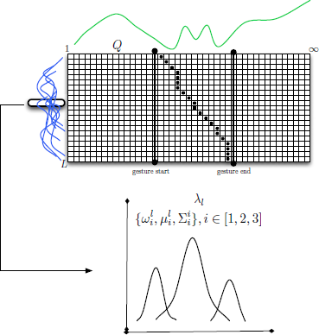
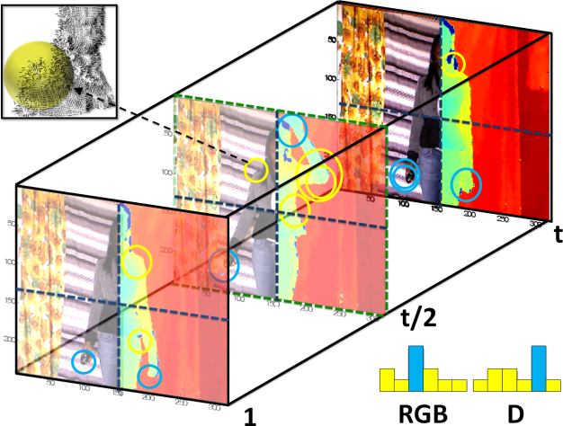
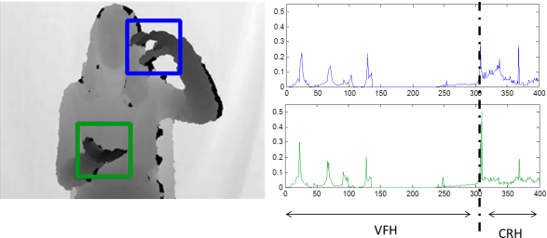
State of Research
Novel RGB-D-motion descriptors applied to gesture recognition
37

Slide 38
State of Research
Submitted papers:
  M. Bautista, A. Hernandez-Vela, V. Ponce, X. Perez-Sala, X. Baró, O. Pujol, C. Angulo, S. Escalera, Probability-based dynamic time warping for gesture recognition, in: WDIA.
  L. Igual, X. Perez-Sala, S. Escalera, C. Angulo, F. De la Torre, Continuous alternative to generalized procrustes analysis, PAA.
38
Notes:
6. Probability-based Dynamic Time Warping for Gesture Recognition [39]: A probabilistic approach to Dynamic Time Warping is proposed in this work in a framework of gesture classification.
7. Survey on Spatio-Temporal View Invariant Human Pose Recovery [14]: This paper is a survey of human pose estimation, where classical methods are reviewed and compared with current trends in this topic.
8. Continuous Alternative to Generalized Procrustes Analysis [74]: In this work, 2D shape models are learned from 3D objects, in order to avoid typical problems of learning certain 2D projections of 3D data.

Slide 39
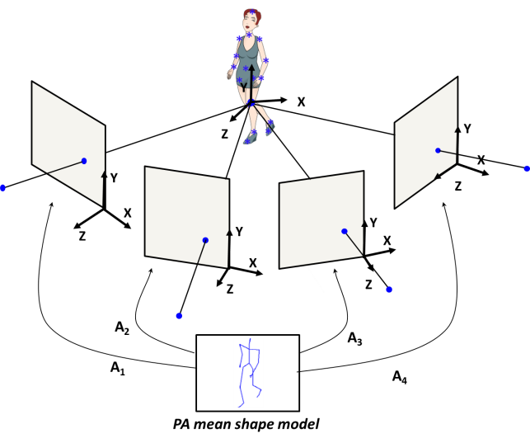
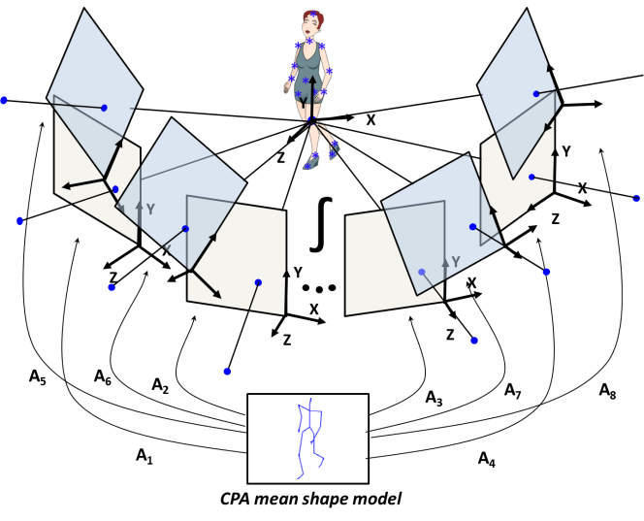



State of Research
A: Value
A: Functional
Continuous formulation of Procrustes Analysis, applied to build 2D models of 3D faces and human bodies
39

Slide 40
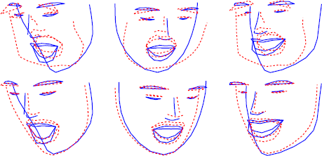
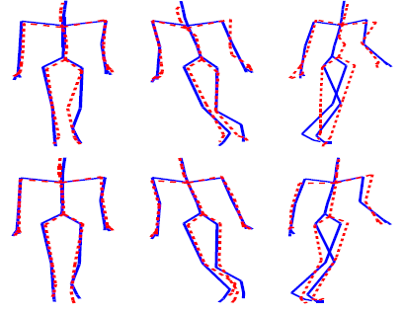
State of Research
Continuous formulation of Procrustes Analysis, applied to build 2D models of 3D faces and human bodies
40

Slide 41
State of Research
Behavior
Body part detectors
- Gesture recognition (5, 6)
- RGB and motion (1, 2)
- Depth detectors (5)
Motion priors
Image sequence
3D human motion
$$t_{n}$$
$$t_{1}$$
$$t_{2}$$
- People tracking (3)
- Uniform rotations (4)
Camera pose space
Camera pose (viewpoint)
3D human pose
Pose priors
- Human pose survey (7)
- Statistical models (8)

Slide 42
Summary
Revision of the State of the Art methods for HPR
Definition of a new taxonomy for HPR
Discussion of drawbacks and possibilities of current HPR methods
Goals of the thesis
Overview of the complete framework
Expected contributions of the thesis
Working plan: tasks and timing of the project
State of research: BBDD and publications
42

Slide 43
Thank you!

