Slide 1

Biologically Inspired Turn Control for Autonomous Mobile Robots
Xavier Perez-Sala, Cecilio Angulo, Sergio Escalera

Slide 2
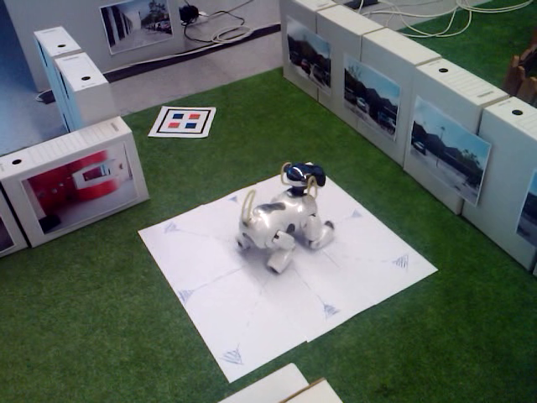
Motivation

Slide 3
Motivation
Path planning
Robot navigation
Path execution
Unexpected behaviour
Path execution control is needed !

Slide 4
Overview
General path execution control
Turn control
Only using: Camera images + “neck” sensor
Without: Artificial landmarks, egomotion
Consecutive frames → Motion information
Successfully tested on Sony Aibo

Slide 5
Biological inspiration
Goal Oriented Human Motion
Mobile Robotics
3-4 years:
Head stabilization
4-6 years:
Egocentric representation of the environment
7-8 years:
Landmarks → Intermediate
goals
9-10 years:
Exocentric representations
Anticipatory movements
Artificial vestibular systems
Odometry, Egomotion...
Navigation using landmarks
SLAM
This work!

Slide 6
Biological inspiration
Goal Oriented Human Motion
Mobile Robotics
3-4 years:
Head stabilization
4-6 years:
Egocentric representation of the environment
7-8 years:
Landmarks → Intermediate
goals
9-10 years:
Exocentric representations
Anticipatory movements
Artificial vestibular systems
Odometry, Egomotion...
Navigation using landmarks
SLAM
This work!

Slide 7
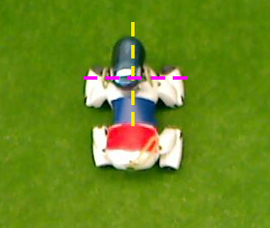
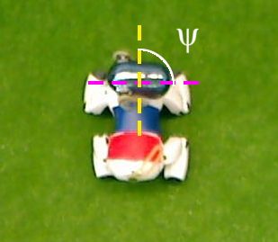
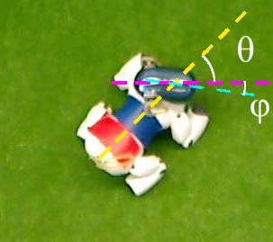
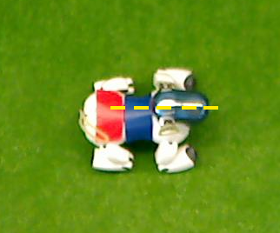
Turn Control (I)
Initial Stage
Head rotation to the desired angle (Set point)
Body-head alignment (body control + head control)
Final orientation (Body and head aligned)

Slide 8
Turn Control (II)
Body-Head alignment
Rotation Angle
SURF flow

Slide 9
Body-Head alignment
Body-Head alignment
Rotation Angle
SURF flow

Slide 10
Body-Head alignment
Head Control
Set point: Maintain head orientation
Action: “Pan” angle θ
Error: Instantaneous head rotation ϕ
Body Control
Set point: Align the neck
Action: Walk velocity
Error: “Pan” angle θ
Notes:
Body Control rotates the whole robot

Slide 11
Rotation Angle
Body-Head alignment
Rotation Angle
SURF flow

Slide 12
Rotation Angle (I)
Motion field:
Projection of 3-D relative velocity vectors of the
scene points onto the 2-D image plane
Pure rotations:
Vectors show the image distortion due to camera
rotation
Notes:
The motion field has a parabolic non-linearity, which is due to perspective → Parallel vectors of the same length

Slide 13
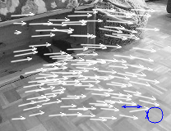
Rotation Angle (II)
Optical flow:
2-D displacements of brightness patterns in the
image
Optical flow = Motion field ?

Slide 14
Rotation Angle (III)
Restriction:
Rotation axis match the image plane
Robot (Sony Aibo):
Rotation involves a small translation
Assumption:
Pure rotation + noise in the measure
Notes:
Rotation involves a translation of the camera

Slide 15
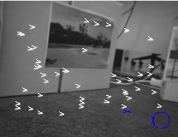
Rotation Angle (IV)

Slide 16
SURF Flow
Body-Head alignment
Rotation Angle
SURF flow

Slide 17
SURF Flow(I)
Optical flow restrictions:
Brightness constancy
Temporal persistence
Spatial coherence

Slide 18
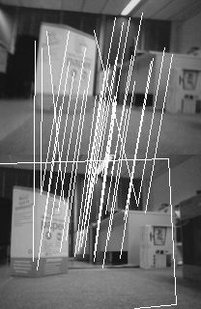
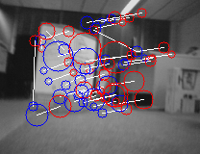
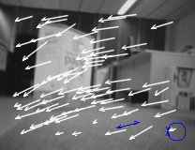
SURF Flow(II)
Corner detection
SURF description & selection
Correspondences
Parallel vectors
Mean length & mean angle

Slide 19
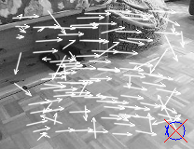
SURF Flow(III)
Correspondences:
Refinement:

Slide 20
Experiments
Rotation angle
Robot turning
Robot: Sony Aibo ERS-7
PC - robot processing (wireless)
Sampling time: 100ms
Rotation measured using a zenithal camera

Slide 21
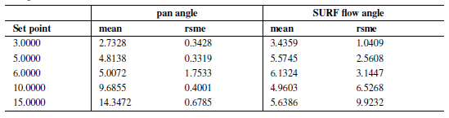
Rotation Angle

Slide 22
Rotation Angle
Maximum rotation/sampling time = 3º

Slide 23
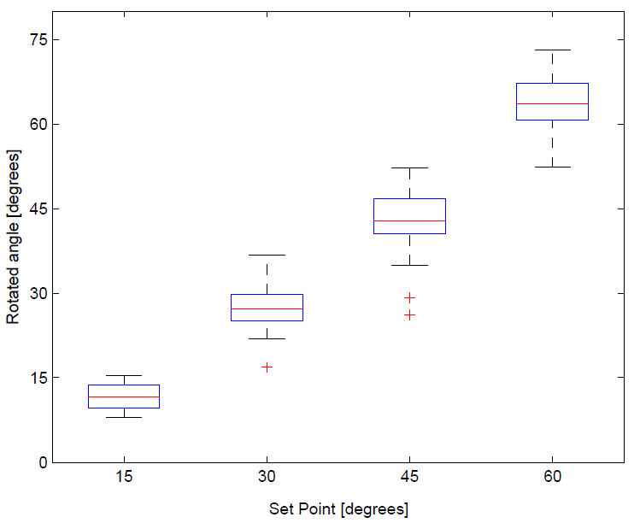
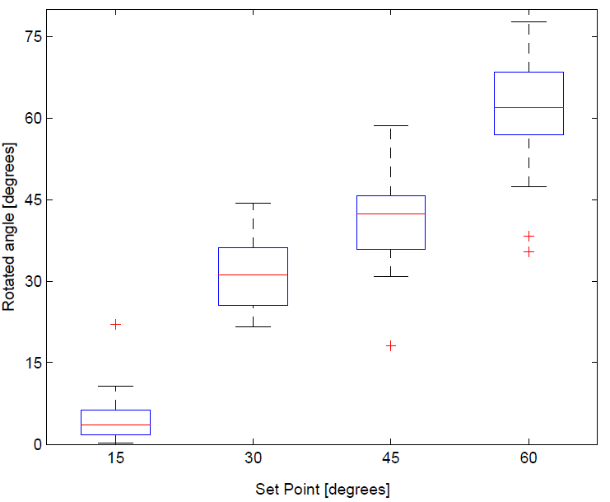
Robot turning
Specific software:
General approach:

Slide 24
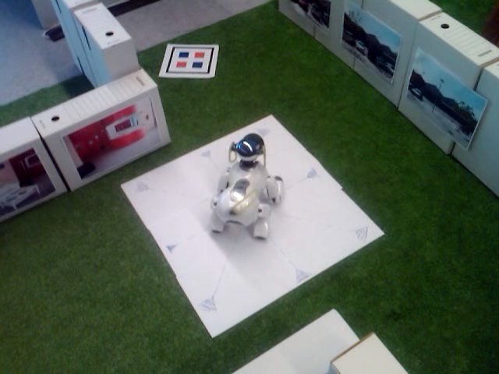
Results

Slide 25

Straight Forward (I)

Slide 26
Straight Forward (II)

Slide 27
Conclusions
Only camera images and neck sensor are used
Biologically inspired navigation
Without artificial landmarks or egomotion
Similar results that to specific system
  Rotations > 15º
Exportable system
Problems with wireless connection

Slide 28
Future work
Test on other platforms
Correct robot trajectory using motor information
Sampling rate decreasing

Slide 29
Thanks for your attention
Questions?

