Slide 1



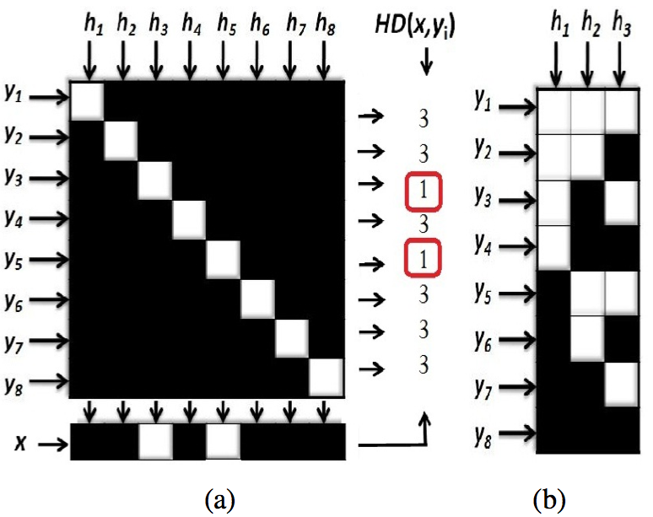
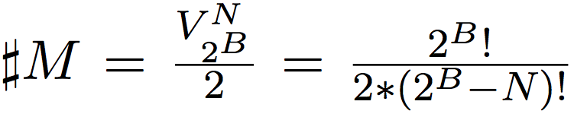
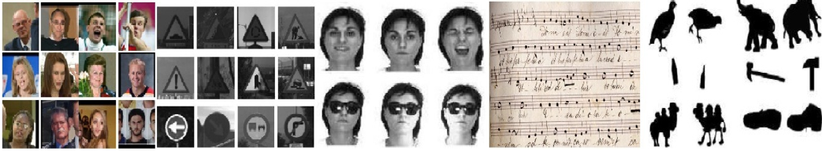
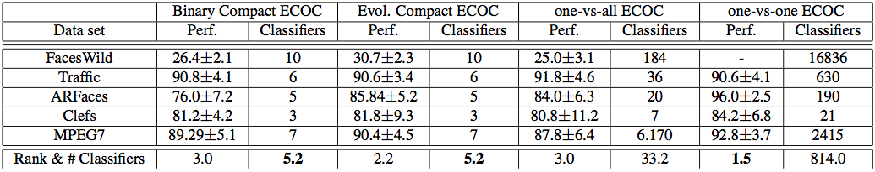
Compact Design of ECOC for Multi-class Object Categorization
Miguel Angel Bautista, Sergio Escalera, Xavier Baró, Oriol Pujol, Petia Radeva and Jordi Vitria
Computer Vision Center, Universitat Autònoma de Barcelona, 08193 Cerdanyola, Spain
Dept. Matemàtica Aplicada i Anàlisi, UB, Gran Via 585,
08007, Barcelona, Spain {mbautista,sescalera,xavier.baro,oriol.pujol,petia,jordi.vitria}@cvc.uab.es
Sub-title
Abstract
We propose a Compact design of Error Correcting Output Codes (ECOC) in terms of the number of dichotomizers. Evolutionary computation is used for tuning the parameters of the classifiers and looking for the best Compact ECOC code configuration. The results over several challenging multi-class Computer Vision problems show comparable and even better results than state- of-the-art ECOC methodologies with far less cost.
1. Error Correcting Output Codes (ECOC)
2. Compact ECOC
A common way to deal with Multi-class Object Categorization problems is by means of a divide- and-conquer approach. In this scope, ECOC have been applied with successful results.
Given a set of N classes to be learnt in an ECOC framework, n different bi-partitions (two groups of classes) are formed, and n binary problems (dichotomizer) are trained.
A codeword of length n is obtained for each class, where each position (bit) of the code corresponds to a response of a given dichotomizer (coded by +1 or -1 according to their class set membership).
Arranging the codewords as rows of a matrix, we define a coding matrix M, where M ∈ {−1, +1} N×n in the binary case. In the case of the ternary symbol-based ECOC, the cod- ing matrix becomes M ∈ {−1, 0, +1} N×n where the symbol zero means that a particular class is not considered for a given classifier.
During the decoding process, applying n binary classifiers, a code x is obtained for each data sample ρ in the test set.
The one-versus-all ECOC coding has been widely applied in the binary ECOC framework (see Fig- ure 1(a)). Given N classes to be coded, the one- versus-all codification is of length N.
We can take advantage of the information theory principles to obtain a more compact definition of the codewords. Having a N-class problem, the minimum number of bits necessary to codify and univocally distinguish N codes is B = ⌈log2 N ⌉, where ⌈.⌉ rounds to the upper inte ger, an example can be seen in figure 1(b).
2. Evolutionary Compact Parametrization
Figure 1. Example for Hamming Decoding (a) and Compact Coding (b)
Given N classes, the number of ECOC matrices that can be build is shown in the expression above. In these type of scenarios, where the search space is huge, evolutionary approaches, in special Genetic Algorithms, are often introduced with good results.
instead of using a predefined Com- pact coding matrix, we also propose the design of a different compact codification of M based on the distribution of the data and the characteristics of the applied base classifier, which can increase the discrimination capabilities of the system.
Finding a suitable Compact ECOC matrix for a N−class problem requires to explore all the pos- sible N × B binary matrices, where B is the minimum codeword length in order to define a valid ECOC matrix
The first step in order to use an evolutionary algorithm is to define the problem encoding, which consists of the representation of a certain solution or point in the search space by means of a genotype or alternatively a chromosome. In our case, the ECOC matrices are represented by means of binary coding.
Once the encoding is defined, we need to define the adaptation function, which associates to each individual its adaptation value to the environment. In the case of the ECOC framework, the adaptation value is related to the classification error.
We use the standard Genetic Algorithm in order to evolve the Compact ECOC matrices. During the evolutionary process, we use a scattered crossover operator. In order to introduce variations to the individuals, we use mutation operator that adds a unit Gaussian distributed random value to the chosen gene.
In this paper we adopt the Support Vector Machines with Gaussian Radial Basis Functions as kernel (SVM-RBF). In the specific case of Gaussian RBF kernels, we need to learn the kernel parameters C and γ, which have a close relation to the data distribution. IWe use Genetic Algorithms in order to find good values for C and γ parameters.
4. Experiments and results
We apply the methodology in five chal-lenging computer vision categorization problems. Labeled Faces in the Wild (184 face categories). We use a real traffic sign categorization problem (36 traffic sign classes). Third, the ARFaces dataset (20 classes). Fourth, we classify old scanned music scores (7 score categories), and fifth, we classify the MPEG7 dataset (70 object categories).
5. CONCLUSIONS
[1] K. DeJong. An analysis of the behavior of a
class of genetic adaptive systems. PhD thesis,
Ann Arbor, MI, USA, 1975.
[2] S. Escalera, O. Pujol, and P.Radeva. On the decoding
process in ternary error-correcting output
codes. IEEE PAMI, 99(1), 2009.
[3] G. B. Huang, M. Ramesh, T. Berg, and
E. Learned-Miller. Labeled faces in the wild.
Technical Report 07-49, University of Massachusetts,
Amherst, October 2007.
We presented a general methodology for the classification of several object categories which only requires ⌈log2 N⌉ classifiers for a N-class problem. The methodology is defined in the ECOC framework, designing a Compact coding matrix which univocally distinguish N codes. Moreover, in or- der to speed up the design of the coding matrix and the tuning of the classifiers, evolutionary computation is also applied.
Results over different Computer Vision problems show comparable ever better results than traditional ECOC designs with far less number of dichotomizers.

