Slide 1
Automatic User Interaction Correction via Multi-label Graph-cuts
Workshop on Human Interaction in Computer Vision
12nd November 2011
Antonio Hernández-Vela, Carlos Primo and Sergio Escalera

Slide 2
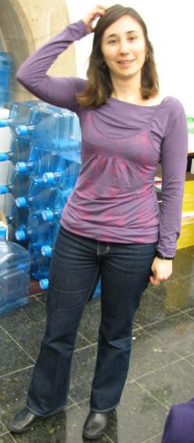
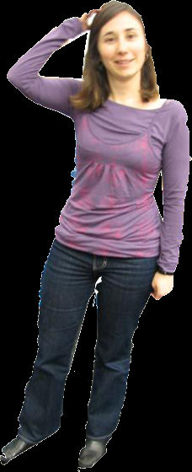
Semi-automatic segmentation
Notes:
Image segmentation exist semi-automatic algorithms require user interaction. For example…

Slide 3
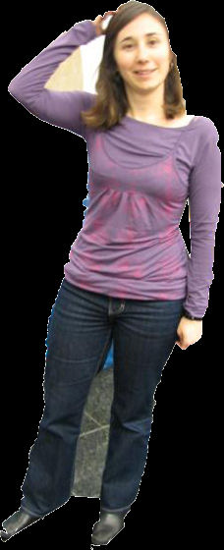
Semi-automatic segmentation
Notes:
What happens if the user interaction contain errors

Slide 4
Outline
Introduction
Methodology
Experiments & results
Conclusion
Notes:
Outline of the presentation

Slide 5
Introduction
How much interaction is required from the user?
What if the user makes a mistake?
Automatic correction
Multi-label approach
X
X
Notes:
In this work we wanted to see how much interaction
What happens if the user makes a mistake
Think of an automatic correction of the user labelling
Finally, we want to do that in a multi-label approach

Slide 6
Outline
Introduction
Methodology
Experiments & results
Conclusion

Slide 7
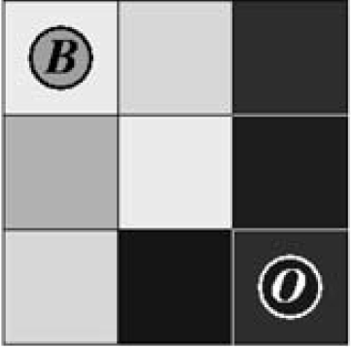
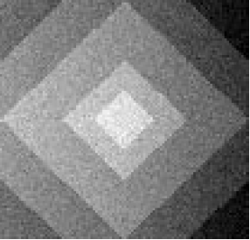
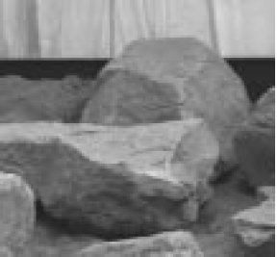
Multi-label graph-cuts¹
Energy minimization framework
Image restoration
Stereo reconstruction
Image segmentation
¹ Y. Boykov, O. Veksler, and R. Zabih. Fast approximate energy minimization via graph cuts. PAMI, nov 2001.
Notes:
In this work we have used the Graph-cuts energy minimization framework. This framework has been applied to problems llike image restoration,stereo reconstruction, finally image segmentation which is the problem we want to deal.

Slide 8
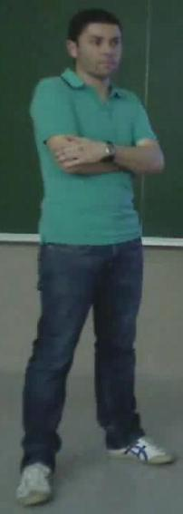
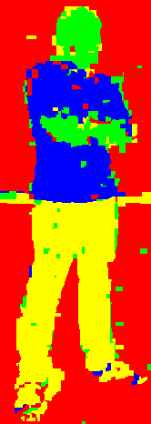
Segmentation with Multi-label graph-cuts
User initialization
Unary potential
Pairwise potential
Segmentation (α-expansion)
Notes:
In the case of segmentation…
Unary potential → builds a likelihood model of the labelled data
Pairwise potential → difference between pixels
Finally, segmentation

Slide 9
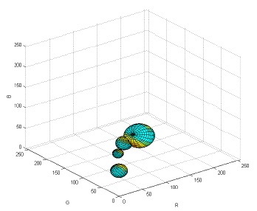
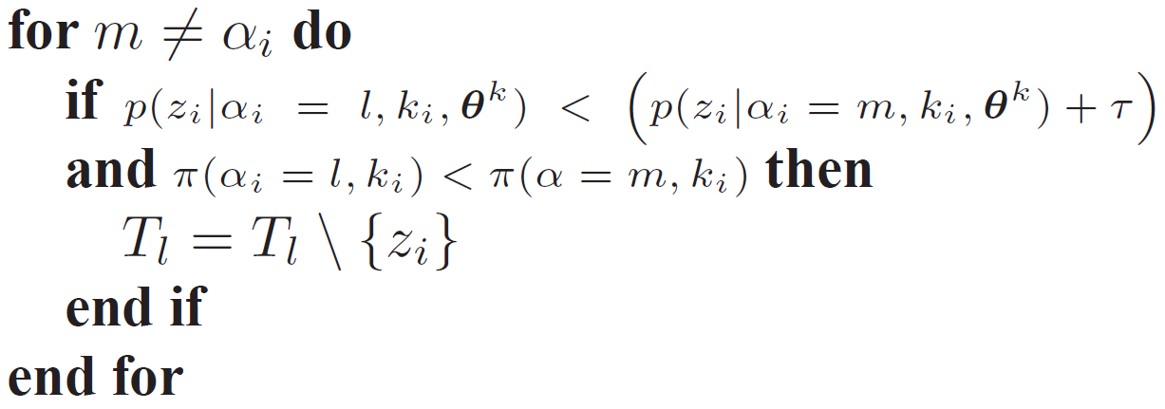
Likelihood-based correction
Color model: Gaussian Mixture Model
:Seeds for label
: weight of GMM
component
Notes:
For the seed correction
If the probability

Slide 10
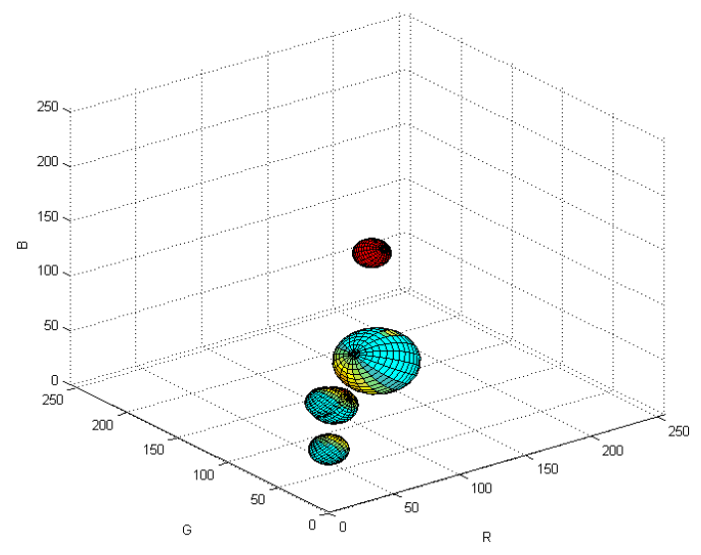
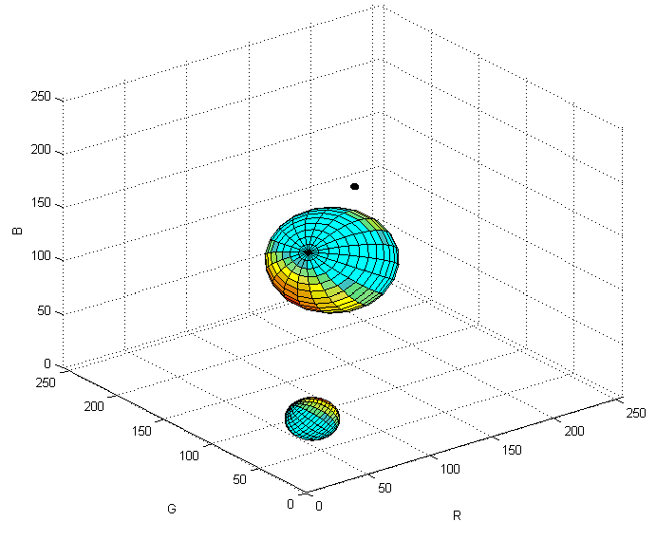
Likelihood-based correction: example

Slide 11
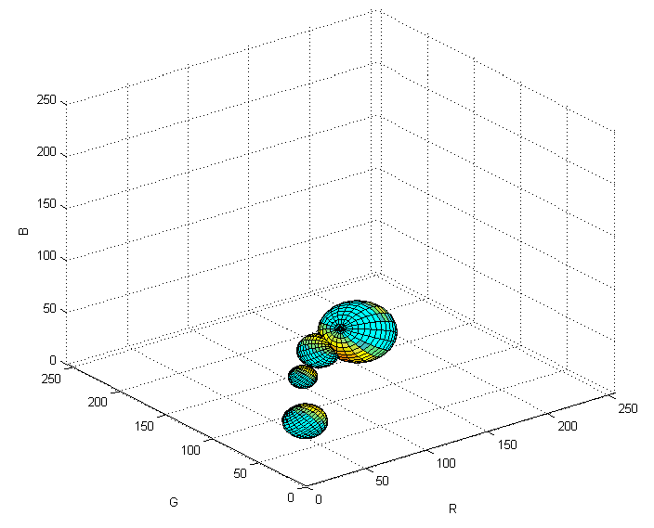
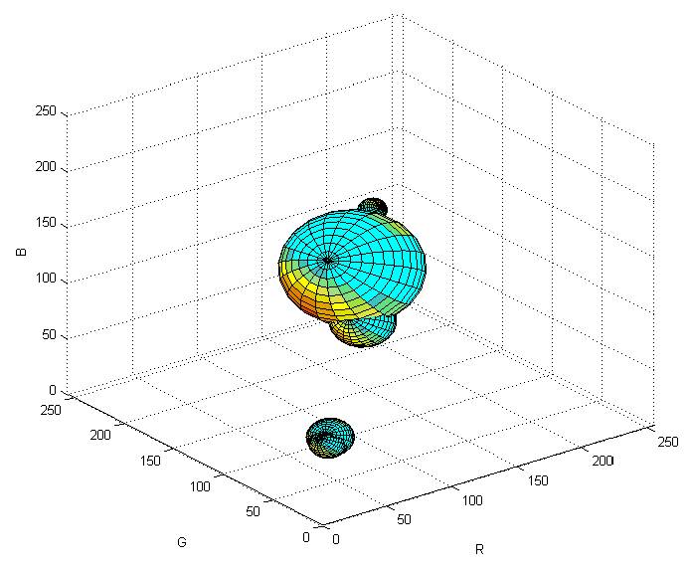
Likelihood-based correction: example

Slide 12
Outline
Introduction
Methodology
Experiments & results
Conclusion

Slide 13
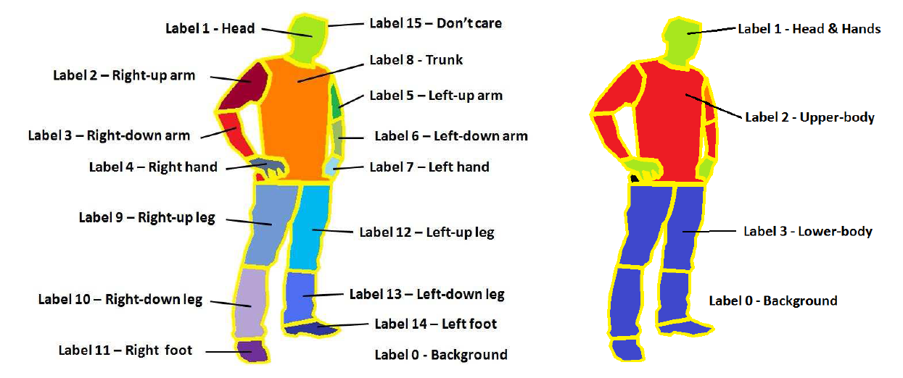
Experiments: Data
Human Limb DB²: 227 images from 25 people, GT provided
Random selection of 10 images –from 10 different people–
²http://www.maia.ub.es/~sergio/linked/humanlimbdb.zip
Notes:
For the experiments, human limb dataset. This Dataset provides annotations…

Slide 14
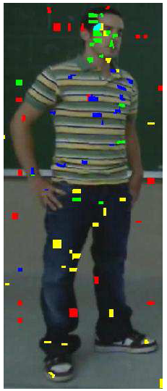
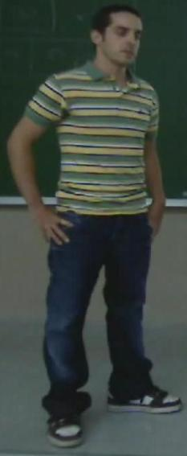
Experiments: Setup
Random interaction simulation
Select 0.2% of total pixels from each label
Repeat the process 10 times
4 scenarios:
With/Without error
Single/Combined mode
Notes:
The experimental setup is the following: we simulate user interaction by choosing random points from the GT. More specifically, select…
Repeat, get a bank of 10 different interactions
Define 4 scenarios. First of all we consider interactions with and without error, and then we also define a cumulative combination of the 10 different interactions.

Slide 15
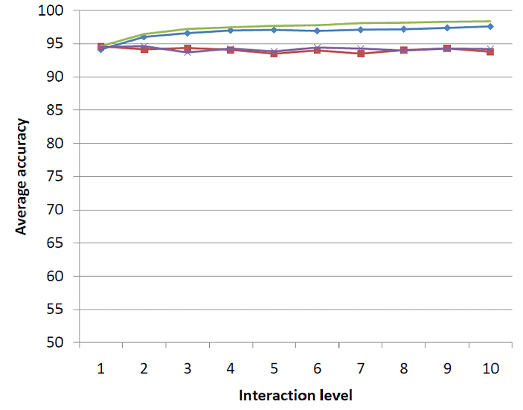
Results without errors
Notes:
In the case of interactions without errors, we can

Slide 16
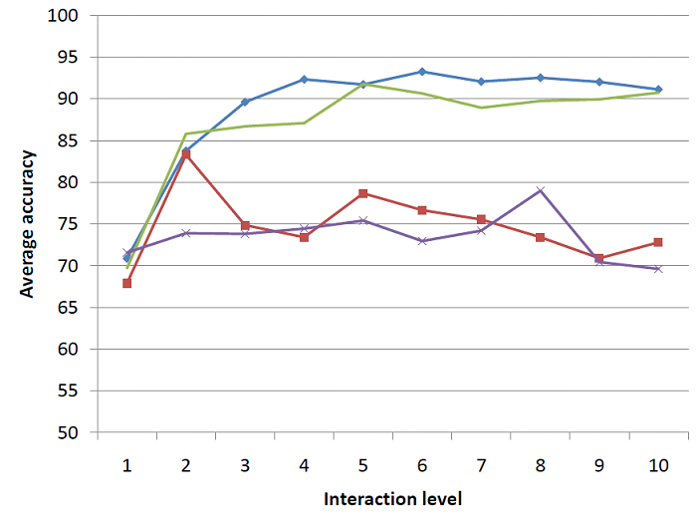
Results with 25% of error
Notes:
Then, as preliminary results I can show you a sequence

Slide 17
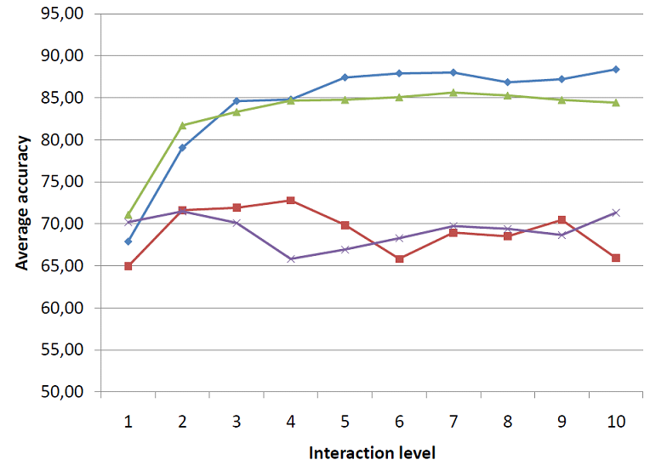
Results with 45% of error
Notes:
Then, as preliminary results I can show you a sequence

Slide 18
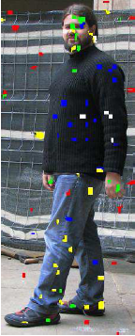
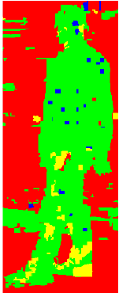
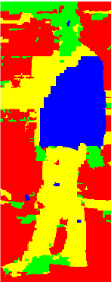
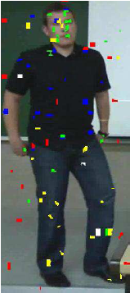
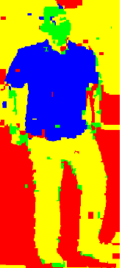
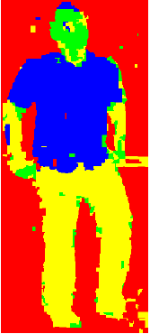
Qualitatve Results (single mode)
Notes:
Then, as preliminary results I can show you a sequence

Slide 19
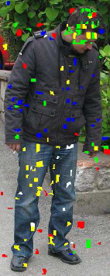
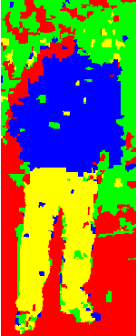
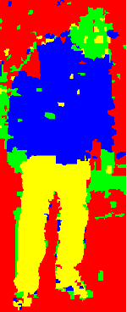
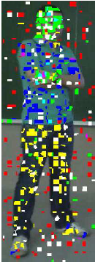
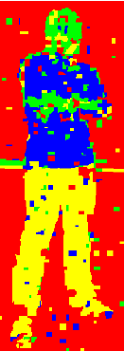
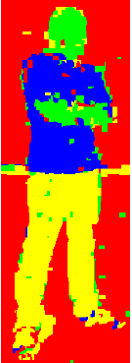
Qualitatve Results (combined mode)
Notes:
Then, as preliminary results I can show you a sequence

Slide 20
Outline
Introduction
Methodology
Experiments & results
Conclusion

Slide 21
Conclusion
Methodology for automatic user interaction correction in multi-label graph-cuts image segmentation.
Study on the influence of the amount of interaction from the user.
With and without errors.
Future work
Further experiment using real user interactions.
Adapt the algorithm to the user.
Notes:
Finally, as conclusions, we have presented a methodology for gesture segmentation and recognition, applied to the detection of ADHD indicators.
And first results indicate that the objectives are feasible, given the presented methodology.
As future work, we plan firstly to make the callibration of the device fully-automatic, and secondly, to give different importance to body parts in order to improve gesture recognition.

Slide 22
Automatic User Interaction Correction via Multi-label Graph-cuts
Thank You!
Workshop on Human Interaction in Computer Vision
12nd November 2011
Antonio Hernández-Vela, Carlos Primo and Sergio Escalera
Questions?

