Slide 1



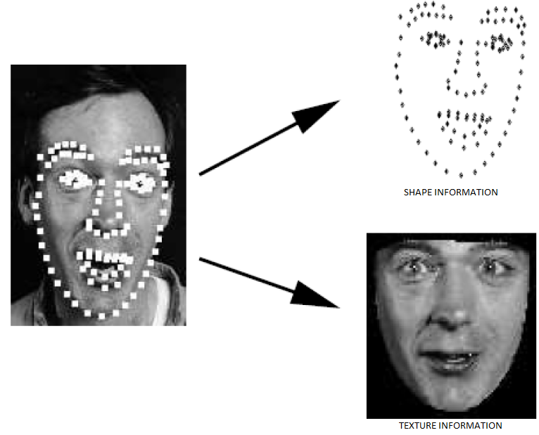
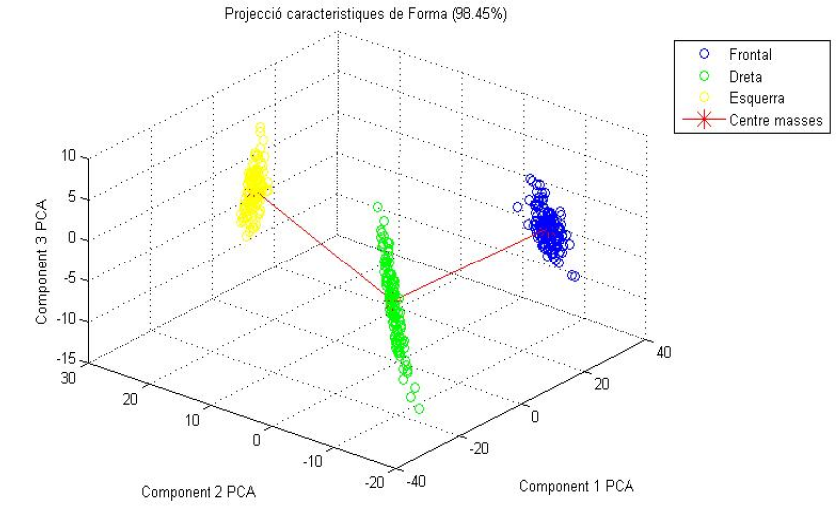
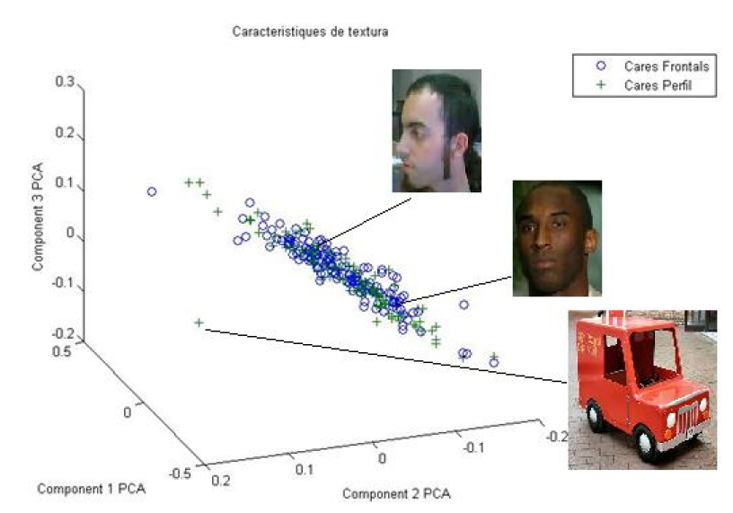
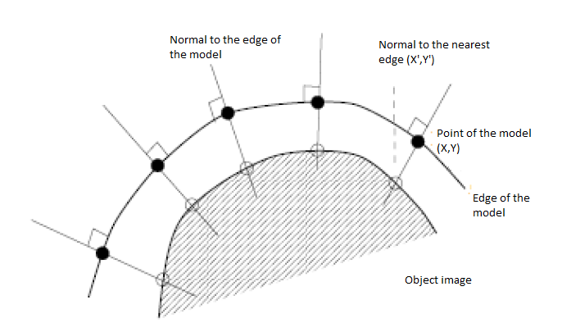
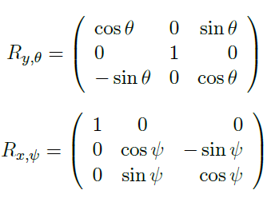
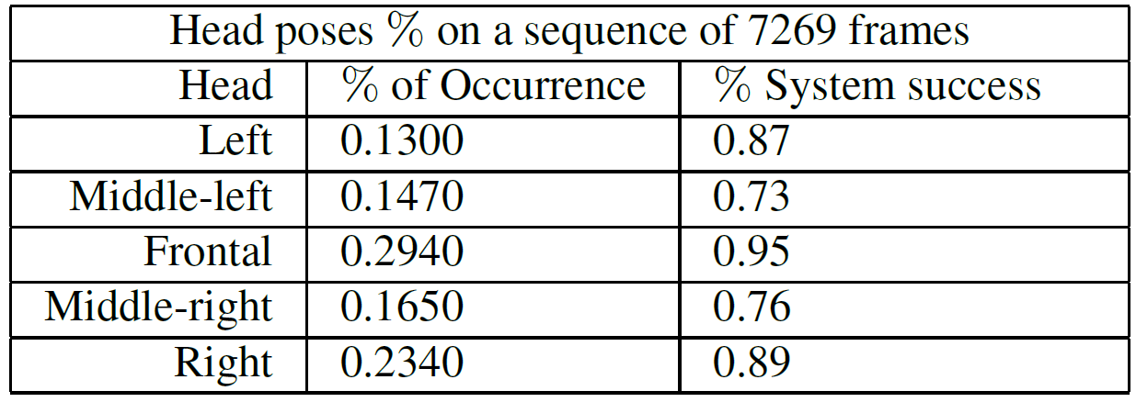
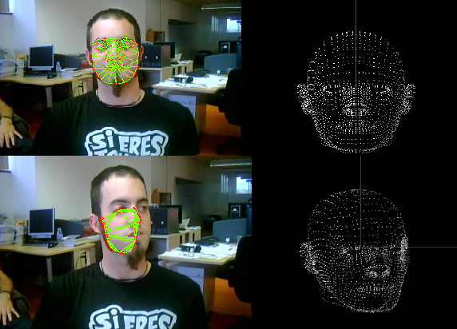
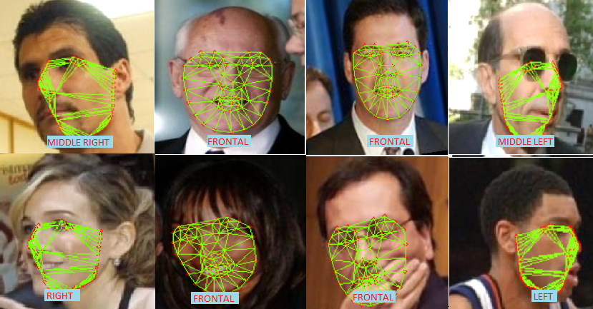

Real-time head pose classification in uncontrolled environments
with Spatio-Temporal Active Appearance Models
Miguel Reyes, Sergio Escalera, and Petia Radeva
Computer Vision Center, Universitat Autònoma de Barcelona, 08193 Cerdanyola, Spain
Dept. Matemàtica Aplicada i Anàlisi, UB, Gran Via 585,
08007, Barcelona, Spain
{mreyes,sescalera,petia}@cvc.uab.es
Sub-title
Abstract
We present a full-automatic real-time system for recognizing the head pose in uncontrolled environments over a continuous spatio-temporal behavior of the subject . The method is based on tracking facial features through Active Appearance Models. To differentiate and identify the different head pose we use a multi-classifier composed of different binary Support Vector Machines. Finally, we propose a continuous solution to the problem using the Tait-Bryan angles, addressing the problem of the head pose as an object that performs a rotational motion in dimensional space.
1. Detection facial features with Active Appearance Models
2. Head Pose Recovery
The representation of a model is composed through a combination of shape and appearance.. We perform a dimension of the face with N landmarks.[1][2]
The description of facial features through AAM provides a vector descriptor of shape, consisting of 21 landmarks.
The target is to discretize the different types of mesh that can form, which will produce different head poses. We use a training set, labeling each point structure, and then perform discrete classification.
The support vector machine classifier is used in an one-against-all design in order to perform five-class classification. The outputs of the classifier are as follows: right, middle-right, frontal, middle-left, and left.
The shape and texture information is contained in b_{s} i b_{g.} To maintain a correlation between high and low spots of shape and texture, PCA is applied.
For the interpretation of an image using a model, you have to find a set of parameters with a high degree of correspondence. Use a function that examines the error.
Taking into account the discontinuity that appears when a face moves, we include temporal and spatial coherence, meshes at frame t + 1 are initialized by the fitted mesh points at frame t. Additionally, we include a temporal change-mesh control procedure, as follows
3. Face Fitting and Motion
4. RESULTS
In order to obtain a continuous output. The goal is to extract the
angles of pitch and yaw movement between two consecutive frames. The angles are extracted from the following transformations:
Data: The data used in our experiments consists on a public data set: ”Labeled Faces in the Wild”[3]:
The transformation that will cause the motion is R = R_{y}R_{x} . Getting in Vi the information of shape in the frame t ,trough AMM, and Vf relative to frame t+1, and angles will be extracted by solving the following trigonometric equation:
5. CONCLUSIONS
[1] T. Cootes, J. Edwards, and C. Taylor, ”Active Apperance Models. IEEE Transactions on Pattern Analysis and Machine Intelligence”, IEEE Transactions on Pattern Analysis and
Machine Intelligence 23(6):681685
It is noted that AAM is able to detect a high number of facial features from different views in a robust and reliable way. Another quality that AAM is its ability to work with success in different situations from uncontrolled environments, such as partial occlusion or noise.
It has also been observed that the robustness and reliability of facial feature extraction is very dependent on the number of points of the model. This is of paramount importance for real-time applications, since a high number of points can make the system unsustainable.
For the continuous output of the system, its success rate is totally dependent and sensitive to the monitoring carried out by AAM.
[2] T. Cootes, C. Taylor, D. Cooper, and J. Graham, ”Active Shape Models - their training and application”, Computer Vision and Image Understanding, 61(1):3859.
3] A Database for Studying Face Recognition in Unconstrained Environments”, University of Massachusetts, Amherst 2007.

