Slide 1
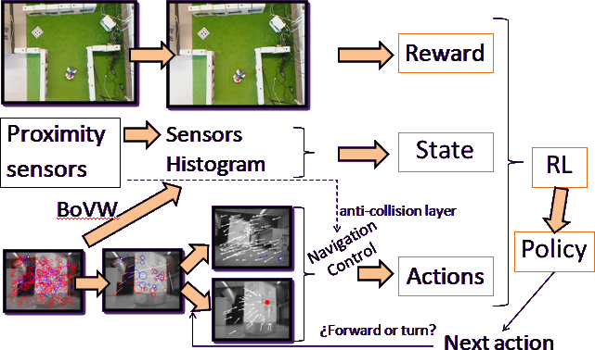
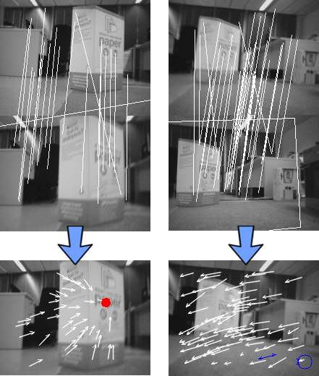
Vision-based Navigation and Reinforcement Learning Path Finding
for Social Robots
Xavier Pérez*, Cecilio Angulo*, Sergio Escalera⁺ and Diego Pardo*
* CETpD, UPC, Rambla de l’Exposició, 59, 08800 Vilanova i la Geltrú, Spain
xavips@gmail.com, cecilio.angulo@upc.edu, diego.pardo@upc.edu
⁺ Dept. Matemàtica Aplicada i Aàlisi, UB, Gran Via 585, Barcelona, Spain
Computer Vision Center, Campus UAB, Edifici O, 08193, Cerdanyola
sergio@maia.ub.es
Sub-title
Abstract
An exportable and robust system for automatic Robot Navigation in unknown environments is proposed. The aim of the system is to allow a robot to automatically find a path that leads to a given goal, avoiding obstacles, only using vision and the least number of sensors. The system is composed by three main modules: the Artificial Vision, the Reinforcement Learning, and the Reactive Anti-collision module. Artificial Vision module is able to provide the information and functionalities needed by the Reinforcement Learning module. Visual Based navigation and a State definition are developed without the use of a map, only using proximity sensors and Sony AIBO camera images.
1. Overview
4. Actions (Navigation control)
In order to follow a route between two points in the environment, a map is usually needed to optimize the route and follow it. However, here a path finding approach is presented where a map of the environment is not needed, neither the use of artificial landmarks.
Actions ordered by Reinforcement Learning module must always be carry out in the same way. Therefore, it is necessary to avoid unexpected behaviors implementing reliable actions: controlled forward and controlled turn.
Feature extraction, applying SURF [1] on robot’s camera images.
To find correspondences between features from consecutive images, obtaining a set of motion vectors describing robot motion in 2D.
Is robot going forward or is it turning?
Forward
Vanishing Point (VP) is achieved looking for motion vector intersections.
VP is the focus of the movement i.e. VP shows the direction of the movement of the robot.
Control consists on maintain VP in the center of the image
Turn
Turn the head in an specific angle, using neck encoders.
Start turning the body in the direction the head is pointing while robot keeps its head still.
Turn is completed when head and body are aligned.
2. Reinforcement Learning
To maintain its head still, Sony Aibo tries to continue watching the same image, avoiding image modifications.
According to the Reinforcement Learning (RL) paradigm, robot should take actions within its universe, looking for maximizing some notion of cumulative reward. RL algorithms attempt to find a policy that maps its current state to the actions the robot should take in those states. Formally, the basic RL model consists of:
Error signal to correct neck angles is steering angle: mean of parallel motion vectors.
Set of world states X: | x є R^{n}, where n = 53 = dictionary size + 3 sensors
Set of actions U: | U = [forward, backward, 90º left, 90º right]
Set of scalar rewards : | r є R
A value of n=53 implies a high state space dimensionality, too large to grid the state space supposing that all states must be visited. It is necessary to look for a continuous RL algorithm that supports high state dimensionality, therefore, a Policy Gradient Reinforcement Learning method (PGRL) [3] is applied. The Natural Actor-Critic Algorithm described in [2] is chosen given that it supports a high state dimensionality.
5. CONCLUSIONS
In this work we presented a new approach for navigation control of mobile robots. Designed Vision based navigation works really well on Sony Aibo, and it probably could work even better on wheeled robots.
The proposed system only uses the robot camera to achieve a controlled loop to go forward and another one to turn a desired angle. Besides, the robot uses proximity infrared sensors in order to avoid obstacles.
3. State definition
Reliable state representation is obtained using proximity sensors and a 50 length histogram resulting from BoVW.
Similar states on the map should have similar state representations and very different state representation is due to distant or very different states.
Restrictions:
Only use robot sensors
World’s map is not known
Artificial landmarks are forbidden
Reinforcement Learning algorithm is able to work with high dimensionality data. The robot looks for the goal, producing behavior changes based on experience, without finding the optimal route that reaches the goal. It seems a reasonably useful approach despite of the needing of a better configuration for learning optimal parameters in order to achieve the desired results.
Idea: Robot camera image describes its position and orientation with a high level of reliability.
[1] Bay H. Ess A. Tuytelaars T. Van Gool L., Surf: Speeded up robust features, Computer Vision and Image Understanding (CVIU), 2008
[2] Peters, J. Vijayakumar, S. Schaal, S., Policy Gradient Methods for robotics, In International Conference on Intelligent Robots and
Systems (IROS), 2006
[3] Peters, J., Machine Learning for Robotics: Learning Methods for Robot Motor Skills, VDM-Verlag, 2008
[4] Yang, J. Jiang Y.G. Hauptmann, A. Ngo C.W., Evaluating bag-of-visual-word representation in scene classification, MIR07 ACMMM, 2007
State description: Vector containing proximity sensor values and result of apply “Bag of Visual Words”(BoVW) [4] on images from robot’s camera, using Speeded Up Robust Features (SURF ) [1] descriptor.
Dictionary size: 50
Test: Image retrieval system using
pictures from maze.

