Slide 1



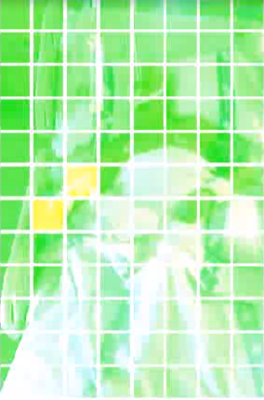
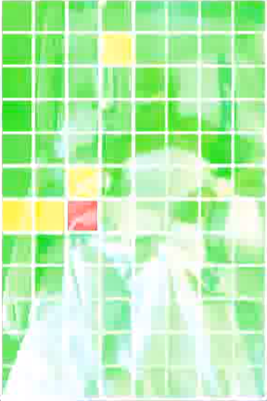
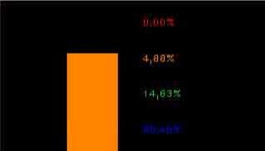
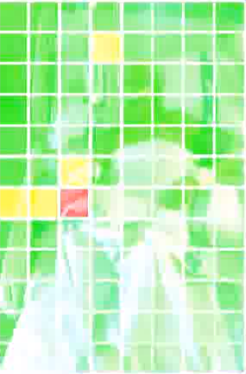
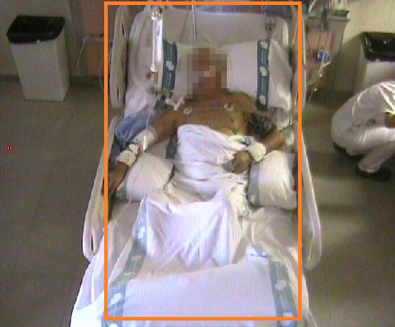
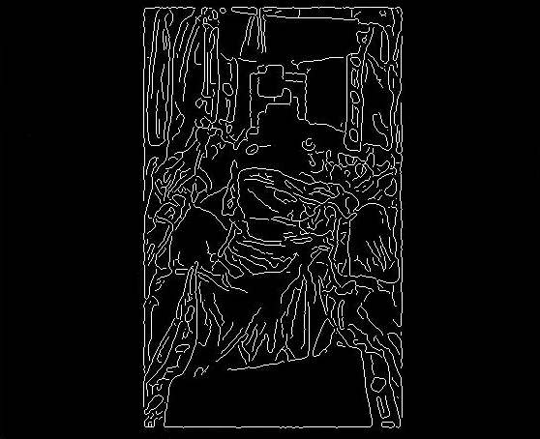


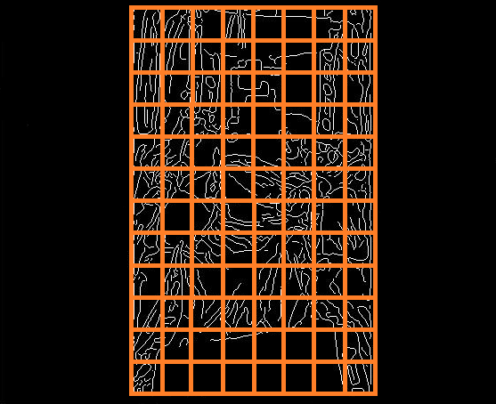
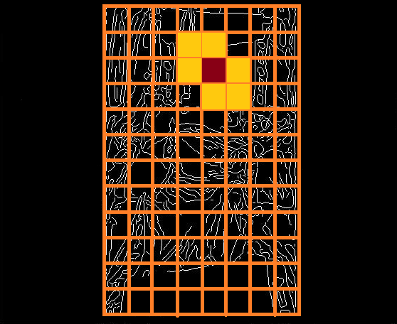
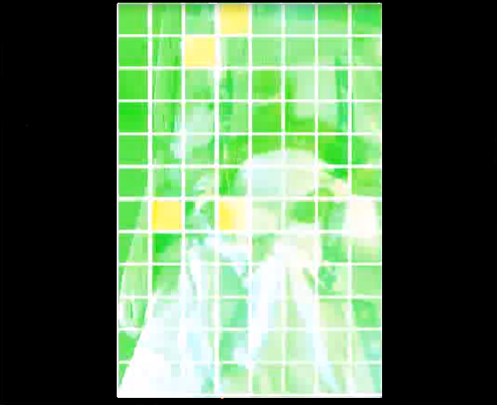
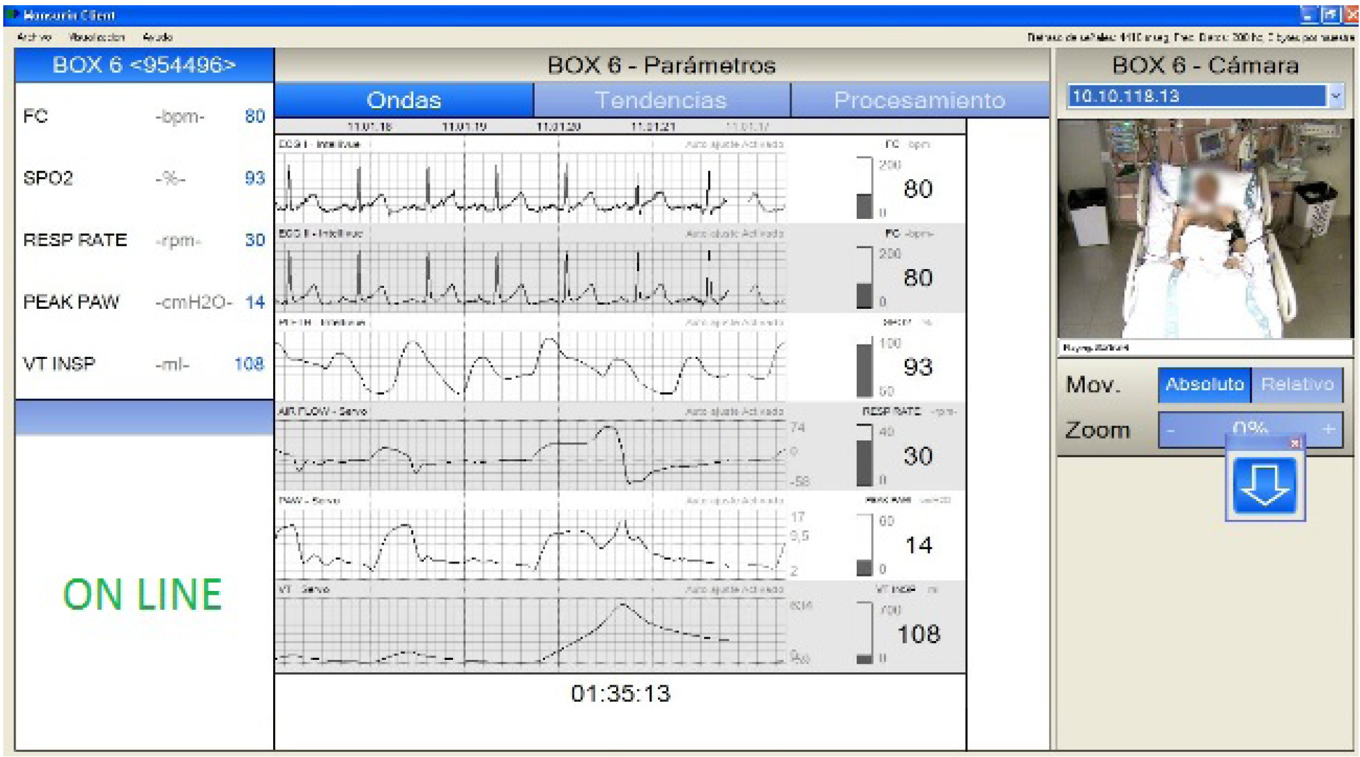
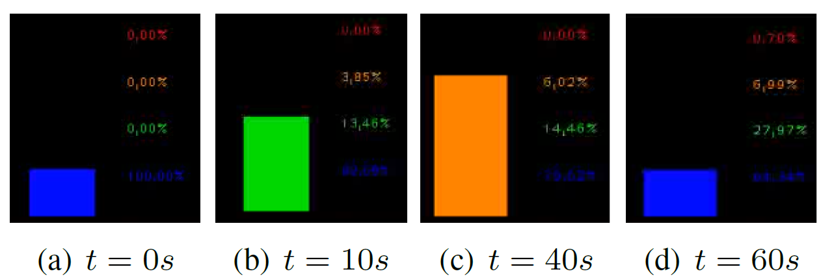
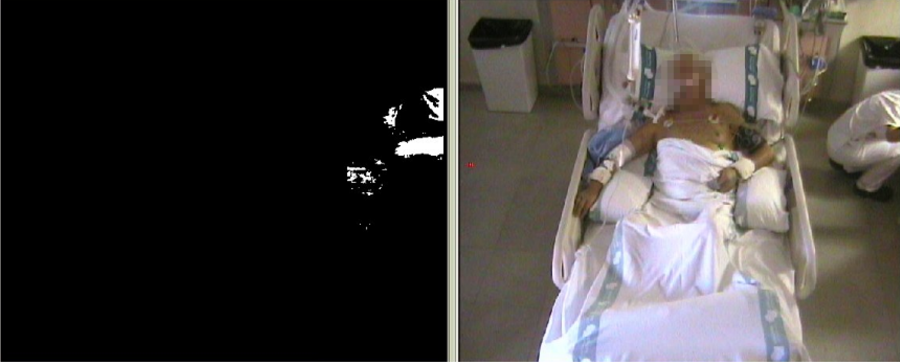
Real-Time Activity Monitoring of Inpatients
Miguel Reyes, Jordi Vitrià, Petia Radeva and Sergio Escalera
Computer Vision Center, Universitat Autònoma de Barcelona, 08193 Cerdanyola, Spain
Dept. Matemàtica Aplicada i Anàlisi, UB, Gran Via 585,
08007, Barcelona, Spain
{mreyes,sescalera,petia}@cvc.uab.es
Sub-title
Abstract
In this poster, we present the development of an application capable of monitoring a set of patient vital signs in real time. The application has been designed to support the medical staff of a hospital. Preliminary results show the suitability of the system to prevent the injury produced by the agitation of the patients.
1. Extraction of Motion with HOG Descriptors
2. Objective Quantification of Motion
Motion Quantification Module
Medical Staff Detector Module[2]
Gradient Difference
Map Image at t-1
Gradient Difference
Map Image at t
Set region of interest
2D HoG[1] Computation
ON/OFF
Gradient Image t-1
Compute the gradient difference
Normalize gamma & colour
Normalization overlapping Blocks
Gradient Image t
Image Sequence
Image at t-1
Compute the gradient difference
We estimate the amount of motion in terms of historical and current frames, discretizing the motion in the following four levels:
No Motion
Slight Motion
High Motion
Gross Motion
Motion Classification
Display to Medical Staff
Block of 4 cells
Motion Classification
1,0
12
Cell NxN
pixels
Normalized gradient difference
0,75
11
0,5
9
10
0,25
7
8
0
1
2
3
4
5
6
7
8
0
1
2
3
4
5
6
Cell Rows
Cell Cols
It sends the data to the medical staff
We accumulate the euclidean difference for all cells of the grid in two consecutive frames. Normalizing the obtained agitation degree in the range [0,1].
Normalize and set ROI
Compute Gradient
Establish cell & block size
Normalization overlapping
Gradient Difference Map
HOG DESCRIPTORS EXTRACTION PROCESS
3. RESULTS
4. CONCLUSIONS
In order to assess the robustness of the system the application has been tested on a video sequence of 8000 frames, with a frame of rate 5 FPS. The resolution of the frame is
640x480 pixels. The video corresponds to a real patient from the Hospital de Sabadell, Parc Tauli. Additionally, we show an example where the presence detection module detects a medical staff in the environment of the patient.
We presented a methodology to detect and quantify the
motion of patients in hospitals. The method is based of
HOG descriptor differences.
Preliminary results show that the system robustly detects and quantifies the motion of the patient at the same time that shows an historic of the patient activity.
We are currently on the analysis of alternative motion quantification
methodologies able to identify the level of agitation
at pixel level by means of adaptive pixel foreground models
Evolution of motion over a real paitent
ACKNOWLEDGMENTS
REFERENCES
The authors thank to Hospital de Sabadell, Parc Tauli for
its collaboration.
[1] N. Dalal and B. Triggs. Histograms of oriented gradients for human
detection., IEEE International Conference on Computer Vision and
Pattern Recognition, volume 2, pages 886-893, 2005.
This work has been supported in part by projects TIN2009-
14404-C02, La Marató de TV3 082131, and CONSOLIDERINGENIO
CSD 2007-00018.
[2] Massimo Piccardi. Background subtraction techniques: a review, IEEE International Conference on Systems, Man and Cybernetics, 0-7803- 8566-7/04 2004.

