Slide 1



Introducing the Separability Matrix for ECOC coding
Miguel Angel Bautista, Sergio Escalera, Xavier Baró & Oriol Pujol

Slide 2
Outline
Classification problems and the ECOC framework.
Motivation.
The Separability Matrix.
The Confusion-Separability Extension Coding.
Experiments and Results.
Conclusions and Future Work.

Slide 3
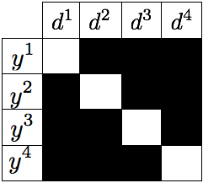
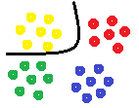
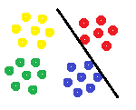
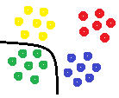
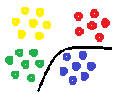
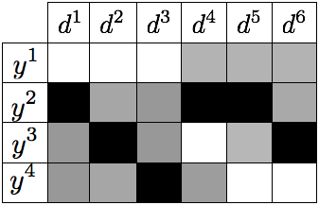
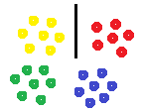
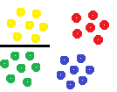
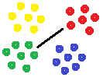
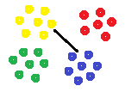
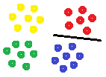
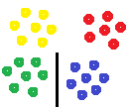
Introduction to the ECOC framework
In classification tasks, the goal is to classify and object among a certain number of possible categories.
This framework is composed of two different steps :
  Coding : Decompose a given N-class problem into a set of n binary problems.
  Decoding : Given a test sample s, determine its category.
+
+
+
+

Slide 4
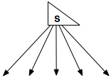
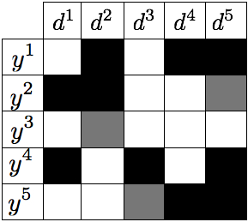


Introduction to the ECOC framework
At the decoding step a new sample s is classified by comparing the binary responses to the rows of M by means of a decoding measure .
Different types of decoding based on the distance used (i.e. Hamming, Euclidean, etc.)

Slide 5
Motivation
Standard predefined strategies may not be suitable for a given problem.
Literature often suggested the use of equidistant codes.
In [1] we show how reduced codes can perform as well as standard designs with far less number of dichotomizers.
Those reduced codes can be extended in a problem-dependent way to benefit from error-correcting principles.
How can we identify those codes?
[1] Compact Evolutionary Design of Error Correcting Output Codes, M. Bautista, S. Escalera, X. Baró, O. Pujol, J. Vitrià and P. Radeva

Slide 6
The Separability Matrix
The Separability matrix S contains the pairwise distance between the codewords in M.
With this matrix we can analyze the correction capability of M since,
Standard ECOC designs shown constant Separability matrices.
Identify those classes that need an increment of distance in order to benefit from error-correcting principles.

Slide 7
The CSE Coding Algorithm
Find the most confused classes :
Compute and Extension matrix E which increments
Fill the empty Extension codes taking into account the confusion of with the rest of the classes.
Update Confusion and Separability matrices.

Slide 8
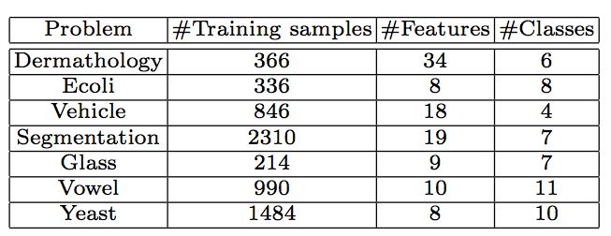
Experiments: Data
We tested the novel methodology on several public datasets from the UCI Machine Learning Repository.
In addition we perform experiments with 3 public Computer Vision problems.
  The ARFace dataset with 20 classes.
  The Traffic Sign dataset with 36 classes.
  The MPEG dataset with 70 classes.

Slide 9
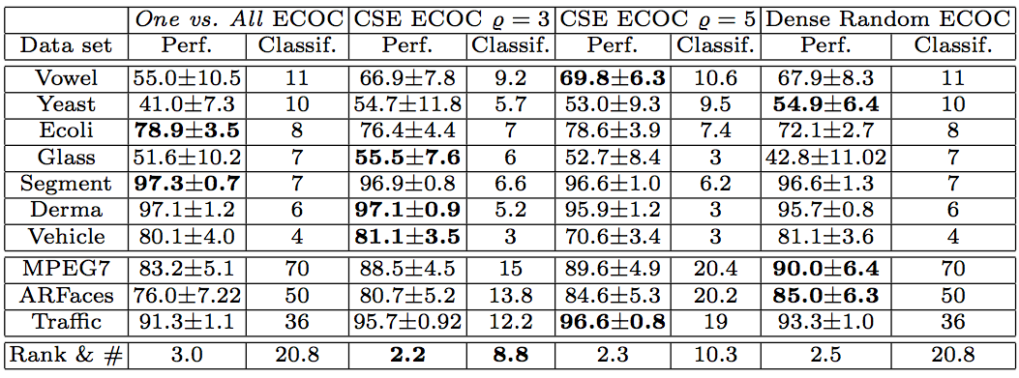
Experiments and Results
Results for UCI and Computer Vision experiments with SVM as the base classifier.

Slide 10
Conclusions and Future Work
The Separability Matrix is introduced as a novel tool to analyze and enhance ECOC coding designs.
The Extension Algorithm proposed can be applied to any existing ECOC scheme.
A new coding design based on the Separability matrix is introduced obtaining significant performance improvements over state-of-the-art ECOC designs.
The proposed methodology reduces the number of base classifiers needed in comparison with state-of-the-art designs.

Slide 11
Thank you!

