Slide 1





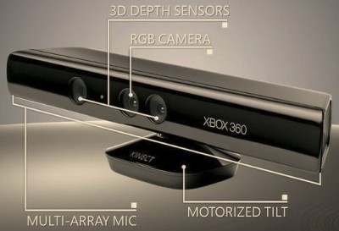
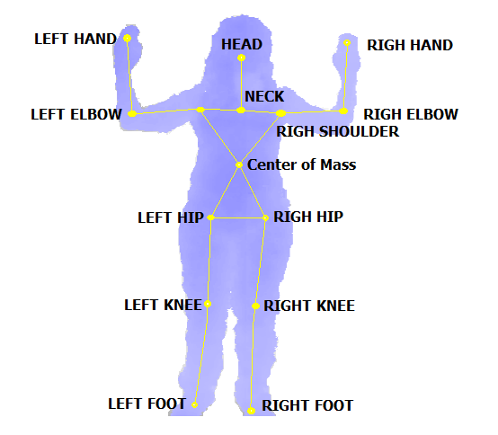
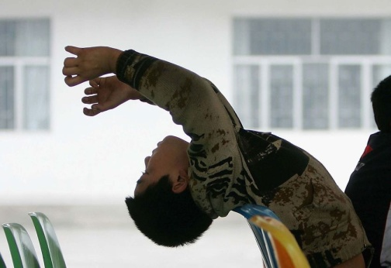
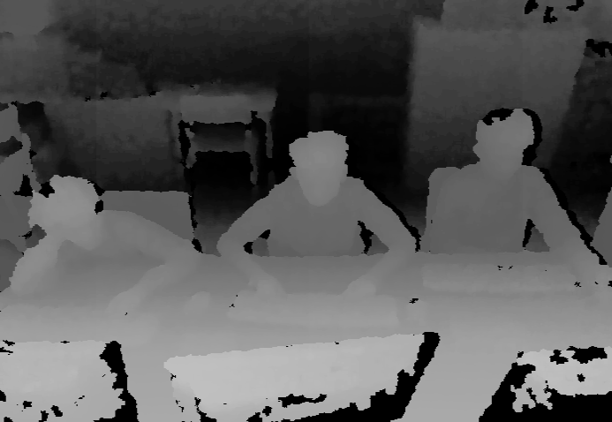
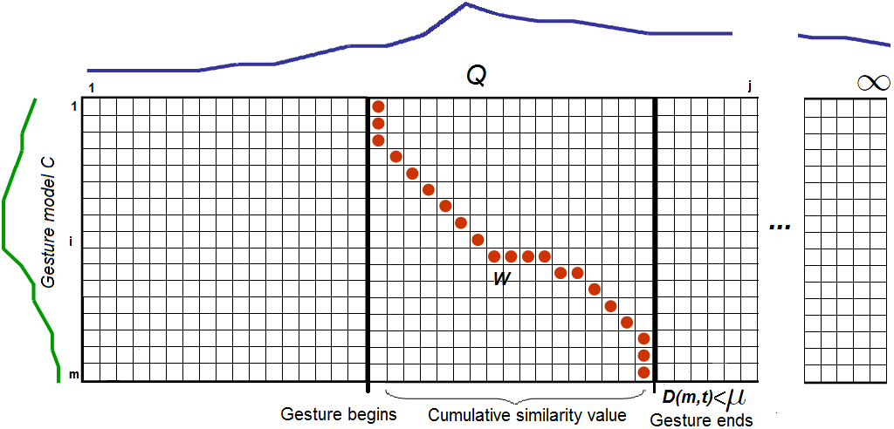
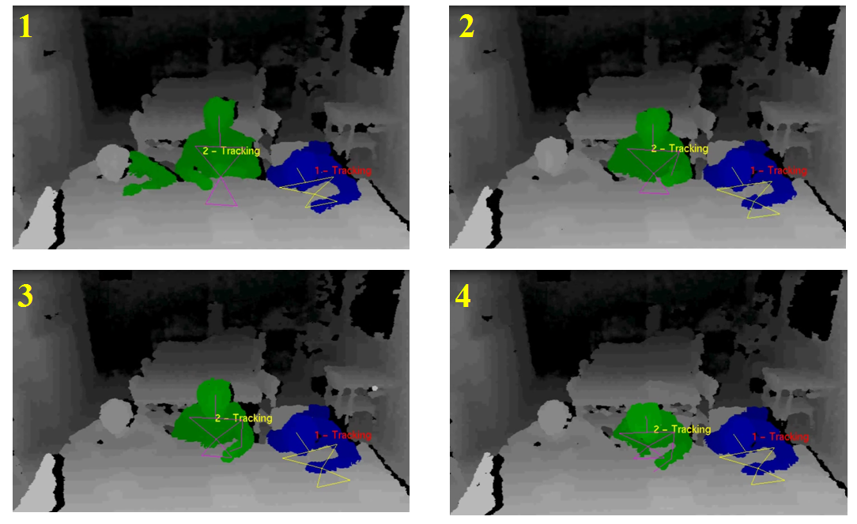
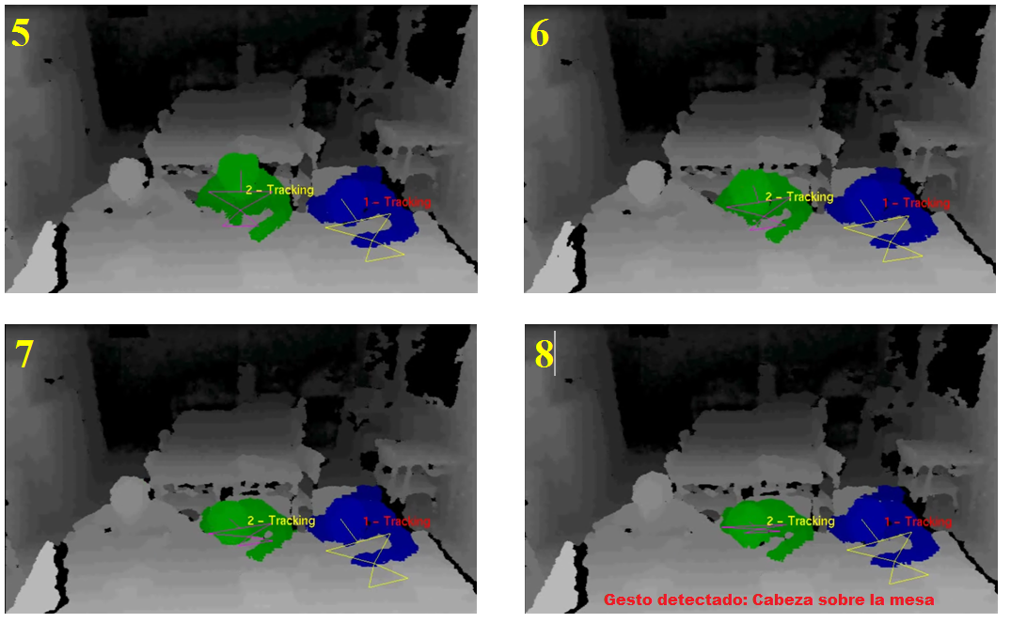
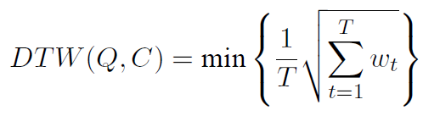
Antonio Hernández^{1,2}, Miguel Reyes^{1,2}, Laura Igual^{1,2}, Josep Moya³,
Verónica Violant² and Sergio Escalera^{1,2}
Computer Vision Center (CVC)¹, University of Barcelona (UB)² and Mental Health Observatory of Catalunya - Parc Taulí³
{ahernandez,mreyes,ligual,sescalera}@cvc.uab.cat, jmoya@tauli.cat,
vviolant@ub.edu
ADHD indicators modelling based on Dynamic Time Warping from RGB data: A feasibility study
ADHD: Attention deficit hyperactivity disorder
1. Data acquisition + Feature extraction
Attention deficit disorder –with or without hyperactivity– is one of the main reasons of consultation in mental health centers for children and adolescents. The basic characteristics of ADHD are excessive and harmful levels of activity, inattention, and impulsiveness. This requires observation of patients for long periods of time, and it is often not feasible in practise; hence, we propose an automation in order to help doctors diagnose the disorder.
Microsoft Kinect
RGB Camera, Depth sensor → Robust to changes in illumination
Body
Skeleton
(set of
Joints)
Impulsivity
Inattention
Feature
vector
Hyperactivity
Depth map
2. Gesture detection
Results
Dynamic Time Warping
Dynamic Time Warping
DTW matches temporal distortions between two models: the input sequence (blue), and a previously recorded gesture model (green), by minimizing the warping cost:
If this warping cost, is lower than a certain threshold, a gesture will be detected.
Gesture training database
Threshold computing
In order to compute the thresholds for each gesture model, similarity measures are computed between different gestures and samples, in a leave-one-out fashion. Furthermore, the most informative sample of each gesture would be selected as the one for the DTW computation.
G1
G1₁
G1₂
G2
G2₁
…
…
G1₃
G2₂
…
G2₃
Gn₃
Gn
Gn₂
Gn₁
[1] N. Dalal and B. Triggs. Histograms of oriented gradients for human detection. CVPR, 1:886–893, 2005.
[2] E. N. Mortensen, Hongli Deng, and L. Shapiro. A sift descriptor with global context. CVPR, 1:184– 190 vol. 1, 2005.
[3] M. Parizeau and R. Plamondon. A comparative analysis of regional correlation, dynamic time warping, and skeletal tree matching for signature verification.
[4] PrimeSense Inc. Prime Sensor NITE 1.3 Algorithms notes, 2010. Last viewed 14-07-2011 13:19.
[5] M. Reyes, G. Domnguez, and S. Escalera. Feature weighting in dynamic time warping for gesture recognition in depth data. HICV workshop, ICCV, 2011.
[6] Jamie Shotton, Andrew Fitzgibbon, Mat Cook, Toby Sharp,Mark Finocchio, RichardMoore, Alex Kipman, and Andrew Blake. Real-time human pose recognition in parts from single depth images. CVPR, 2011.
Acknowledgements
FALTA POR COMPLETAR!!!

