Slide 1








Human Pose Recovery and Behavior Analysis
Multi Hand Pose Recognition System using Kinect Depth Sensor: Application to Medical Image Navigation
Oscar Lopes, Miguel Pousa, Miguel Reyes, Sergio Escalera, and Jordi González
All rights reserved HuBPA©

Slide 2


Human Pose Recovery and Behavior Analysis
Index
Motivation
System Architecture
Descriptor
Gesture Recognition
Dataset
Application
Results
Conclusion
All rights reserved HuBPA©

Slide 3
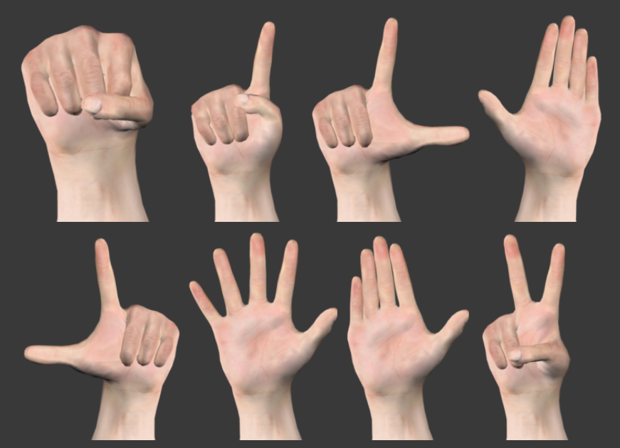
Human Pose Recovery and Behavior Analysis
Motivation
Recognize hand poses and gestures with high visual variability.
Introduce the recognition process in an automatic medical image navigation application
All rights reserved HuBPA©

Slide 4
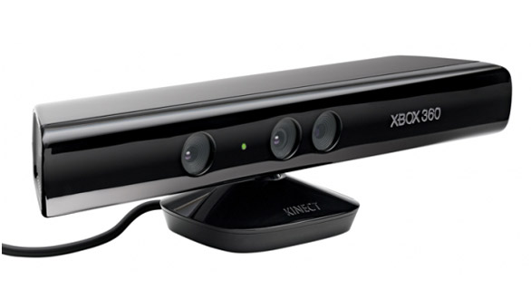
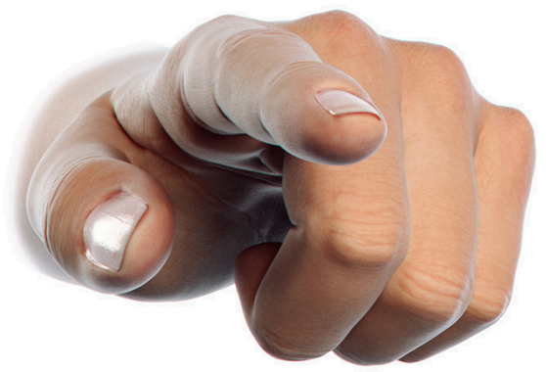
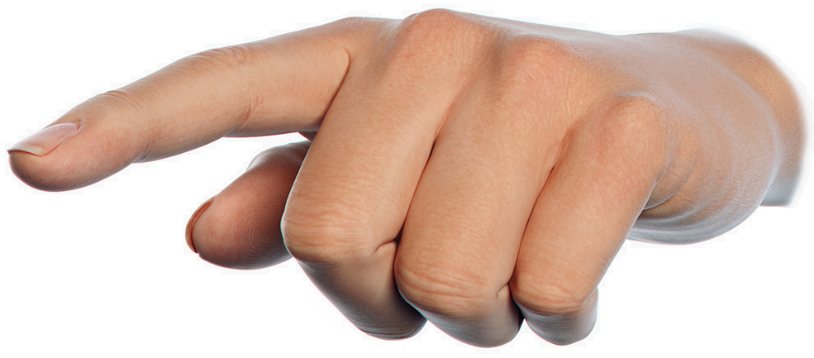
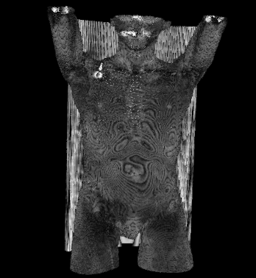
Human Pose Recovery and Behavior Analysis
System architecture
B
Trained spherical descriptors and HMM gesture recognition
RGBD data acquisition
A
C
Medical image navigation
All rights reserved HuBPA©

Slide 5
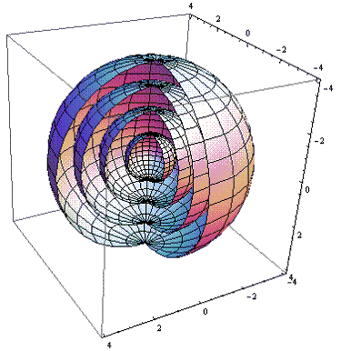



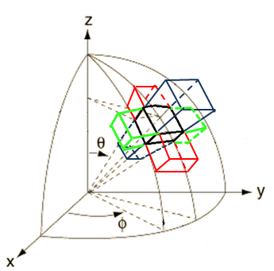
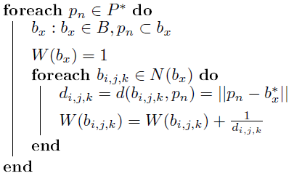

Human Pose Recovery and Behavior Analysis
Descriptor
Sergio Escalera, Alicia Fornés, Oriol Pujol, Josep Lladós, and Petia Radeva, Circular Blurred Shape Model for Multiclass Symbol Recognition, Systems, Man, and Cybernetics, Part B: Cybernetics, IEEE Transactions On, Volume 99, pp. 1-10, Digital Object Identifier: 10.1109/TSMCB.2010.2060481, pp. 1-10, IEEE Society, Hanover, USA, ISSN 1083-4419, IF JCR CCIA 3.007 2009 11/103, 2010.
All rights reserved HuBPA©

Slide 6
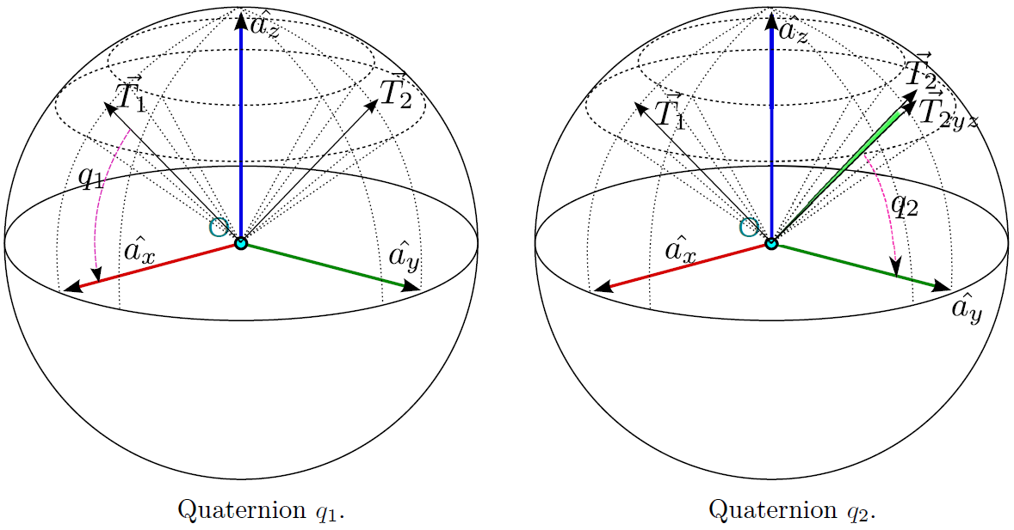
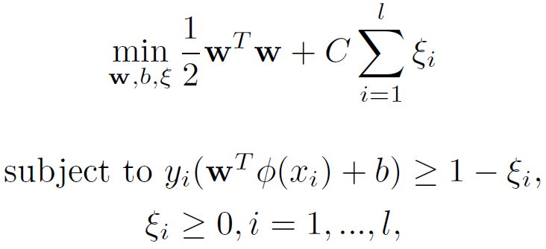
Human Pose Recovery and Behavior Analysis
Descriptor
Rotation invariance
Multiclass SVM
All rights reserved HuBPA©

Slide 7
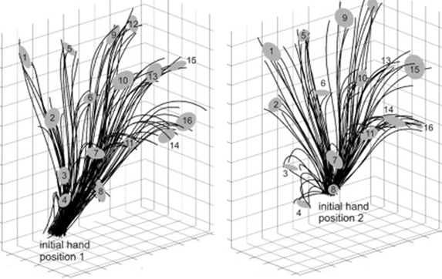
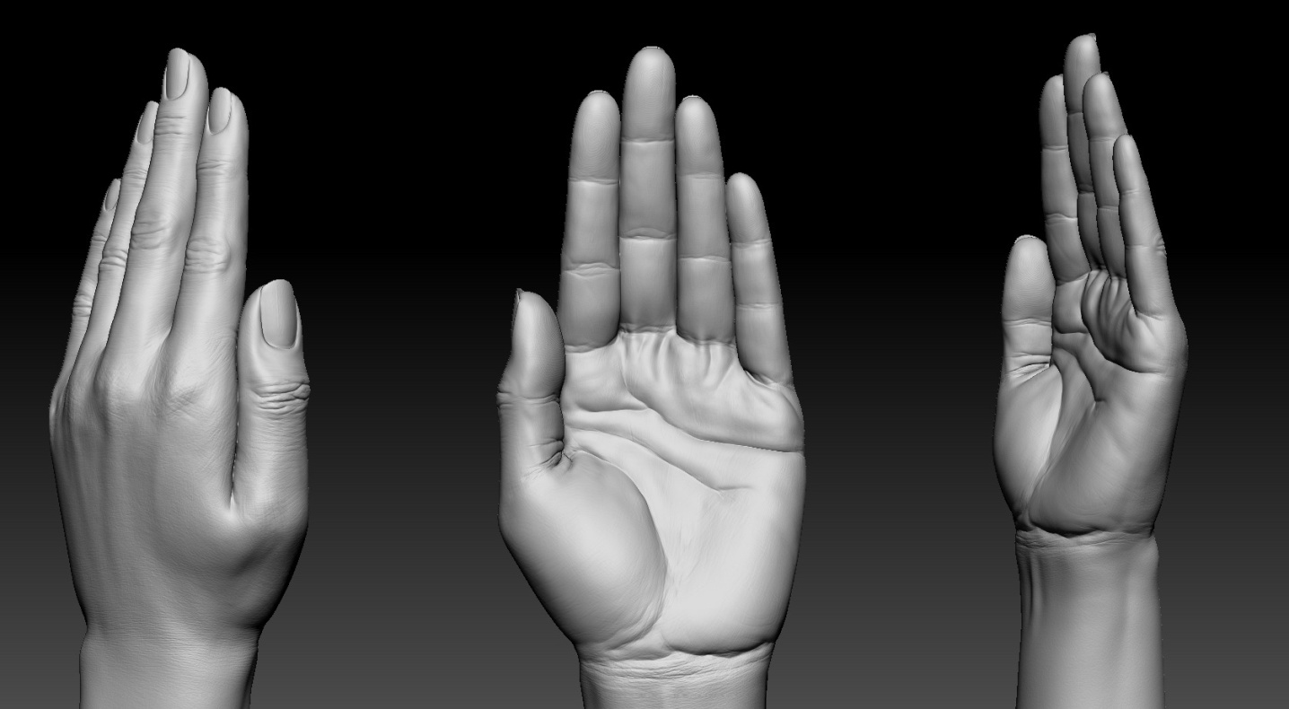
Human Pose Recovery and Behavior Analysis
Gesture recognition
Probabilistic HMM gesture recognition using hand trajectories and hand labels
All rights reserved HuBPA©

Slide 8
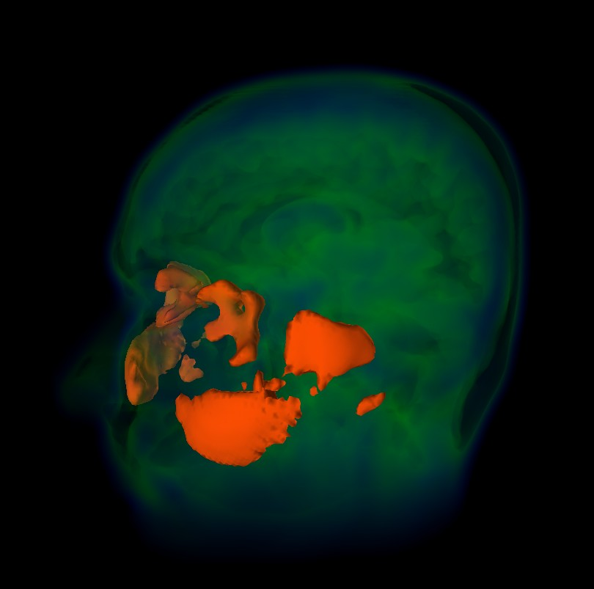
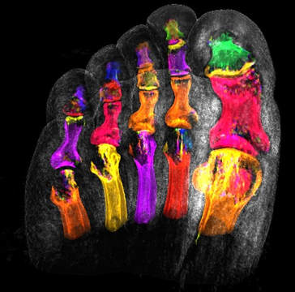
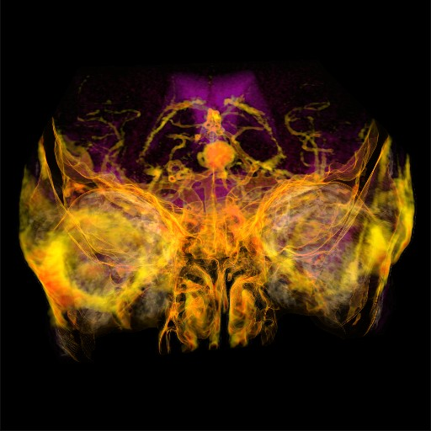
Human Pose Recovery and Behavior Analysis
Dataset
Medical image repository
http://www9.informatik.uni-erlangen.de/External/vollib/
All rights reserved HuBPA©

Slide 9
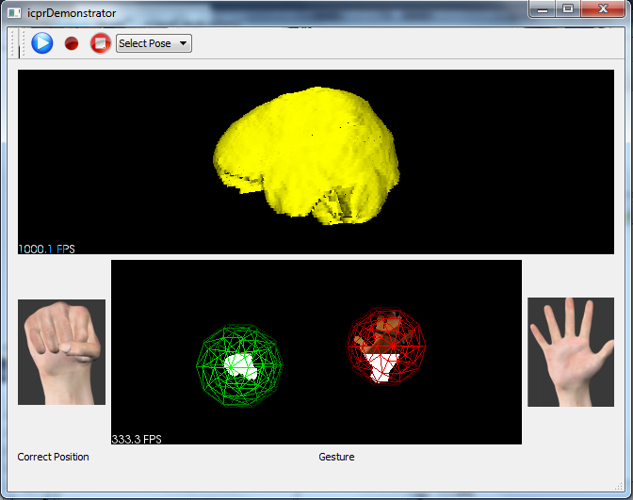
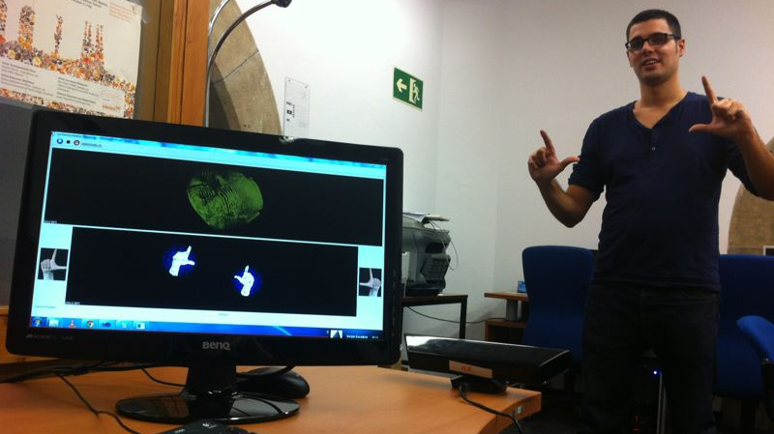
Human Pose Recovery and Behavior Analysis
Application
All rights reserved HuBPA©

Slide 10
Human Pose Recovery and Behavior Analysis
Results
Descriptor results improve state-of-the-art approaches (51 categories)
Methods | Papers | Depth
SIFT + Texton + Color Histogram + Spin Images + 3D Bounding Boxes | ICRA11A | 64.7
Sparse Distance Learning | ICRA11B | 70.2
RGB-D Kernel Descriptors | IROS11 | 80.3
Hierarchical Matcing Pursuit | ISER12 | 81.2
Ours | ICPR Demonstrator challenge | 85.13
http://www.cs.washington.edu/rgbd-dataset/dataset.html
All rights reserved HuBPA©

Slide 11
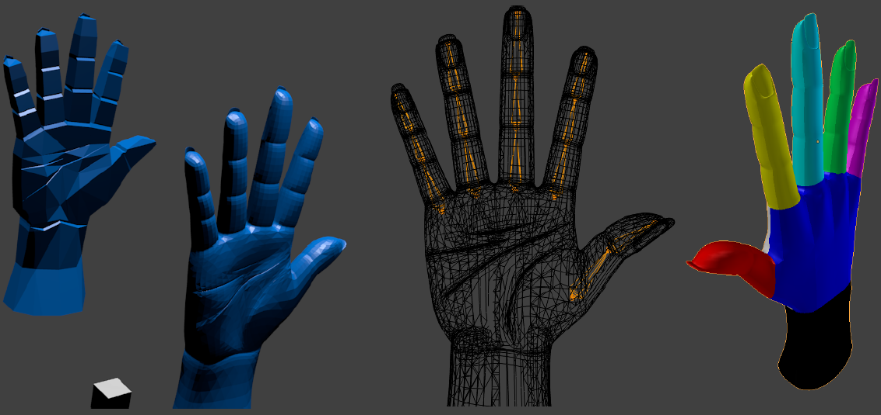
Human Pose Recovery and Behavior Analysis
Conclusion
Conclusion
Future work
A new, fast, and robust 3D object descriptor
Spherical descriptor improves state-of-the-art approaches
Gesture recognition using HMM including hand poses and trajectories
Fully-functional application using Microsoft Kinect SDK for medical image navigation
Use virtual models to learn objects as a composition of parts
Use the same descriptor to learn spatial relations of object parts
All rights reserved HuBPA©

Slide 12
Human Pose Recovery and Behavior Analysis
Thank you!
Multi Hand Pose Recognition System using Kinect Depth Sensor: Application to Medical Image Navigation
Oscar Lopes, Miguel Pousa, Miguel Reyes, Sergio Escalera, and Jordi González
All rights reserved HuBPA©

