Slide 1






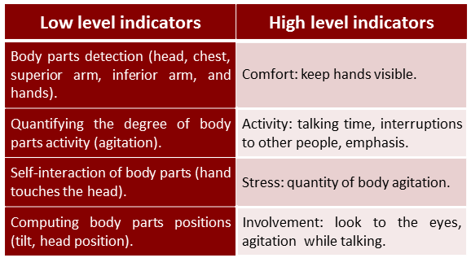
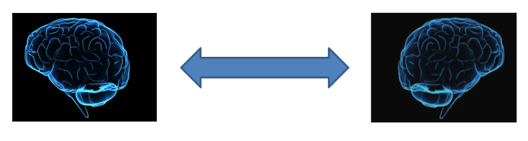
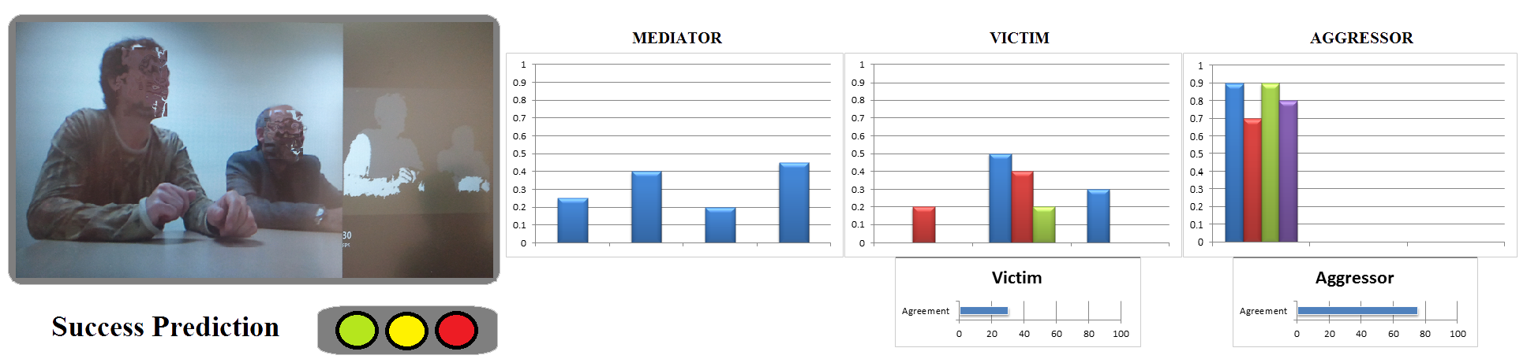
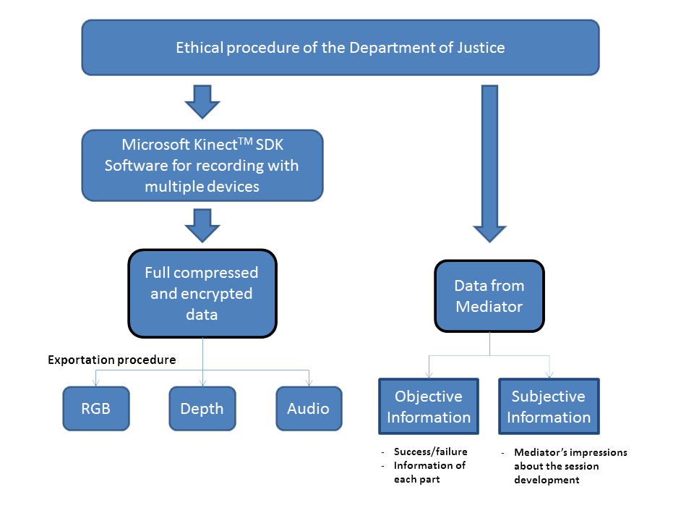

Víctor Ponce^{1,2}, Sergio Escalera^{1,2}, and Xavier Baró^{1,3}
Computer Vision Center (CVC) ¹, University of Barcelona (UB) ², Open University of Catalonia (UOC) ³.
E-mail: vponce@cvc.uab.es, sergio@maia.ub.es, xbaro@uoc.edu
Social Signal Analysis in Criminal Mediation Processes
Motivation
Problem Definition and System Proposal
Automatic analysis of human behavior from non-verbal communication in conversational processes.
Criminal Mediation is an specific scenario from the Justice area where two parts are involved (offender and victim) in order to achieve an agreement, helped by the figure of a mediator.
By observing and quantifying the levels of detected social signals in Criminal Mediation, one could be able to estimate more precisely the agreement between the parts to predict the success of the conversation.
This analysis can provide an important feedback for improving the mediator skills
Some social signals can be defined as psychological indicators coming from the observational methodology.
Visual indicators are provided by both analyzing the depth information and the expert observation. Multi-modal sensors such as Microsoft KinectTM device provides depth information.
Indicator levels are defined as the probability distribution function $P\left(I_{a} | S\right)$, where given a gesture sequence $S$, $P$ is the probability of having a certain indicator $I$ from an actor $a$ (mediator, victim or offender).
Experts feedback is useful for obtaining a correlation between their subjective observations, objective information from the mediation itself, and the system’s observations in order to predict more precise indicator levels for the final solution.
Social Signals
Provide high amount of important and hidden information of conversational processes. Difficult to be detected by human conscious.
Proposed System Overview
Achievements
Discussion
Data base has been built recording with multiple multi-modal Microsoft KinectTM devices during different criminal mediation sessions.
About 25 criminal mediation sessions has been recorded, each one of 1 to 3 hours depending on the session itself. Each session captured data from multiple Microsoft KinectTM sensors (from 1 to 3), depending on the number of actors.
Automatic analysis of human behavior is a hard task by itself due to the high amount of subjective information that one can consider -specially psychologists or other experts in the area of observational methodology-. However, as we deal with quantitative indicators described and used in many social contexts [1], we can guide this process towards an objective evaluation of these social signals, obtaining confident values for predicting the success of the mediation process.
Gesture sequences from recorded people in the data is the most significant information to perform an analysis of the non-verbal communication. In this way, we need to deal with such sequence processing in order to detect and analyze the fragments containing a gesture composed by a certain defined vocabulary.
We are planning to use different temporal clustering techniques such as [2], and hence a proper discretization in order to learn and define our vocabulary.
In the future, other information contained in our data such as the speech can be also analyzed as signals from the audio in order to integrate it in a full framework for behavior analysis in conversational situations.
[1] Alex (Sandy) Pentland. ”Honest Signals: How They Shape OurWorld” Book, The MIT Press; First Edition,2008.
[2] F. Zhou, F. D. la Torre, and J. K. Hodgins. ”Hierarchical Aligned Cluster Analysis for Temporal Clustering of Human Motion. Journal, IEEE Journal TPAMI, 2011.

