Slide 1




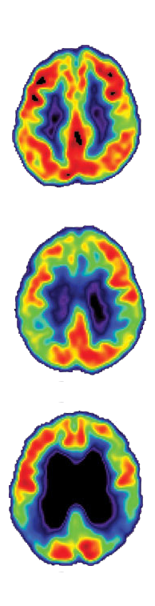
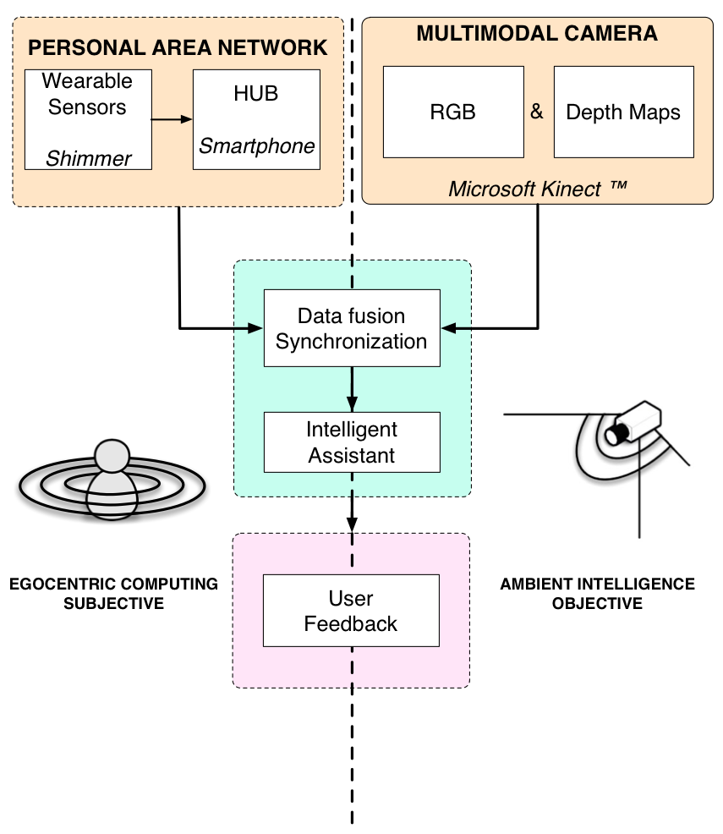
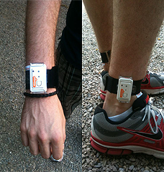
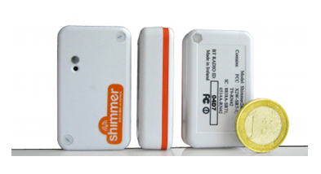
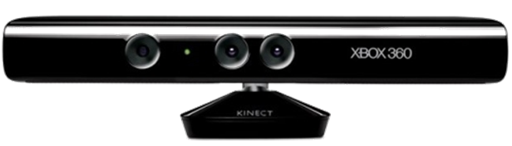
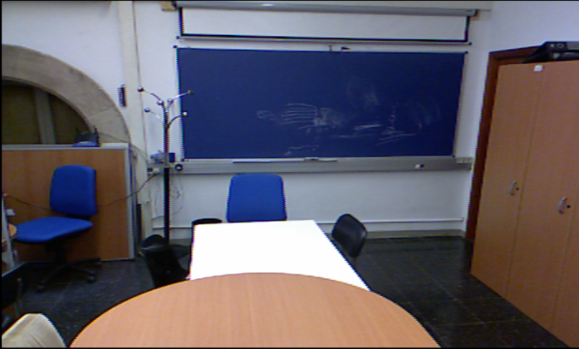
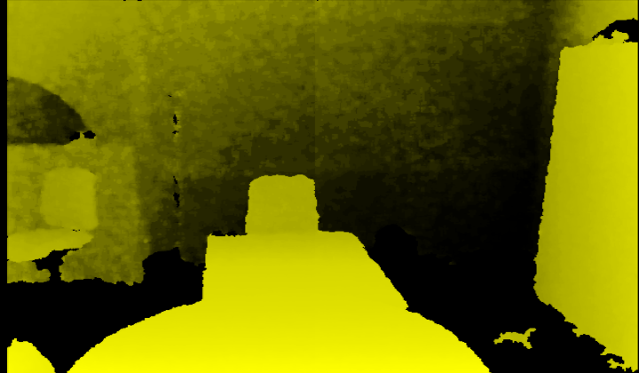
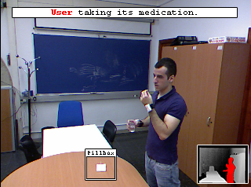
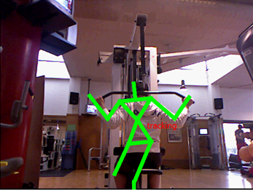
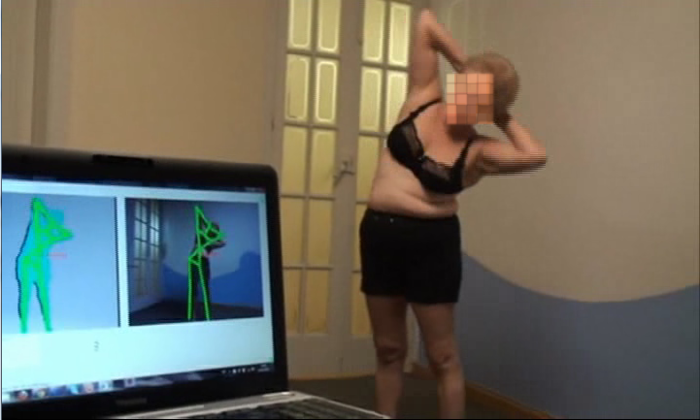
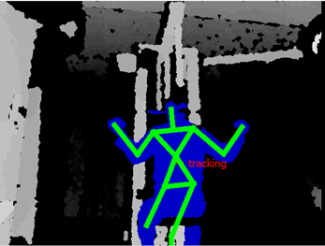
Albert Clapés^{1,2}, Alex Pardo², Miguel Reyes^{1,2}, Sergio Escalera^{1,2}, Oriol Pujol^{1,2}
Computer Vision Center (CVC)¹, University of Barcelona (UB)²
aclapes@cvc.uab.cat, alexpardo.5@gmail.com, mreyes@cvc.uab.cat, sergio@maia.ub.es, oriol@maia.ub.es
Intelligent Homecare Assistive Technology
for People with Dementia in Smart Cities
ABSTRACT
Dementia is a syndrome that can be caused by a number of progressive disorders that affect memory, thinking, behavior and the ability to perform everyday activities. Alzheimer’s disease is the most common type of dementia. This illness affects roughly 40 million people and its growth doubles every five years. Lack of awareness is the most common problem. This problem poses a serious health threat and a potential hazard for the user and those living with her/him, i.e. floods, scalding baths, gas, falls, etc. In this context assistive technology may allow individuals to perform tasks that they would otherwise be unable to do, or increase the ease and safety of the performed task. This includes equipment and devices to help disabled people. At the University of Barcelona and Computer Vision Center we have developed a proof-of-concept based on a multi-sensor non-invasive intelligent homecare framework to help dementia affected people in their daily home tasks, such as reminders (keys, medicines, etc.), advices (do certain tasks in particular periods of time), anomaly detection (such as fall detection and automatic alarm sending), and an intelligent control pipeline that not only offers reminders but also proves and certifies that the procedure has been performed successfully.
1. Motivation
2. Framework
Dementia syndrome affects memory, thinking, behavior, and the ability to perform everyday activities.
40 million people were diagnosed with alzheimer, the most common type of dementia, in 2010.
Improve elder people quality of life, increasing their independence and choice, reduce the risk of accidents, reducing avoidable residential and hospital cares, and also reducing the stress on carers.
Technique
Multi-modal data fusion, combining a RGB-Depth camera and wearable sensors.
Intelligent assistance by meanings of the application of Computer Vision, Pattern Recognition, and Machine Learning novel techniques.
User Feedback module that takes into account the behavior of the user and gives him proper recommendations.
System Overview
3. Hardware/Software results
Wearable Sensors (Shimmer)
Multi-axial accelerometer, gyroscope, and magnetometer.
Multi-modal camera (Microsoft Kinect™)
RGB
Depth
4. Future work
Qualitative results
Intelligent assistant improvement by learning daily routines, to provide task reminder and outstanding objects tracking.
Implementation of other straighforward applications of the proposed technology: autonomous rehabilitation, e-health, telecare, automatic evolution analysis, and fitness equipments.
Built a proof of concept.
Supervises the. action of taking daily medication.
  Multi-modal camera: user identification and object recognition.
  Wearable sensors: action recognition.
References
[1] Agnes: User-sensitive Home-based Systems for Successful Aging in a Networked Society, AAL Joint Programme, 2009 – 2012, ALL-2008-1-014
[2] J. Shotton, A. Fitzgibbon, M. Cook, T. Sharp, M. Finocchio, R. Moore, A. Kipman, and A. Blake. Real-time human pose recognition in parts from single depth images. CVPR, 2011.
[3] A. Clapés, M. Reyes, and S. Escalera. User Identification and Object Recognition in Clutter Scenes Based on RGB-Depth Analysis. Articulated Motion of Deformable Objects, LNCS 7378, pp. 1--11, Mallorca, 2012.
Acknowledgements
This work is partly supported by projects TIN2009-14404-C02, IMSERSO -inisterio de Sanidad 2011 Ref. MEDIMINDER, and RECERCAIXA 2011 Ref. REMEDI.

