Slide 1


ADHD indicators modelling based on Dynamic Time Warping from RGB data: A feasibility study
Antonio Hernández-Vela, Miguel Reyes, Laura Igual, Josep Moya, Verónica Violant, and Sergio Escalera

Slide 2
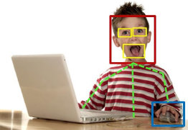
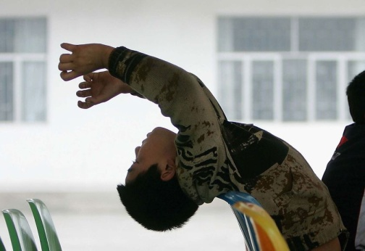
ADHD: Attention deficit hyperactivity disorder
Inattention
Hyperactivity
Impulsivity

Slide 3
Outline
Introduction
Methodology
Results
Conclusion

Slide 4
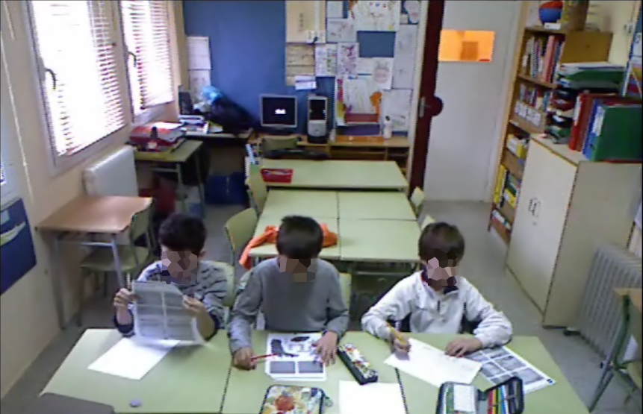
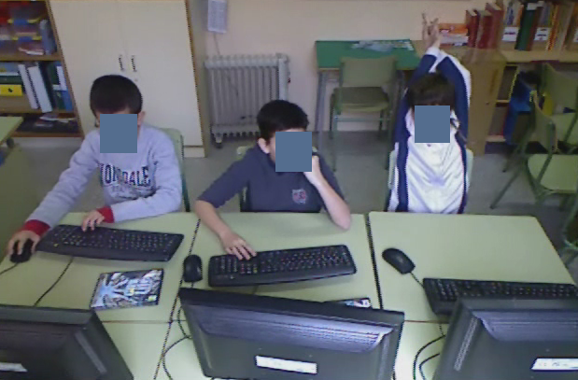
Introduction
Video-based behavior analysis for ADHD diagnosis in children between 8-11 years.

Slide 5
Introduction
Behavior analysis → Human pose information along time
Inattention
Head
Body
Hands
time
Gestures
Hyperactivity
Impulsivity
2. Feature extraction: Human Pose
1. Data acquisition
3. Gesture detection

Slide 6
Outline
Introduction
Methodology
  Data acquisition
  Feature extraction
  Gesture detection
Results
Conclusion

Slide 7
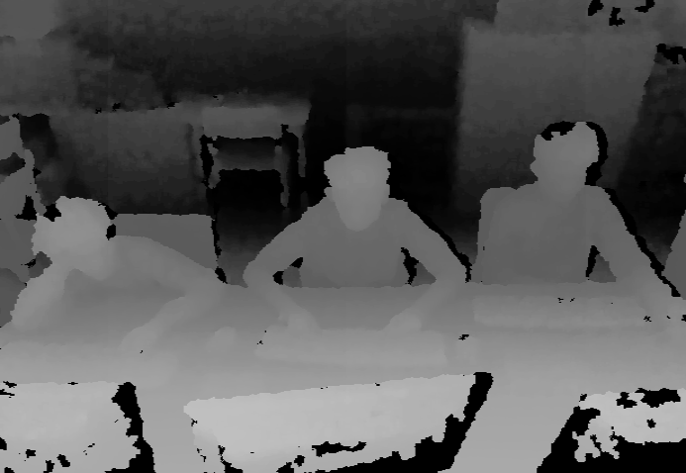
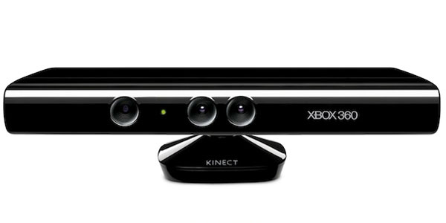
Data aqcuisition
Microsoft’s Kinect
RGB + Depth
Invariant to color, texture and lighting conditions
Human pose directly obtained

Slide 8
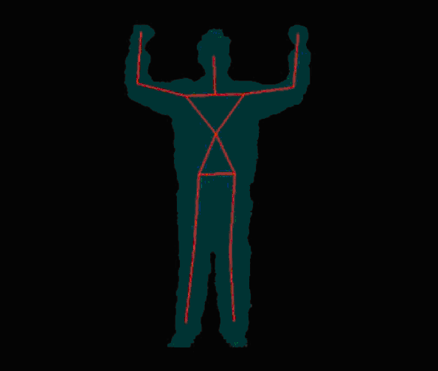
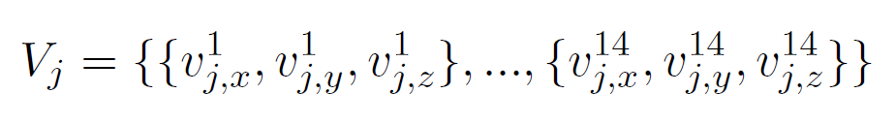
Feature extraction: Human Pose
RGB + Depth
Body skeleton
42-dimensional vector: 14 joints × 3 spatial dimensions

Slide 9
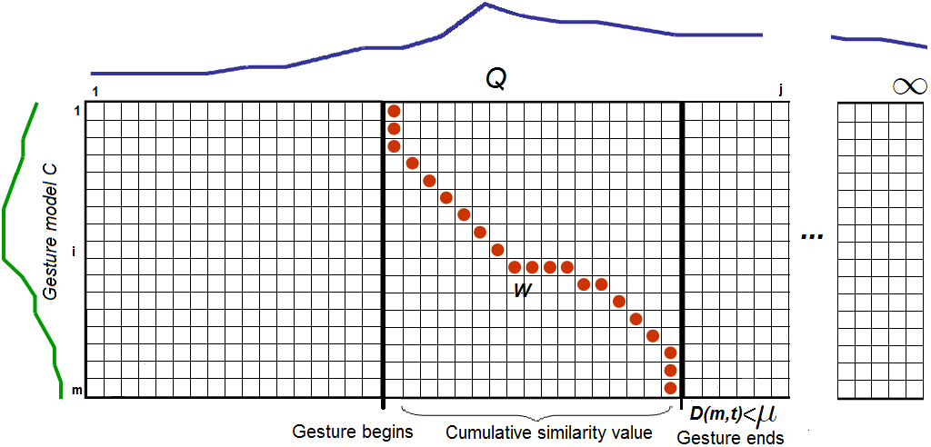
Gesture detection
Dynamic Time Warping (DTW)

Slide 10
Threshold computing
G1
G1₁
G1₂
G2
G2₁
…
…
G1₃
G2₂
…
G2₃
Gn₃
Gn
Gn₂
Gn₁
G1₁
Different
samples
Leave-one-out similarity measure between different samples and gestures
Different gestures

Slide 11
Outline
Introduction
Methodology
Results
Conclusion

Slide 12
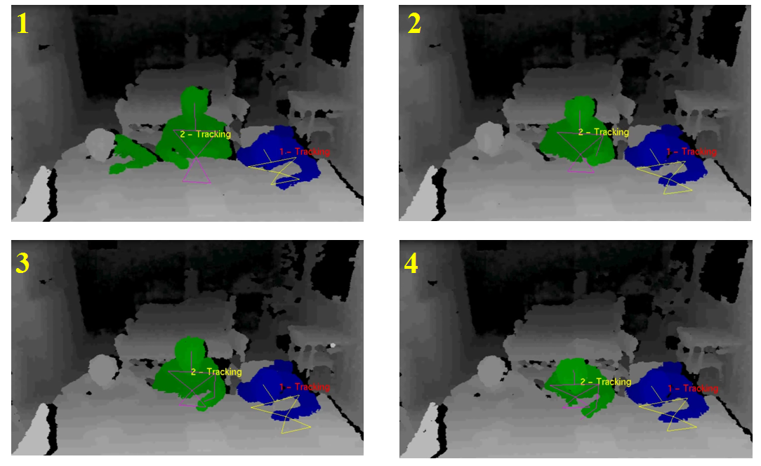
Results

Slide 13
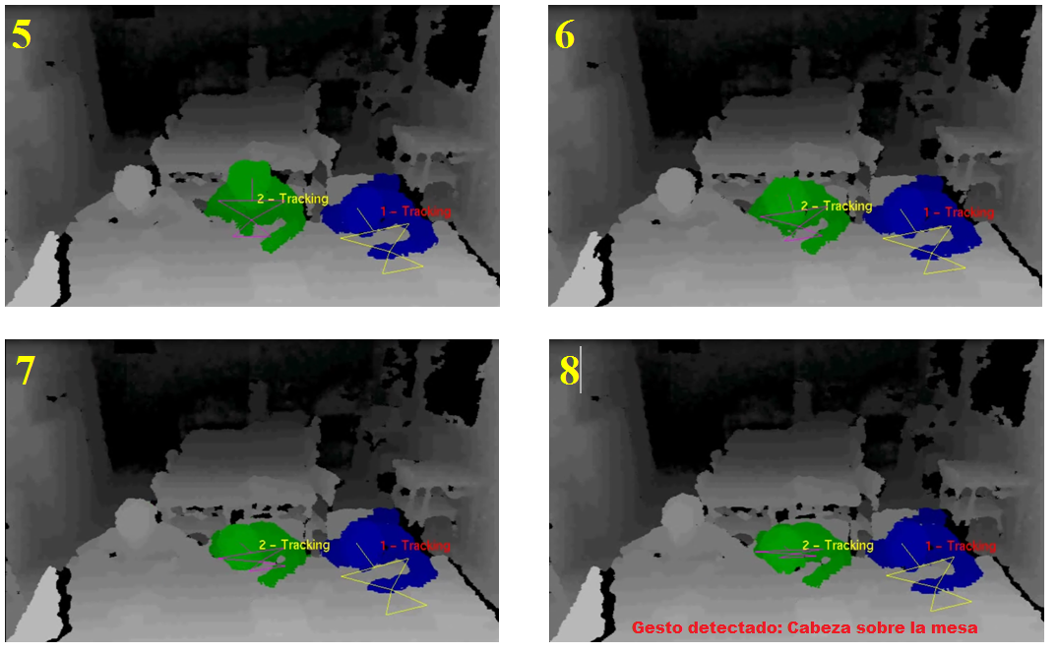
Results

Slide 14
Outline
Introduction
Methodology
Results
Conclusion

Slide 15
Outline
Introduction
Methodology
Results
Conclusion

Slide 16
Conclusion
Methodology for gesture segmentation and recognition at the same time.
First results indicate the objectives are feasible.
Future work:
Automatic callibration
Feature weighting (body joints)

Slide 17
ADHD indicators modelling based on Dynamic Time Warping from RGB data: A feasibility study
Thank You!
Antonio Hernández-Vela, Miguel Reyes, Laura Igual, Josep Moya, Verónica Violant, and Sergio Escalera
Questions?

